Slide 1
The Gospel of Matthew Series 马太福音系列

Slide 2
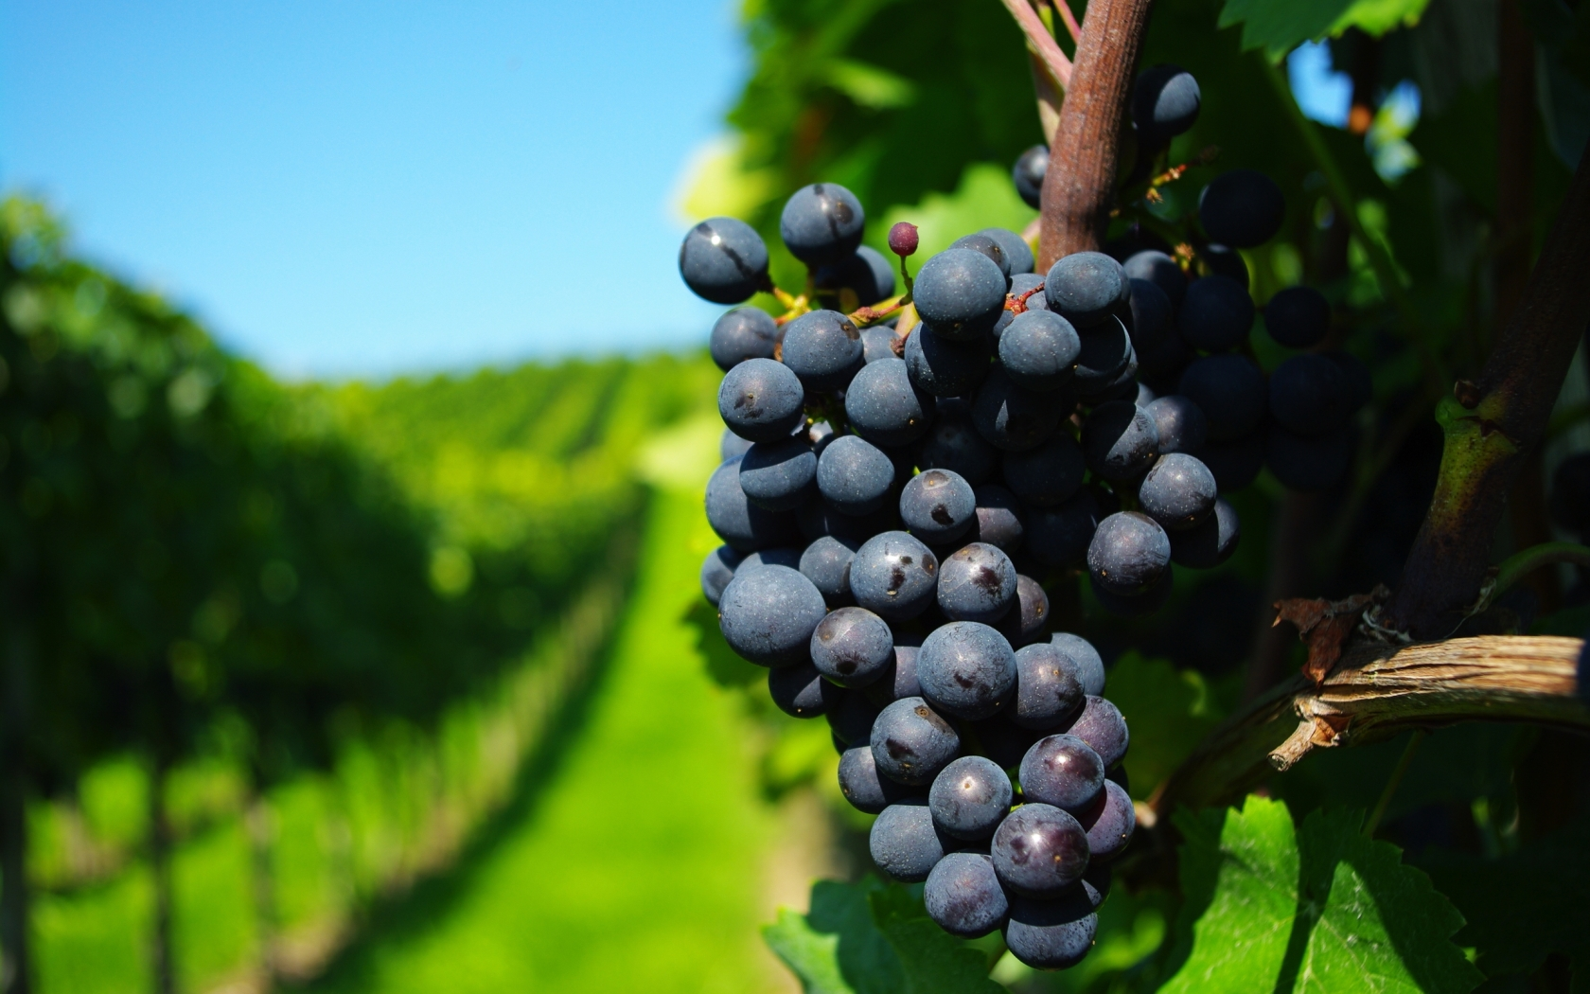
第一部分：
Part I：

Slide 3
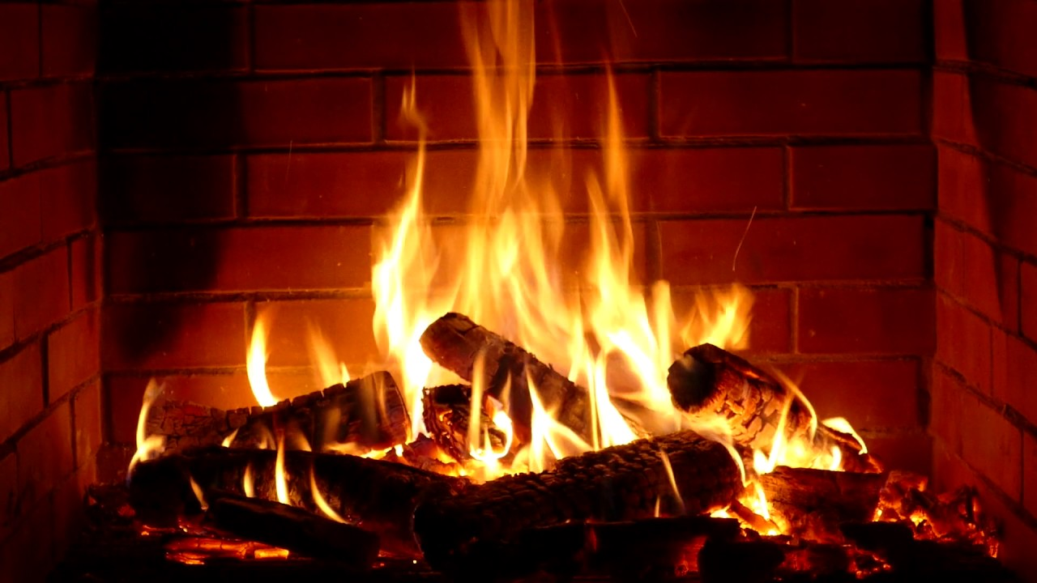
第二部分：
Part II：

Slide 4
马太福音 Matthew 3:7-10
⁷约翰看见许多法利赛人和撒都该人也来受洗，就对他们说：毒蛇的种类！谁指示你们逃避将来的忿怒呢？ ⁸你们要结出果子来，与悔改的心相称
⁷But when he saw many of the Pharisees and Sadducees coming to his baptism, he said to them, "You offspring of vipers! Who warned you to flee from the wrath to come? ⁸Bear fruit in keeping with repentance.

Slide 5
马太福音 Matthew 3:7-10
⁹ 不要自己心里说：有亚伯拉罕为我们的祖宗。我告诉你们，神能从这些石头中给亚伯拉罕兴起子孙来。 ¹⁰ 现在斧子已经放在树根上，凡不结好果子的树就砍下来，丢在火里。
⁹And do not presume to say to yourselves, 'We have Abraham as our father,' for I tell you, God is able from these stones to raise up children for Abraham. ¹⁰Even now the axe is laid to the root of the trees. Every tree therefore that does not bear good fruit is cut down and thrown into the fire.

Slide 6
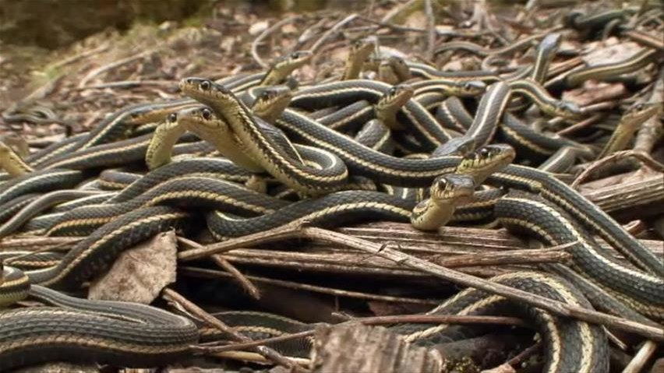
毒蛇的后裔
Offspring of vipers

Slide 7
马太福音 Matthew 3:7-10
⁷约翰看见许多法利赛人和撒都该人也来受洗，就对他们说：毒蛇的后裔！谁指示你们逃避将来的忿怒呢？ ⁸你们要结出果子来，与悔改的心相称
⁷But when he saw many of the Pharisees and Sadducees coming to his baptism, he said to them, "You offspring of vipers! Who warned you to flee from the wrath to come? ⁸Bear fruit in keeping with repentance.

Slide 8
马太福音 Matthew 3:7-10
⁹ 不要自己心里说：有亚伯拉罕为我们的祖宗。我告诉你们，神能从这些石头中给亚伯拉罕兴起子孙来。 ¹⁰ 现在斧子已经放在树根上，凡不结好果子的树就砍下来，丢在火里。
⁹And do not presume to say to yourselves, 'We have Abraham as our father,' for I tell you, God is able from these stones to raise up children for Abraham. ¹⁰Even now the axe is laid to the root of the trees. Every tree therefore that does not bear good fruit is cut down and thrown into the fire.

Slide 9
马太福音 Matthew 3:7-10
⁷约翰看见许多法利赛人和撒都该人也来受洗，就对他们说：毒蛇的后裔！谁指示你们逃避将来的忿怒呢？ ⁸你们要结出果子来，与悔改的心相称
⁷But when he saw many of the Pharisees and Sadducees coming to his baptism, he said to them, "You offspring of vipers! Who warned you to flee from the wrath to come? ⁸Bear fruit in keeping with repentance.

Slide 10
真悔改/True Repentance
1 谦卑【愿意放下自己】
2 爱真理的心
3 与悔改相称的果子【生命会产生相对应的行动与改变】
Humbleness (laying down one’s self)
Love for the truth/what is true
Bear Fruit in keeping with repentance [Corresponding actions and changes seen in one’s life]

Slide 11
马太福音 Matthew 3:11-12
¹¹ 我是用水给你们施洗，叫你们悔改。但那在我以后来的，能力比我更大，我就是给他提鞋也不配。他要用圣灵与火给你们施洗。 ¹² 他手里拿着簸箕，要扬净他的场，把麦子收在仓里，把糠用不灭的火烧尽了。
¹¹I baptize you with water for repentance, but he who is coming after me is mightier than I, whose sandals I am not worthy to carry. He will baptize you with the Holy Spirit and fire. ¹² His winnowing fork is in his hand, and he will clear his threshing floor and gather his wheat into the barn, but the chaff he will burn with unquenchable fire."

Slide 12
使徒行传 Acts 2:38-40
³⁸彼得说：你们各人要悔改，奉耶稣基督的名受洗，叫你们的罪得赦，就必领受所赐的圣灵； ³⁹ 因为这应许是给你们和你们的儿女，并一切在远方的人，就是主―我们神所召来的。⁴⁰ …劝勉他们说：你们当救自己脱离这弯曲的世代。
³⁸ And Peter said to them, "Repent and be baptized every one of you in the name of Jesus Christ for the forgiveness of your sins, and you will receive the gift of the Holy Spirit. ³⁹ For the promise is for you and for your children and for all who are far off, everyone whom the Lord our God calls to himself." ⁴⁰ …Save yourselves from this crooked generation."

Slide 13
使徒行传 Acts 10:42-43
⁴² 他(基督)吩咐我们传道给众人，证明他是神所立定的，要作审判活人死人的主。⁴³众先知也为他作见证，说，凡信他的人，必因他的名，得蒙赦罪。
⁴² And he (Christ) ordered us to preach to the people, and solemnly to testify that this is the one who has been appointed by God as Judge of the living and the dead.
⁴³ Of him all the prophets bear witness that through his name everyone who believes in him receives forgiveness of sins.''

Slide 14
马太福音 Matthew 3:11-12
¹¹ 我是用水给你们施洗，叫你们悔改。但那在我以后来的，能力比我更大，我就是给他提鞋也不配。他要用圣灵与火给你们施洗。 ¹² 他手里拿着簸箕，要扬净他的场，把麦子收在仓里，把糠用不灭的火烧尽了。
¹¹I baptize you with water for repentance, but he who is coming after me is mightier than I, whose sandals I am not worthy to carry. He will baptize you with the Holy Spirit and fire. ¹² His winnowing fork is in his hand, and he will clear his threshing floor and gather his wheat into the barn, but the chaff he will burn with unquenchable fire."

Slide 15
出埃及记 Exodus 13:21-22
²¹日间，雅伟在云柱中领他们的路，夜间，在火柱中光照他们，使他们日夜都可以行走。22 日间云柱，夜间火柱，总不离开百姓的面前。
²¹ And Yahweh went before them by day in a pillar of cloud to lead them along the way, and by night in a pillar of fire to give them light, that they might travel by day and by night. ²² The pillar of cloud by day and the pillar of fire by night did not depart from before the people.

Slide 16
使徒行传 Acts 2:3-4
³又有舌头如火焰显现出来，分开落在他们各人头上。⁴他们就都被圣灵充满
³ And divided tongues as of fire appeared to them and rested on each one of them. ⁴ And they were all filled with the Holy Spirit

Slide 17
真悔改/True Repentance
1 谦卑【愿意放下自己】
2 爱真理的心
3 与悔改相称的果子【生命会产生相对应的行动与改变】
Humbleness (laying down one’s self)
Love for the truth/for what is true
Bear Fruit in keeping with repentance [Corresponding actions and changes seen in one’s life]

