Slide 1
Mathew 马太福音 5:9
Blessed are the peacemakers, for they shall be called sons of God.
使人和睦的人有福了！因为他们必称为神的儿子。

Slide 2
Mathew马太福音 5:43-45
“You have heard that it was said, ‘You shall love your neighbor and hate your enemy.’ But I say to you, Love your enemies and pray for those who persecute you, so that you may be sons of your Father who is in heaven.
你们听见有话说：当爱你的邻舍，恨你的仇敌。 只是我告诉你们，要爱你们的仇敌，为那逼迫你们的祷告。 这样就可以作你们天父的儿子。
But WHY?
为啥？

Slide 3
马太福音 Mathew 5:43-45
“You have heard that it was said, ‘You shall love your neighbor and hate your enemy.’ But I say to you, Love your enemies and pray for those who persecute you, so that you may be sons of your Father who is in heaven.
你们听见有话说：当爱你的邻舍，恨你的仇敌。
只是我告诉你们，要爱你们的仇敌，为那逼迫你们的祷告。 这样就可以作你们天父的儿子。
How can this be possible?
这怎么可能呢？

Slide 4
Video 1

Slide 6
Why are you killing us? We came to be your friends….your sincere friends
你们为什么要杀我们呢？ 我们之所以来，是要做你们的朋友….真诚的朋友
(Pete Fleming)

Slide 10
Romans 罗马书 5:6-8
For while we were still helpless, at the right time Christ died for the ungodly.
当我们还软弱的时候，基督就照所定的日期，为不敬虔的人死了。
Now it is rare when someone gives up his life even for the sake of somebody righteous, although possibly for a truly good person one might have the courage to die.
为义人死，是少有的；为好人死，或有敢作的；

Slide 11
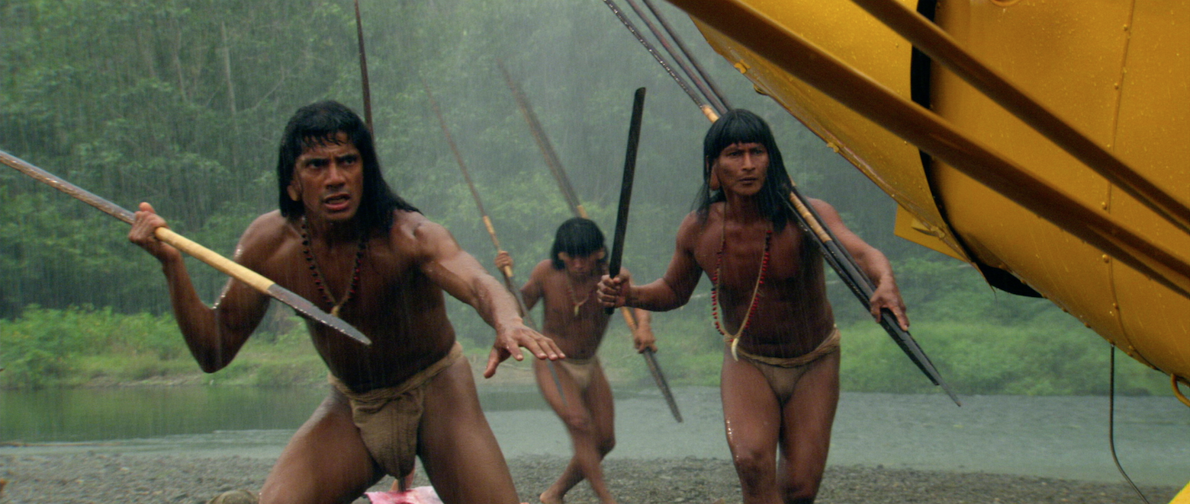
Romans 罗马书 5:8
but God shows his love for us in that while we were still sinners, Christ died for us.
唯有基督在我们还作罪人的时候为我们死，神对我们的爱就在此显明了。

Slide 12
1 Peter 彼得前书 2:21-24
For to this you have been called, because Christ also suffered for you, leaving you an example, so that you might follow in his steps.
你們蒙召原是為此，因基督也為你們受過苦，給你們留下榜樣，叫你們跟隨他的腳蹤行。

Slide 13
“He committed no sin, and no deceit was found in his mouth.” When he was reviled, he did not revile in return; when he suffered, he did not threaten, but continued entrusting himself to Him who judges justly.
他並沒有犯罪，口裡也沒有詭詐； 他被罵不還口，受害不說威嚇的話，只將自己交託那按公義審判人的主；

Slide 14
He himself bore our sins in his body on the tree, that we might die to sin and live to righteousness. By his wounds you have been healed.
他被掛在木頭上，親身擔當了我們的罪，使我們既然 在罪上死，就得以在義上活。因他受的鞭傷，你們便得了醫治。

Slide 15
1 Peter 彼得前书 2:21-24 （Alternative Translation 其他译本）
Christ, himself, carried our sins away in his body on the tree, in order that we, having nothing more to do with sins, might live subjected to righteousness…. 【MIT】
他在木頭上親身擔當了我們的罪，使我們既然不活在罪中，就可以為義而活… 【新译本】

Slide 17
马太福音 Mathew 5:43-45
“You have heard that it was said, ‘You shall love your neighbor and hate your enemy.’ But I say to you, Love your enemies and pray for those who persecute you, so that you may be sons of your Father who is in heaven.
你们听见有话说：当爱你的邻舍，恨你的仇敌。
只是我告诉你们，要爱你们的仇敌，为那逼迫你们的祷告。
这样就可以作你们天父的儿子。
Is that possible?
这可能吗？

Slide 18
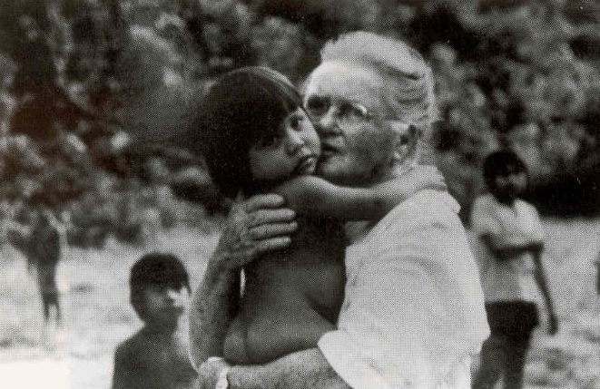
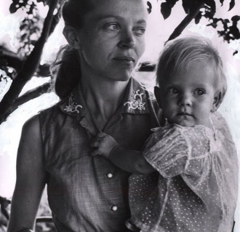
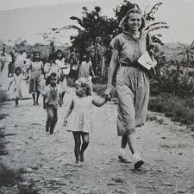
Aunt Rachel, sister of Nate Saint
Elizabeth Elliot & daughter

Slide 19
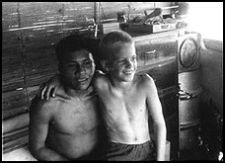
Steve, son of Nate Saint
(Aged 8-9)
Steve Saint was not quite 5 when his father and four other Christian missionaries
were speared to death by Auca Indians.

Slide 20
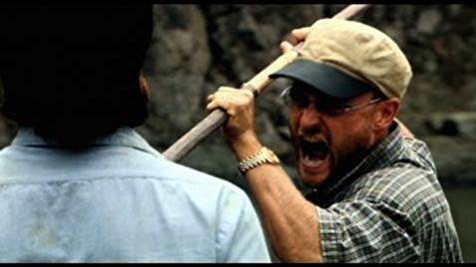
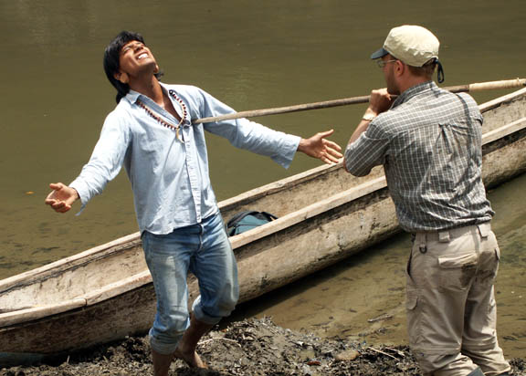

Slide 21
Romans 罗马书 12:19
Beloved, never avenge yourselves, but leave it to the wrath of God, for it is written, "Vengeance is mine, I will repay, says the Lord."
亲爱的啊，不要为自己伸冤，宁可等候主的忿怒，因为经上记着，主说："伸冤在我，我必报应。"

Slide 22
Romans 罗马书 12:20
On the contrary, "If your enemy is hungry, feed him; if he is thirsty, give him something to drink. For by doing this, you will heap fiery coals [of shame] on his head."
相反地，"如果你的仇敌饿了，就给他吃；如果渴了，就给他喝。因为你这样作，就是把炭火堆在他的头上。"

Slide 23
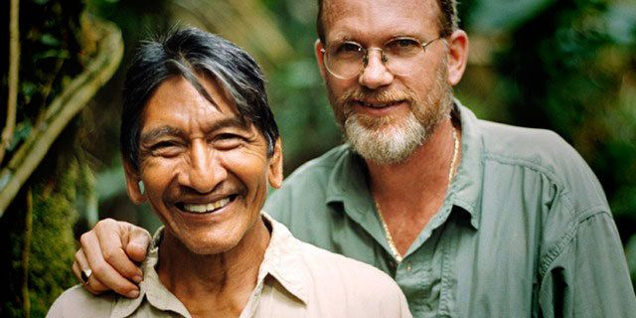

Slide 26
Mathew 马太福音 6:12
And forgive us our debts, as we also have forgiven our debtors.
免我们的债，如同我们免了人的债 。

Slide 27
Mathew 马太福音 6:12 （Alternative Translation 其他译本）
Forgive us what we have done wrong, as we too have forgiven those who have wronged us. 【CJB】
赦免我们的罪， 好像我们饶恕了得罪我们的人 。 【新译本】

Slide 28
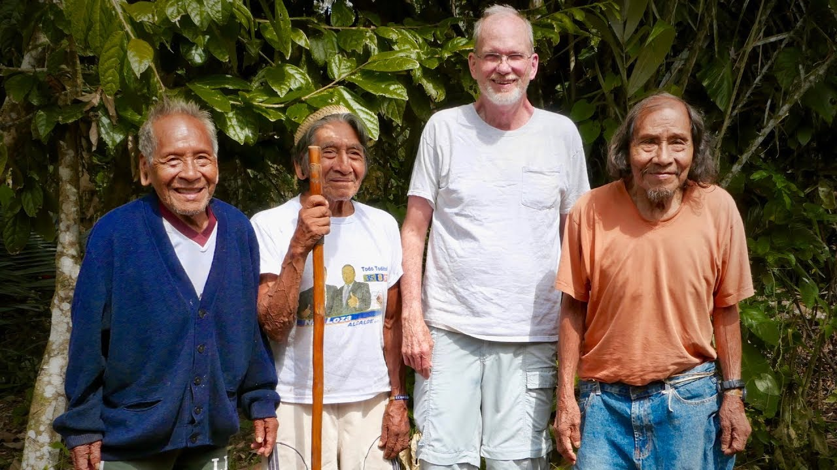

Slide 29
2 Cor 哥林多后书 5:17
Therefore, if anyone is in Christ, he is a new creation- the old has passed; look, what has come is fresh and new!
若有人在基督里，他就是新造的人。旧事已经过去，
你看，都变成新的了！

Slide 30
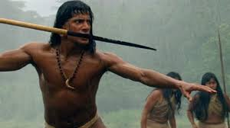
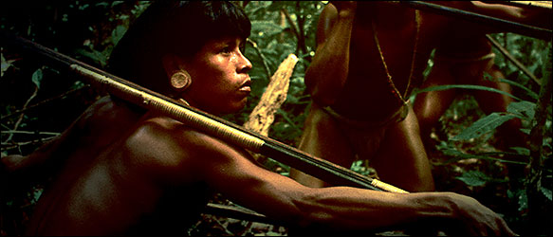
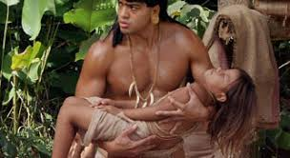

Slide 31
Steve Saint
Mincaye,
the man who
killed Steve’s Dad

Slide 33
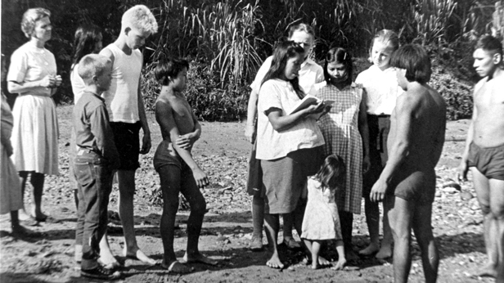

Slide 34
2 Cor 哥林多后书 5:18-20
All this is from God, who through Christ reconciled us to himself and gave us the ministry of reconciliation;
一切都是出于神，他借着基督使我们与他和好，又将劝人与他和好的职分赐给我们

Slide 35
2 Cor 哥林多后书 5:19
that is, in Christ God was reconciling the world to Himself, not counting their trespasses against them, and entrusting to us the message of reconciliation.
就是神在基督里使世人与他自己和好，不再追究他们的过犯，并且把和好的道理托付了我们。

Slide 36
2 Cor 哥林多后书 5:20
Therefore, we are ambassadors for Christ, God making his appeal through us. We implore you on behalf of Christ, be reconciled to God.
因此，我们就是基督的使者，神借着我们劝告世人。我们代替基督请求你们：跟神和好吧！

Slide 38
Isaiah 以赛亚书 52:7
那报佳音，传平安，报好信，传救恩的…这人的脚踪何等佳美。
How beautiful on the mountains are the feet of those who bring good news, who proclaim peace, who bring good tidings, who proclaim salvation…

