Slide 1
2019.07.21

Slide 2
The Gospel of Matthew Series 马太福音系列

Slide 3
If your eye is sound, your whole body will be full of light 眼睛若健全 全身就明亮 （马太福音 Matthew 6:22-23）

Slide 4
Matthew 6:22
The eye is the lamp of the body. So, if your eye is sound, your whole body will be full of light;
眼睛就是身体的灯。如果你的眼睛健全，全身就都明亮；

Slide 5
Matthew 6:23
but if your eye is not sound, your whole body will be full of darkness. If then the light in you is darkness, how great is the darkness!
如果你的眼睛有毛病，全身就都黑暗。如果你里面的光变成黑暗，这是多么的黑暗！

Slide 6
健全 ἁπλοῦς
Single
专一

Slide 7
健全 ἁπλοῦς
Single
Simple
专一
单纯

Slide 8
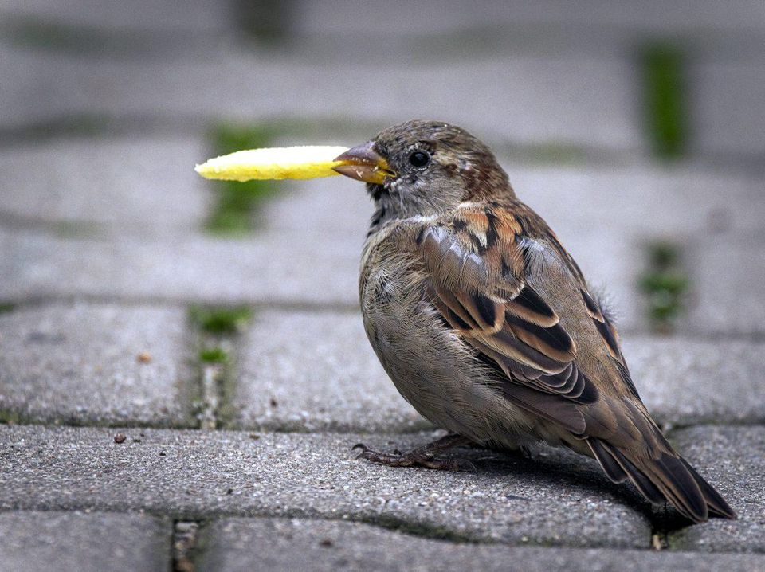

Slide 10
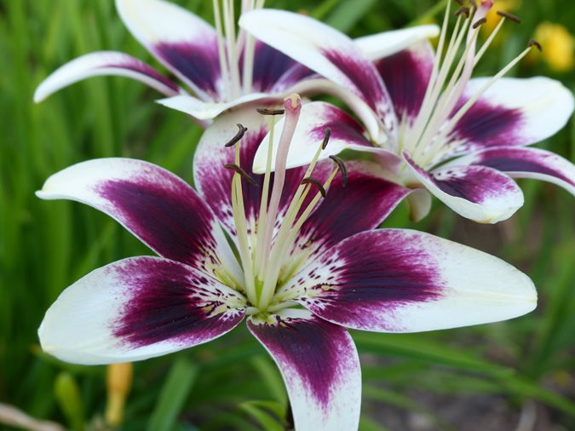

Slide 11
马太福音 Mat 6:31-32
Therefore do not be anxious, saying, `What shall we eat?' or `What shall we drink?' or `What shall we wear?’ For the Gentiles seek all these things; and your heavenly Father knows that you need them all.
所以不要忧虑，说：'我们该吃什么？喝什么？穿什么？’ 这些都是教外人所寻求的，你们的天父原知道你们需要这一切。

Slide 12
马太福音 Mat 6:33-34
But seek first his kingdom and his righteousness, and all these things shall be yours as well. "Therefore do not be anxious about tomorrow, for tomorrow will be anxious for itself. Let the day's own trouble be sufficient for the day.
你们要先求他的国和他的义，这一切都必加给你们。所以不要为明天忧虑，因为明天自有明天的忧虑，一天的难处一天当就够了。"

Slide 13
马太福音 Matthew 18:3-4
and said, "Truly, I say to you, unless you turn and become like children, you will never enter the kingdom of heaven. Whoever humbles himself like this child, he is the greatest in the kingdom of heaven.
“我实在告诉你们，如果你们不回转，变成像小孩子一样，一定不能进天国。所以，凡谦卑像这小孩子的，他在天国里是最大的。”

Slide 14
Matthew 5:8
Blessed are the pure in heart, for they shall see God.
清心的人有福了，因为他们必得见神。

Slide 15
完

