Slide 1
The Gospel of Matthew Series 马太福音系列

Slide 2
马太福音 Matthew 7:24-27
²⁴ 所以，凡听见我这话就去行的，好比一个聪明人，把房子盖在磐石上； ²⁵ 雨淋，水沖，风吹，撞着那房子，房子总不倒塌，因为根基立在磐石上。
²⁴ Everyone then who hears these words of mine and does them will be like a wise man who built his house on the rock. ²⁵ And the rain fell, and the floods came, and the winds blew and beat on that house, but it did not fall, because it had been founded on the rock.

Slide 3
马太福音 Matthew 7:24-27
²⁶ 凡听见我这话不去行的，好比一个无知的人，把房子盖在沙土上； ²⁷ 雨淋，水沖，风吹，撞着那房子，房子就倒塌了，并且倒塌得很大。
²⁶ And everyone who hears these words of mine and does not do them will be like a foolish man who built his house on the sand. ²⁷ And the rain fell, and the floods came, and the winds blew and beat against that house, and it fell, and great was the fall of it.”

Slide 5
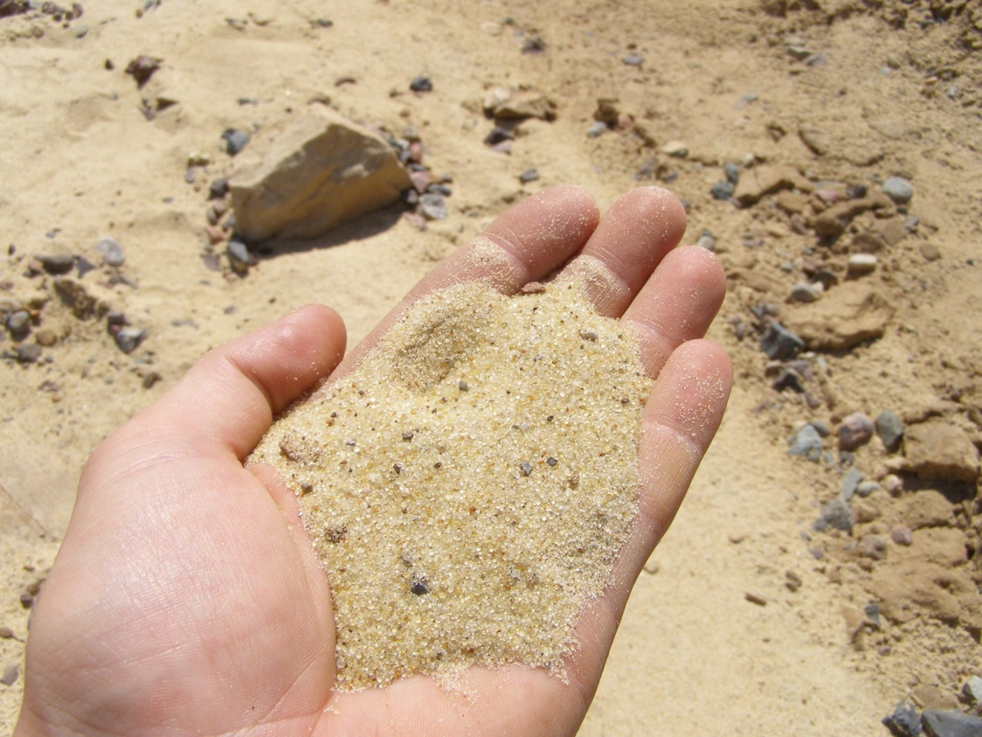
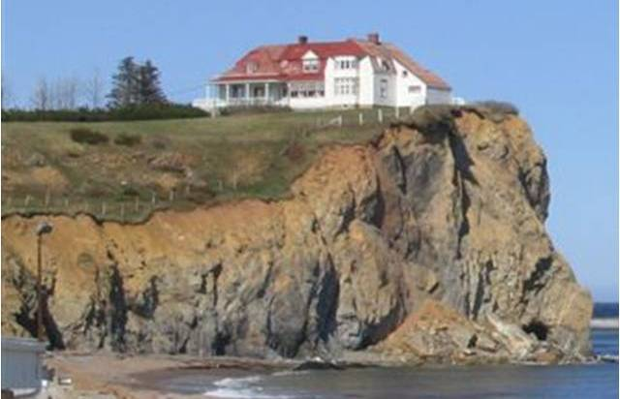
vs

Slide 7
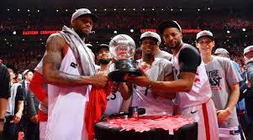

Slide 8
路加福音 Luke 16:10
人在最小的事上忠心，在大事上也忠心；在最小的事上不义，在大事上也不义。
“One who is faithful in a very little is also faithful in much, and one who is dishonest in a very little is also dishonest in much.

Slide 9
马太福音 Matthew 7:6
不要把圣物给狗，也不要把你们的珍珠丢在猪前，恐怕他践踏了珍珠，转过来咬你们。
Do not give dogs what is holy, and do not throw your pearls before pigs, lest they trample them underfoot and turn to attack you.

Slide 10
路加福音 Luke 18:35-43
耶稣将近耶利哥的时候，有一个瞎子坐在路旁讨饭。 ³⁶ 听见许多人经过，就问是甚么事。 ³⁷ 他们告诉他，是拿撒勒人耶稣经过。 ³⁸ 他就呼叫说：大卫的子孙耶稣阿，可怜我罢！ ³⁹ 在前头走的人就责备他，不许他作声；他却越发喊叫说：大卫的子孙，可怜我罢！
As he drew near to Jericho, a blind man was sitting by the roadside begging. ³⁶ And hearing a crowd going by, he inquired what this meant. ³⁷ They told him, “Jesus of Nazareth is passing by.” ³⁸ And he cried out, “Jesus, Son of David, have mercy on me!” ³⁹ And those who were in front rebuked him, telling him to be silent. But he cried out all the more, “Son of David, have mercy on me!”

Slide 11
路加福音 Luke 18:35-43
⁴⁰ 耶稣站住，吩咐把他领过来，到了跟前，就问他说： ⁴¹ 你要我为你做甚么？他说：主阿，我要能看见。⁴² 耶稣说：你可以看见！你的信救了你了。 ⁴³ 瞎子立刻看见了，就跟随耶稣，一路归荣耀与神。
⁴⁰ And Jesus stopped and commanded him to be brought to him. And when he came near, he asked him, ⁴¹ “What do you want me to do for you?” He said, “Lord, let me recover my sight.” ⁴² And Jesus said to him, “Recover your sight; your faith has made you well.” ⁴³ And immediately he recovered his sight and followed him, glorifying God.

Slide 12
诗篇 Psalm 36:9
在你那里有生命的源头；在你的光中，我们必得见光。
For with you is the fountain of life; in your light do we see light.

Slide 13
箴言 Proverbs 3:5-6
你要专心仰赖雅伟，不可倚靠自己的聪明， ⁶在你一切所行的事上都要认定他，他必指引你的路。
Trust in the Yahweh with all your heart, and do not lean on your own understanding. ⁶In all your ways acknowledge him, and he will make straight your paths.

