Slide 1
2017.12.03

Slide 2
The Gospel of Matthew Series 马太福音系列

Slide 3
The Temptation of Jesus (Part 2) 耶稣的试探（二）

Slide 4
Temptation of Jesus, Part II
耶稣的试探 (二)

Slide 5
Matthew 马太福音 4:5-7
⁵ Then the devil took him to the holy city and set him on the pinnacle of the temple ⁶ and said to him, "If you are the Son of God, throw yourself down, for it is written, "'He will command His angels concerning you,' and "'On their hands they will bear you up, lest you strike your foot against a stone.'" ⁷ Jesus said to him, "Again it is written, 'You shall not put the Lord your God to the test.'“
⁵ 魔鬼就带他进了圣城，叫他站在殿顶上， ⁶ 对他说：你若是神的儿子，可以跳下去，因为经上记着说：主要为你吩咐他的使者用手托着你，免得你的脚碰在石头上。⁷ 耶稣对他说：经上又记着说：不可试探主―你的神。

Slide 6
Deuteronomy 申命记 8:3
³ …man does not live by bread alone, but man lives by every word that comes from the mouth of Yahweh.
³ …人活着不是单靠食物，乃是靠雅伟口里所出的一切话。

Slide 7
Psalms 诗篇 91:11-12
¹¹ For he will command his angels concerning you to guard you in all your ways. ¹² On their hands they will bear you up, lest you strike your foot against a stone.
¹¹ 因他要为你吩咐他的使者，在你行的一切道路上保护。 ¹² 他们要用手托着你，免得你的脚碰在石头上。

Slide 8
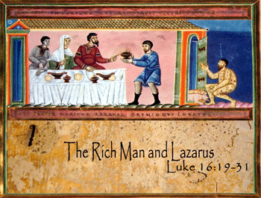
财主与拉撒路

Slide 9
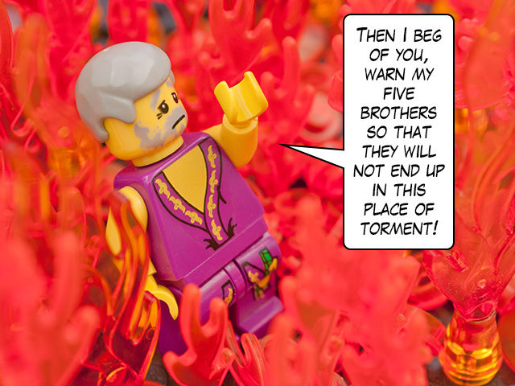
27 财主就说：那么我祖啊，求你派拉 撒路去我父亲的家，28 因为我有五 个兄弟，请他警告他们，免得他们 也来到这痛苦的地方。
路加福音 Luke 16
27 “He answered, ‘Then I beg you, father, send Lazarus to my family, 28 for I have five brothers. Let him warn them, so that they will not also come to this place of torment.’

Slide 10
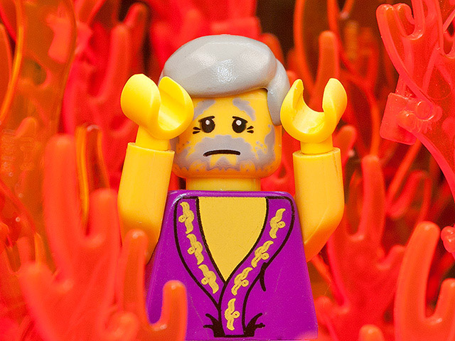
30 财主却说：不，我祖亚伯拉罕哪！ 如果有人从死人中间回到他们那里 ， 他们定必悔改了。
30 “‘No, father Abraham,’ he said, ‘but if someone from the dead goes to them, they will repent.’

Slide 11
31 可是亚伯拉罕对他说：如果他们连 摩西和先知都不听，就算有人死而 复活，他们也不会被说服的。
31 “He said to him, ‘If they do not listen to Moses and the Prophets, they will not be convinced even if someone rises from the dead.’”

Slide 12
Matthew 4:7 Jesus said to him, "Again it is written, 'You shall not put the Lord your God to the test.'“
Deuteronomy 6:16 You shall not put Yahweh your God to the test, as you tested Him at Massah.
马太福音 4:7 耶稣对他说: 经上又记着说: 不可试探主你的神。
申命记 6:16 你们不可试探雅伟你们的神, 象你们在玛撒那样试探他。

Slide 13
Problem with modern day Christianity:
Partial truth - quoting and teaching Scripture out of context
现今基督教的问题
部分真理 – 断章取义的引用和教导圣经

Slide 14
Acts 使徒行传 17:11
Now these Jews were more noble than those in Thessalonica; they received the word with all eagerness, examining the Scriptures daily to see if these things were so.
这地方的人贤于帖撒罗尼迦的人，甘心领受这道，天天考查圣经，要晓得这道是与不是。

Slide 15
Luke 路加福音 11:9
“And I tell you, ask, and it will be given to you; seek, and you will find; knock, and it will be opened to you.”
我又告诉你们，你们祈求，就给你们；寻找，就寻见；叩门，就给你们开门。

Slide 16
Romans 罗马书 8:28
And we know that for those who love God all things work together for good, for those who are called according to his purpose.
我们晓得万事都互相效力，叫爱神的人得益处，就是按他旨意被召的人。

Slide 17
The End 完

