Slide 1
2017.12.17

Slide 2
The Gospel of Matthew Series 马太福音系列

Slide 3
耶稣开始传福音 The Beginning of Jesus’ Ministry

Slide 4
马太福音 Matthew 4:12-17
耶稣听见约翰下了监，就退到加利利去； ¹³ 后又离开拿撒勒，往迦百农去，就住在那里。那地方靠海，在西布伦和拿弗他利的边界上。 ¹⁴ 这是要应验先知以赛亚的话，
Now when he heard that John had been arrested, he withdrew into Galilee. ¹³ And leaving Nazareth he went and lived in Capernaum by the sea, in the territory of Zebulun and Naphtali, ¹⁴ so that what was spoken by the prophet Isaiah might be fulfilled:

Slide 5
马太福音 Matthew 4:12-17
¹⁵ 说：西布伦地，拿弗他利地，就是沿海的路，约但河外，外邦人的加利利地。 ¹⁶ 那坐在黑暗里的百姓看见了大光；坐在死荫之地的人有光发现照着他们。¹⁷ 从那时候，耶稣就传起道来，说：天国近了，你们应当悔改！
¹⁵ "The land of Zebulun and the land of Naphtali, the way of the sea, beyond the Jordan, Galilee of the Gentiles-- ¹⁶ the people dwelling in darkness have seen a great light, and for those dwelling in the region and shadow of death, on them a light has dawned." ¹⁷ From that time Jesus began to preach, saying, "Repent, for the kingdom of heaven is at hand."

Slide 6
马太福音 Matthew 4:12-13
耶稣听见约翰下了监，就退到加利利去； ¹³ 后又离开拿撒勒，往迦百农去，就住在那里。那地方靠海，在西布伦和拿弗他利的边界上
Now when he heard that John had been arrested, he withdrew into Galilee. ¹³ And leaving Nazareth he went and lived in Capernaum by the sea, in the territory of Zebulun and Naphtali.

Slide 7
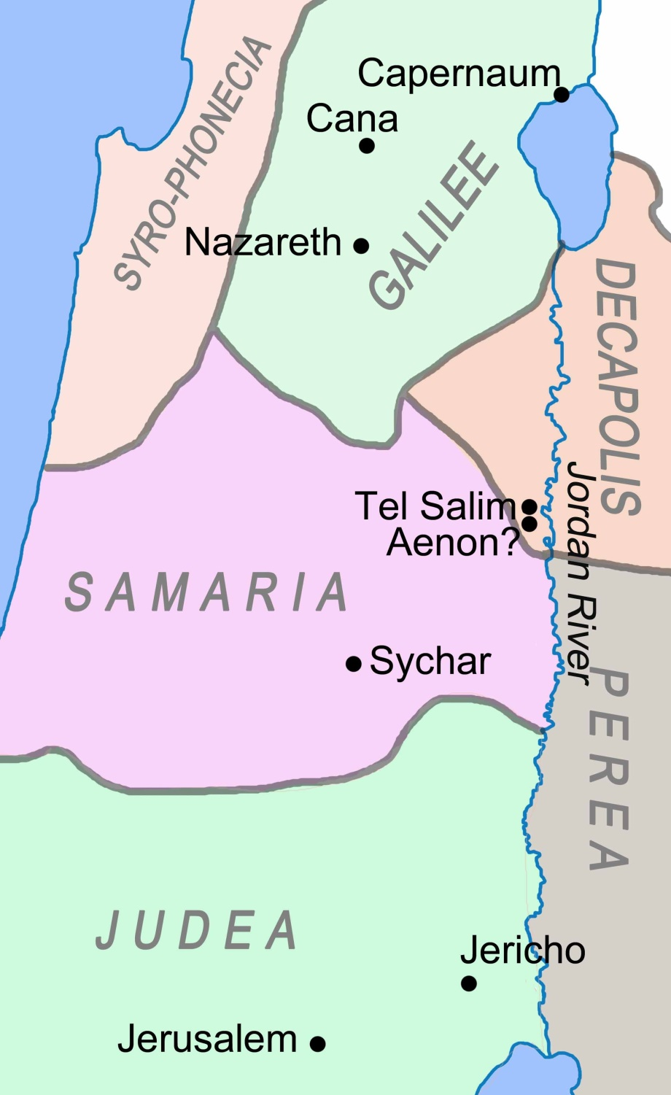
迦百农
拿撒勒
加利利
犹大

Slide 8
马太福音 Matthew 4:12-13
耶稣听见约翰下了监，就退到加利利去； ¹³ 后又离开拿撒勒，往迦百农去，就住在那里。那地方靠海，在西布伦和拿弗他利的边界上
Now when he heard that John had been arrested, he withdrew into Galilee. ¹³ And leaving Nazareth he went and lived in Capernaum by the sea, in the territory of Zebulun and Naphtali.

Slide 9
迦百农
¹³ 后又离开拿撒勒，往迦百农去
¹³ And leaving Nazareth he went and lived in Capernaum
拿撒勒
加利利
耶稣离开拿撒勒
平行经文路加福音 4:16-31
Jesus leaves Nazareth
Parallel verses in Luke 4:16-31
犹大

Slide 10
马太福音 Matthew 4:12-13
耶稣听见约翰下了监，就退到加利利去； ¹³ 后又离开拿撒勒，往迦百农去，就住在那里。那地方靠海，在西布伦和拿弗他利的边界上
Now when he heard that John had been arrested, he withdrew into Galilee. ¹³ And leaving Nazareth he went and lived in Capernaum by the sea, in the territory of Zebulun and Naphtali.

Slide 11
迦百农
马太第四章1-13
耶稣所到的地方：
旷野
犹大
拿撒勒 （加利利）
迦百农 （加利利）
拿撒勒
加利利
Mt 4:1-13
Places that Jesus had been:
Wilderness
Judea
Nazareth (Galilee)
Capernaum (Galilee)
犹大

Slide 12
马太福音 Matthew 4:1
当时，耶稣被圣灵引到旷野，受魔鬼的试探。
Then Jesus was led up by the Spirit into the wilderness to be tempted by the devil.

Slide 13
马太福音 Matthew 4:15-17
这是要应验先知以赛亚的话¹⁵说：西布伦地，拿弗他利地，就是沿海的路，约但河外，外邦人的加利利地。 ¹⁶ 那坐在黑暗里的百姓看见了大光；坐在死荫之地的人有光照亮他们。¹⁷ 从那时候，耶稣就传起道来，说：天国近了，你们应当悔改！
so that what was spoken by the prophet Isaiah might be fulfilled: ¹⁵ "The land of Zebulun and the land of Naphtali, the way of the sea, beyond the Jordan, Galilee of the Gentiles-- ¹⁶ the people dwelling in darkness have seen a great light, and for those dwelling in the region and shadow of death, on them a light has dawned." ¹⁷ From that time Jesus began to preach, saying, "Repent, for the kingdom of heaven is at hand."

Slide 14
以赛亚书 Isaiah 55:66
当趁雅伟可寻找的时候寻找他，相近的时候求告他。
Seek Yahweh while He may be found. Call on Him while he is near.

Slide 15
马太福音 Matthew 4:15-17
这是要应验先知以赛亚的话 ¹⁵说：西布伦地，拿弗他利地，就是沿海的路，约但河外，外邦人的加利利地。 ¹⁶ 那坐在黑暗里的百姓看见了大光；坐在死荫之地的人有光照亮他们。¹⁷ 从那时候，耶稣就传起道来，说：天国近了，你们应当悔改！
so that what was spoken by the prophet Isaiah might be fulfilled: ¹⁵ "The land of Zebulun and the land of Naphtali, the way of the sea, beyond the Jordan, Galilee of the Gentiles-- ¹⁶ the people dwelling in darkness have seen a great light, and for those dwelling in the region and shadow of death, on them a light has dawned." ¹⁷ From that time Jesus began to preach, saying, "Repent, for the kingdom of heaven is at hand."

Slide 16
马太福音 Matthew 4:15-17
这是要应验先知以赛亚的话 ¹⁵说：西布伦地，拿弗他利地，就是沿海的路，约但河外，外邦人的加利利地。 ¹⁶ 那坐在黑暗里的百姓看见了大光；坐在死荫之地的人有光照亮他们。¹⁷ 从那时候，耶稣就传起道来，说：天国近了，你们应当悔改！
so that what was spoken by the prophet Isaiah might be fulfilled: ¹⁵ "The land of Zebulun and the land of Naphtali, the way of the sea, beyond the Jordan, Galilee of the Gentiles-- ¹⁶ the people dwelling in darkness have seen a great light, and for those dwelling in the region and shadow of death, on them a light has dawned." ¹⁷ From that time Jesus began to preach, saying, "Repent, for the kingdom of heaven is at hand."

Slide 17
约翰福音 John 8:12
耶稣又对众人说：“我是世界的光，跟从我的，必定不在黑暗里走，却要得着生命的光。
Again Jesus spoke to them, saying, "I am the light of the world. Whoever follows me will not walk in darkness, but will have the light of life."

Slide 18
完 The End

