Slide 1
2018.01.21

Slide 2
Gospel of Matthew Series 马太福音系列

Slide 3
I and My Children Are Signs and Wonders 我和我的孩子们是预兆和奇迹

Slide 4
Is God doing anything to fix problems in the world? 上帝有做什么去解决世界的问题吗？

Slide 5
Earth care 维护地球

Slide 6
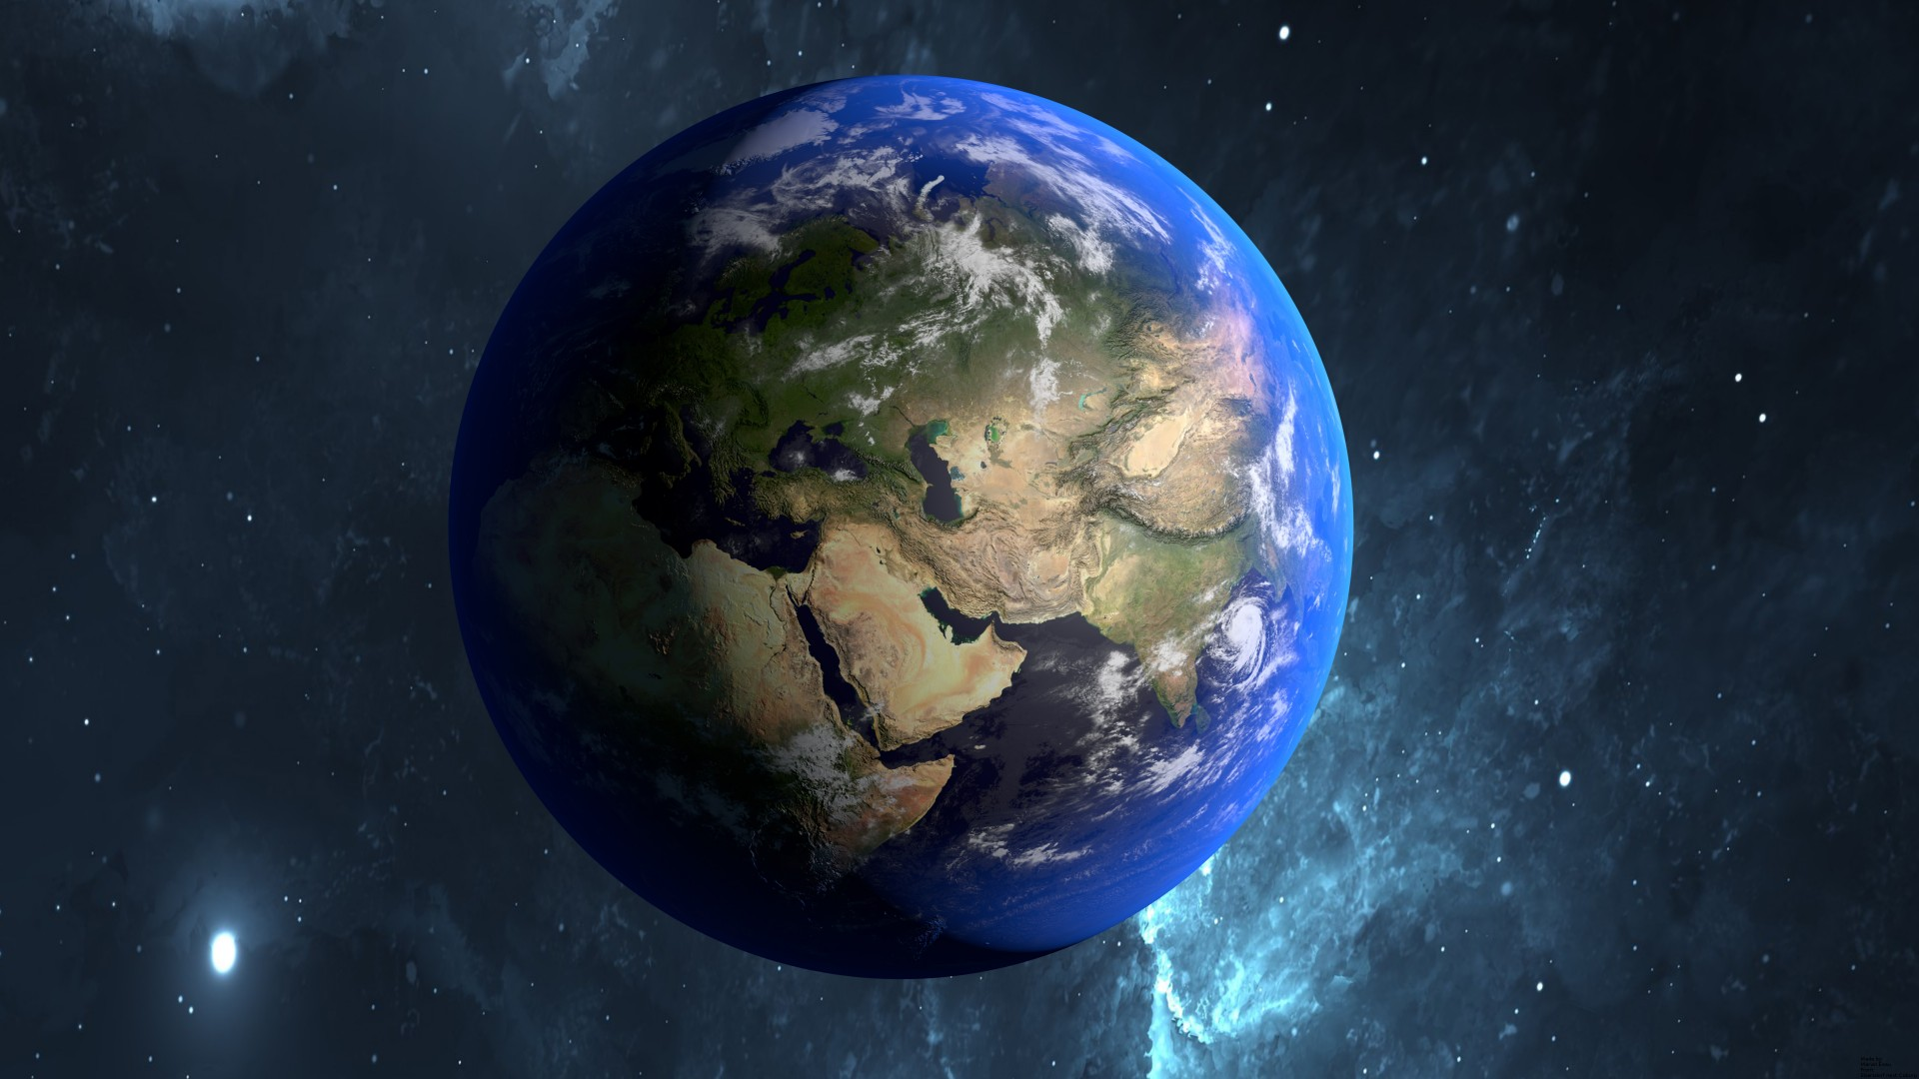

Slide 8
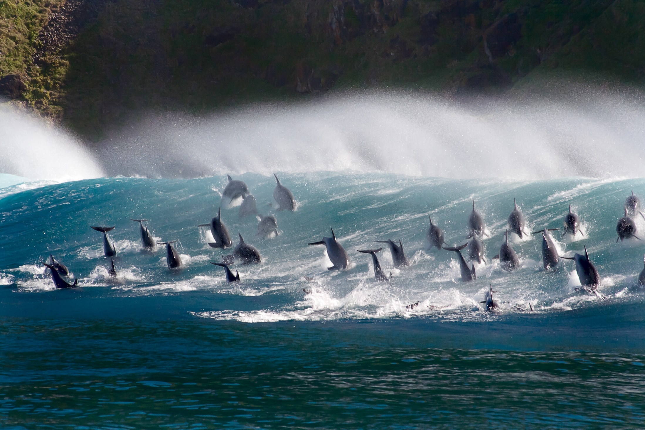

Slide 10
Israel---Discipline of the firstborn 管教好长子——以色列

Slide 11
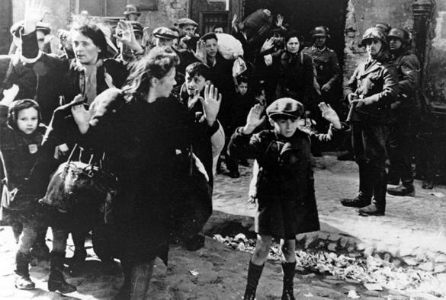

Slide 12
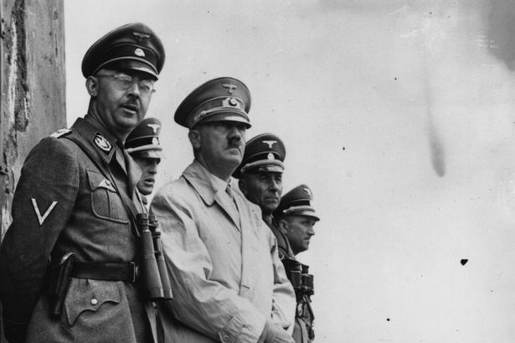

Slide 13
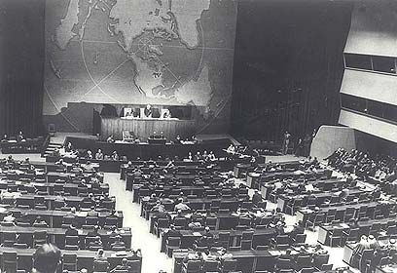

Slide 15
Eradicate death---through Jesus 通过耶稣根灭死亡

Slide 16
Training of the Core 培育核心

Slide 17
Matthew 马太福音 5:1-3
After seeing the crowds, he went up on the mountain. When he took his seat, his disciples came to him. Then he opened his mouth and taught them, saying: “Blessed are the poor in spirit, for theirs is the kingdom of heaven.”
耶稣看见群众，就上了山，他坐下之后，门徒来到他跟前，就开口教训他们：“心灵贫穷的人有福了，因为天国是他们的……”

Slide 18
In Matthew 5, 6, 7 Jesus addresses the core first & foremost 耶稣在《马太福音》5-7章的话， 首先是对核心说的。

Slide 19
Matthew 马太福音 5:13-15
“You are the salt of the earth…... You are the light of the world. One does not light a lamp and place it under a basket, but on a lampstand, and it gives light to all who are in the house.”
“你们是地上的盐…... 。你们是世上的光。建在山上的城是无法隐藏的。人点了灯，不会放在量器底下，而是放在灯台上，就照亮一家人。”

Slide 20
Matthew 5, 6, 7：Sermon on the Mount 《马太福音》5, 6, 7章：登山宝训

Slide 21
Kingdom of God is coming to earth soon. Enter by the narrow gate! 天国快要降临地球了，要进天国、用窄门！

Slide 22
As the core, you are salt & light of the world. 你们是核心，是世界的盐和光。

Slide 23
How? 怎样能做到？

Slide 24
1. Study & Do 2. Pray 1. 研读、实行 2. 祈祷

Slide 25
We understand Matthew better if we know background of Book of Isaiah 要更好明白《马太福音》，就得了解《以赛亚书》

Slide 26
Matthew 马太福音 4:14-16
This was to fulfil what was spoken through Isaiah the prophet, saying, “The land of Zebulun and the land of Naphtali, by the way of the sea, beyond the Jordan, Galilee of the Gentiles. The people who were sitting in darkness have seen a great light. Upon those who dwelt in a land of gloom, light has dawn.”
为了应验以赛亚先知所说的：“西布伦地、拿弗他利地、沿海之路，约旦河外，外族人的加利利啊！住在黑暗中的人民，看见了大光；死亡幽暗之地的居民，有光照亮他们。”

Slide 27
Isaiah以赛亚书 9:2
² The people who walked in darkness have seen a great light. Upon those who dwelt in a land of gloom, light has dawn.
² 行在黑暗中的人民，看见了大光；住在死阴之地的人，有光照耀他们。

Slide 28
Isaiah 7-12: the main points 《以赛亚先知书》第7-12章：主要内容

Slide 29
A faithful core within Israel against background of apostasy 在以色列的背叛背景下的一个核心

Slide 30
Isaiah以赛亚书 8:19-20
¹⁹ When they say to you, “Consult the mediums and the spiritists who whisper and mutter,” should not a people consult their God? Should they consult the dead on behalf of the living? ²⁰ To the Torah and the testimony! If they do not speak according to this word, it is because they have no dawn.
¹⁹ 若有人对你们说，“去求问那些交鬼的和行巫术的、那些喃喃细语的人吧。一族之民不应当求问自己的上帝吗？他们怎能为活人求问死人呢？” ²⁰ 他们应当求问上帝的妥拉（训诲）和法度；他们若不照着这些准则说话，就见不到曙光。

Slide 31
Isaiah以赛亚书 8:22
²² Then they will look to the earth, and see trouble and darkness, gloom of anguish; they will be driven into darkness.
²² 他们向天观望、俯视大地，只见困苦、黑暗、可怕的黑暗；他们必被赶入幽黑的黑暗中。

Slide 32
Apostasy is ‘darkness’ “黑暗”指的是离背神的话

Slide 33
Isaiah以赛亚书 8:16-18
¹⁶ Bind up the testimony, seal the Torah among my disciples. ¹⁷ I will wait on Yahweh who hides His face from the house of Jacob, and I will look eagerly for Him. ¹⁸ Here am I and the children whom Yahweh has given me! We are for signs and wonders in Israel from Yahweh of hosts, who dwells in Mount Zion.
你要卷起律法书，在我的门徒中间封住妥拉（训诲）。
¹⁷ 我要等候那掩面不顾雅各家的雅伟，我要仰望他。
¹⁸ 看哪！我和雅伟赐给我的孩子们，在以色列中作
预兆与奇迹，都是从住在锡安山的万军之雅伟来的。

Slide 34
Isaiah以赛亚书 8:16-18
¹⁶ Bind up the testimony, seal the Torah among my disciples. ¹⁷ I will wait on Yahweh who hides His face from the house of Jacob, and I will look eagerly for Him. ¹⁸ Here am I and the children whom Yahweh has given me! We are for signs and wonders in Israel from Yahweh of hosts, who dwells in Mount Zion.
你要卷起律法书，在我的门徒中间封住妥拉（训诲）。
¹⁷ 我要等候那掩面不顾雅各家的雅伟，我要仰望他。
¹⁸ 看哪！我和雅伟赐给我的孩子们，在以色列中作
预兆与奇迹，都是从住在锡安山的万军之雅伟来的。

Slide 35
Matthew 马太福音 5:13-15
“You are the salt of the earth; but if the salt loses its flavor, how shall it be used? It no longer is useful and will be thrown out and trampled by people. You are the light of the world. A city that is set on a hill cannot be hidden. One does not light a lamp and place it under a basket, but on a lampstand, and it gives light to all who are in the house.”
“你们是地上的盐；如果盐失了味，怎能使它再咸 呢？结果毫无用处，唯有丢在外面任人践踏。你们是世上的光。建在山上的城是无法隐藏的。人点了灯，不会放在量器底下，而是放在灯台上，就照亮一家人。”

Slide 36
Torah：the word of God 妥拉：上帝之圣言

Slide 37
Isaiah以赛亚书 8:16-18
¹⁶ Bind up the testimony, seal the Torah among my disciples. ¹⁷ I will wait on Yahweh who hides His face from the house of Jacob, and I will look eagerly for Him. ¹⁸ Here am I and the children whom Yahweh has given me! We are for signs and wonders in Israel from Yahweh of hosts, who dwells in Mount Zion.
你要卷起律法书，在我的门徒中间封住妥拉（训诲）。
¹⁷ 我要等候那掩面不顾雅各家的雅伟，我要仰望他。
¹⁸ 看哪！我和雅伟赐给我的孩子们，在以色列中作
预兆与奇迹，都是从住在锡安山的万军之雅伟来的。

Slide 38
Matthew 马太福音 5:17
“Do not think that I came to destroy the Law (Torah) or the Prophets. I did not come to destroy but to fulfill them.”
“你们不要以为我来是要废除律法和先知；我来不是要废除，而是要完成。”

Slide 39
Prayer 祈祷

Slide 40
Isaiah以赛亚书 8:16-18
¹⁶ Bind up the testimony, seal the Torah among my disciples. ¹⁷ I will wait on Yahweh who hides His face from the house of Jacob, and I will look eagerly for Him. ¹⁸ Here am I and the children whom Yahweh has given me! We are for signs and wonders in Israel from Yahweh of hosts, who dwells in Mount Zion.
你要卷起律法书，在我的门徒中间封住妥拉（训诲）。
¹⁷ 我要等候那掩面不顾雅各家的雅伟，我要仰望他。
¹⁸ 看哪！我和雅伟赐给我的孩子们，在以色列中作
预兆与奇迹，都是从住在锡安山的万军之雅伟来的。

Slide 41
Matthew 马太福音 6:22-23
“The lamp of the body is the eye. If therefore your eye is single, your whole body will be full of light. But if your eye is bad, your whole body will be full of darkness. If therefore the light that is in you is darkness, how great is that darkness!”
“眼睛就是身体的灯。如果你的眼睛专一，全身就都明亮。如果你的眼有昏花，全身就都黑暗。如果你里面的光变成黑暗，这是多么的黑暗！”

Slide 42
Glorious Ending 荣耀的结局

Slide 43
Your kingdom come 愿你的国降临

Slide 44
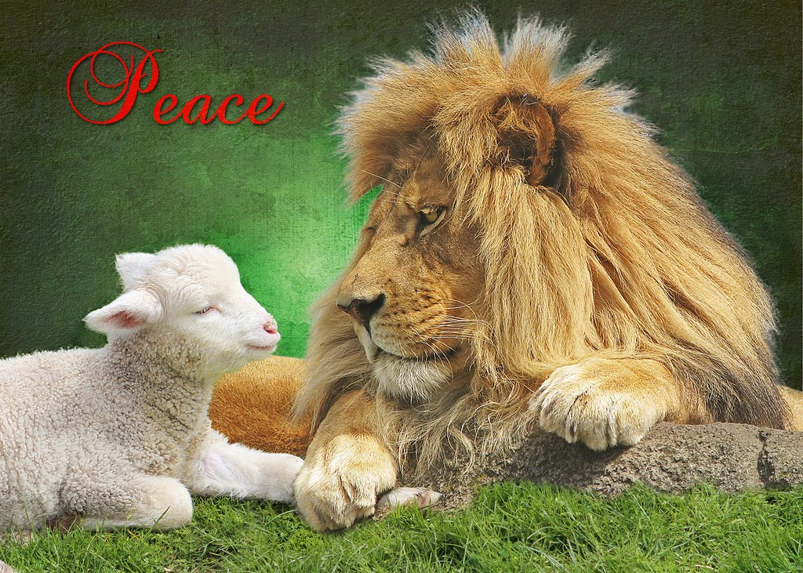

Slide 45
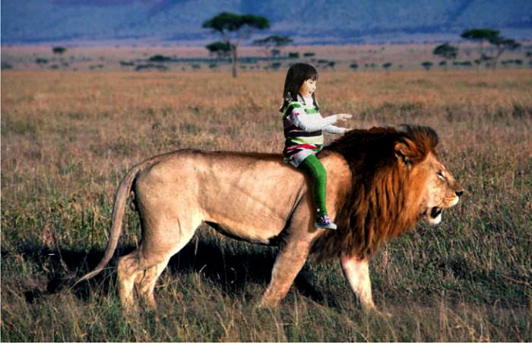

Slide 46
Isaiah以赛亚书 12:1-2
Then you will say on that day, “I will give thanks to You, Yahweh; for although You were angry with me, Your anger is turned away, and You do comfort me. Behold, God is my salvation (yeshua), I will trust and not be afraid. For Yah Yahweh is my strength and song, He has become my salvation (yeshua).”
到那日， 你必说：“雅伟啊！我要称谢你，因为你虽曾向我发怒，你的怒气却已转消，你有安慰了我。看哪！神是我的拯救（ yeshua）；我要依靠他，并不惧怕，因为雅 雅伟是我的力量，我的诗歌，他也成了我的拯救（yeshua）。”

Slide 47
God is fixing problems in the world. Would you want to be included in His plan? 上帝正在解决世界的问题。 你想加入他的计划吗？

Slide 48
完 The End

