Slide 1
2018.02.18

Slide 2
The Gospel of Matthew Series 马太福音系列

Slide 3
Matthew马太 5.1-20

Slide 4
Kingdom Blessings 幸福在天国

Slide 5
Observations 观察

Slide 6
Matthew 马太福音 5:1-20
1-12 Blessings 幸福
13-16 Responsibility 责任
17-20 Entry Requirement 进天国条件

Slide 7
Matthew 马太福音 5:1-20
3 …for theirs is the kingdom 天国是他们的
10 …for theirs is the kingdom 天国是他们的
20 Unless your righteousness exceeds… you will never enter the kingdom
你们的义若不超过…… 就必不能进天国

Slide 8
Matthew 马太福音 5:1-20
1-12 Blessings 幸福
13-16 Warning 警告
17-20 Warning 警告

Slide 9
Matthew 马太福音 5:1-20
3-12 Blessed are… …的人有福了
13 But if the salt has become tasteless… Thrown out 但如果盐失了味… 丢在外面
20 Unless your righteousness exceeds… you will by no means enter the kingdom
你们的义若不超过…… 就必不能进天国

Slide 10
3-12 Kingdom Blessings 幸福在天国

Slide 11
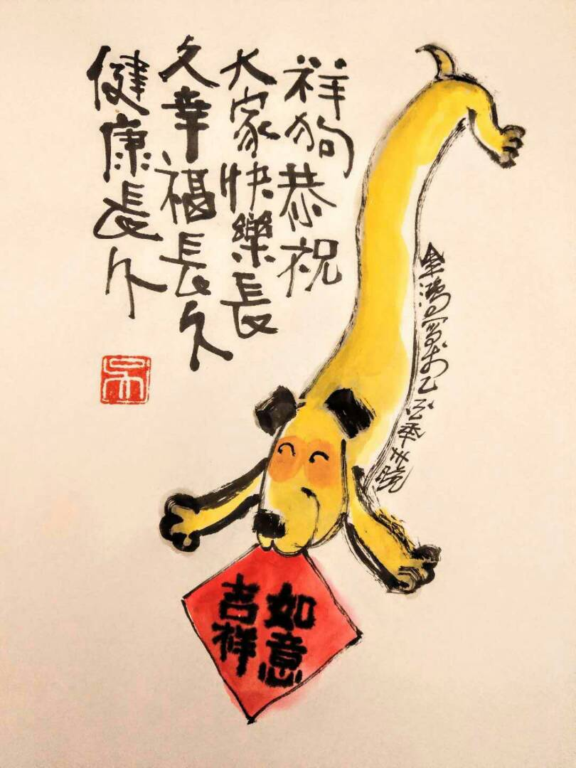

Slide 12
3 Poor in spirit enter God’s kingdom 心灵贫穷 得进天国

Slide 13
Matthew 马太福音 5:3
Blessed are the poor in spirit, for theirs is the kingdom of heaven.
心灵贫穷的人有福了，因为天国是他们的。

Slide 14
Matthew马太福音 6:24
²⁴ No one can serve two masters; either he will hate the one and love the other, or he will hold to one and despise the other. You cannot serve God and money.
²⁴ 一个人不能服侍两个主人；他若不是恨这个爱那个，就是忠于这个轻视那个。你们不能服侍上帝，又服侍金钱。

Slide 15
Luke 路加福音 6:20
Turning his gaze on his disciples, he began to say, “Blessed are the poor, for yours is the kingdom of God.”
耶稣抬头看着门徒，说：“贫穷的人有福了，因为上帝的国是你们的。”

Slide 16
1Timothy 提摩太前书 6:7-8, 10
⁷ We have brought nothing into the world, so we cannot take anything out of it. ⁸ If we have food and covering, with these we will be content. ¹⁰ The love of money is a root of all evil, and some by longing for it have wandered away from the faith, and pierced themselves with many a pang.
⁷ 我们什么也没有带来世上，什么也不能带走。
⁸ 但只要有吃有穿，就应当知足。¹⁰ 爱钱是万恶的根。人贪求就背离真道，把自己交给剧痛去刺透。

Slide 17
Matthew马太福音 6:33-34
³³ Seek first His kingdom and His righteousness; and all these things will be added to you.
³⁴ Therefore do not be anxious about tomorrow; for tomorrow will take care of itself. There is enough trouble as it is when we take life one day at a time.
³³ 你们要先求他的国和他的义，这一切都必加给你们。 ³⁴ 所以，不要为明天忧虑，因为明天自有明天的忧虑，一天的难处一天当就够了。

Slide 18
Matthew马太福音 16:25
Whoever wishes to save his life will lose it; but whoever loses his life for my sake will find it.
凡是想救自己生命的，必丧掉生命；但为我的缘故丧失生命的，必得着生命。

Slide 19
“Happiness is when you live for something or somebody greater than yourself.” Viktor E. Frankl, Man’s Search For Meaning

Slide 20
4 Mourning Comfort 伤心 安慰

Slide 21
We understand Matthew better if we know Book of Isaiah 要更好明白《马太福音》就得了解《以赛亚书》

Slide 22
Isaiah以赛亚书 61:1
The Spirit of the Lord Yahweh is upon me,
because Yahweh has anointed me
To bring good news to the afflicted.
He has sent me to bind up the brokenhearted.
To proclaim liberty to captives, and freedom to prisoners.
主雅伟的灵在我身上，因为雅伟膏了我，
叫我传福音给困苦的人；
差遣我去医治伤心的人，
向被掳的宣告自由，向被囚的宣告释放；

Slide 23
Isaiah以赛亚书 61:2
To proclaim the favourable year of Yahweh,
and the day of vengeance of our God;
To comfort all who mourn,
To grant those who mourn in Zion,
Giving them garland instead of ashes,
宣告雅伟悦纳人的禧年，
和我们的上帝报仇的日子；
安慰悲哀的人，
为锡安悲哀的人穿上装饰，

Slide 24
Isaiah以赛亚书 61:3
Giving them garland instead of ashes,
The oil of gladness instead of mourning,
The mantle of praise instead of a spirit of fainting.
So they will be called oaks of righteousness,
The planting of Yahweh,
That He may be glorified.
为锡安悲哀的人穿上装饰，赐给他们华冠代替灰尘，
喜乐油代替悲哀，赞美衣代替沮丧的灵，他们必称为
公义的橡树，是雅伟栽种的，好使他自己得着荣耀。

Slide 25
5 Humble Inherit the Earth 柔和谦卑 承受地球

Slide 26
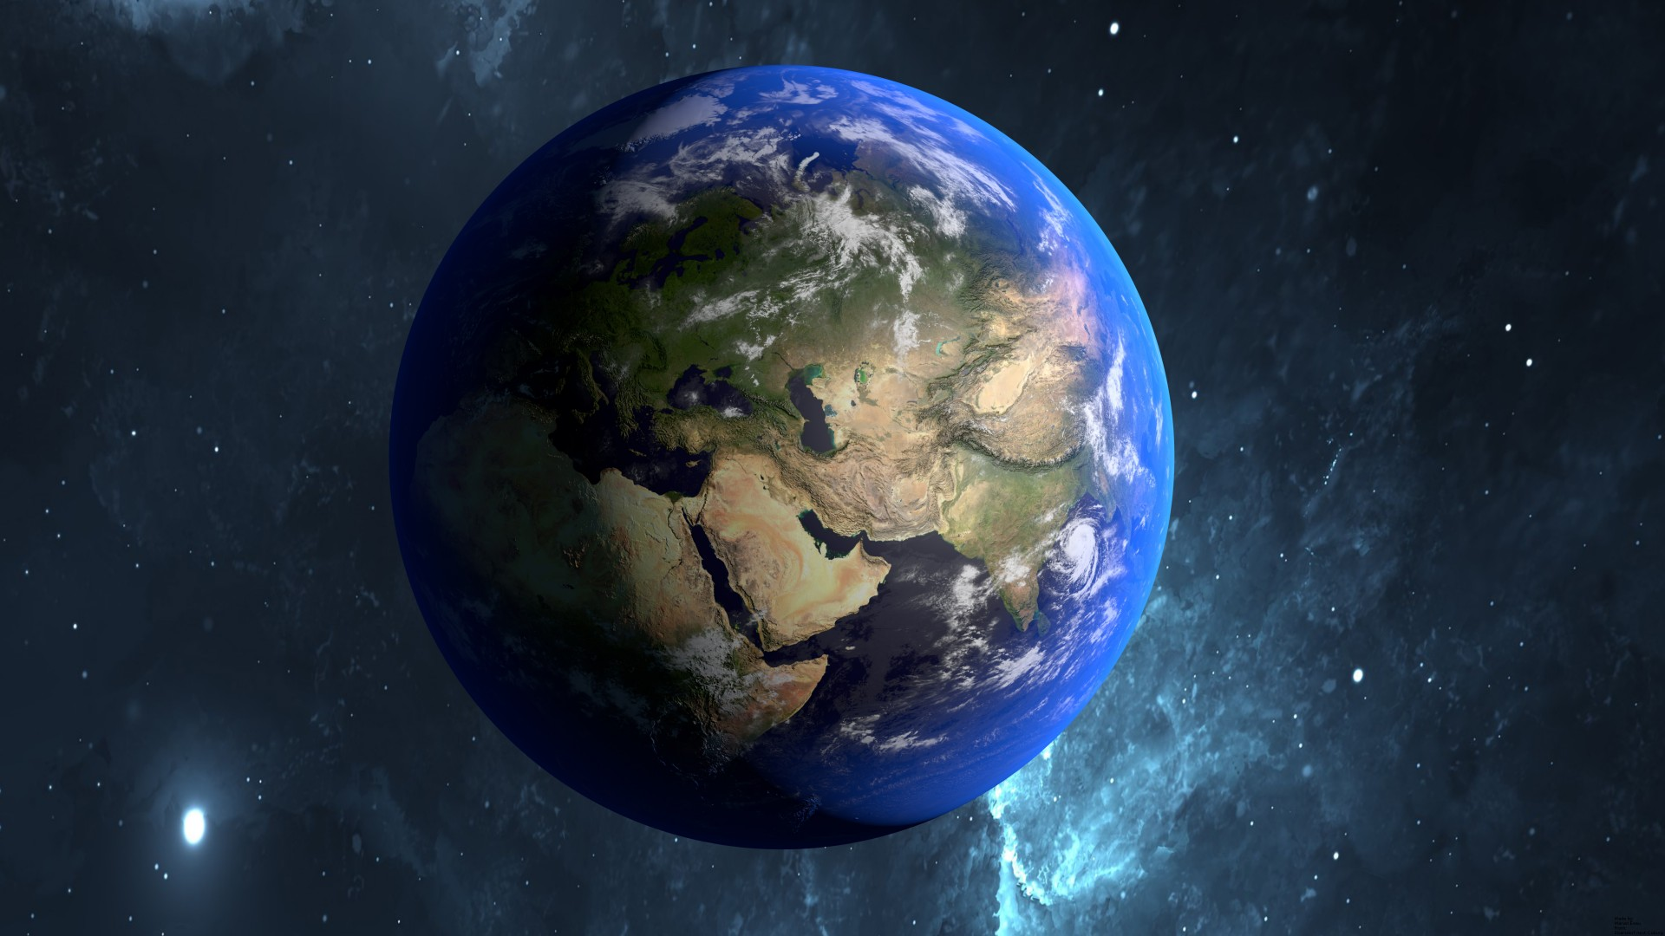

Slide 27
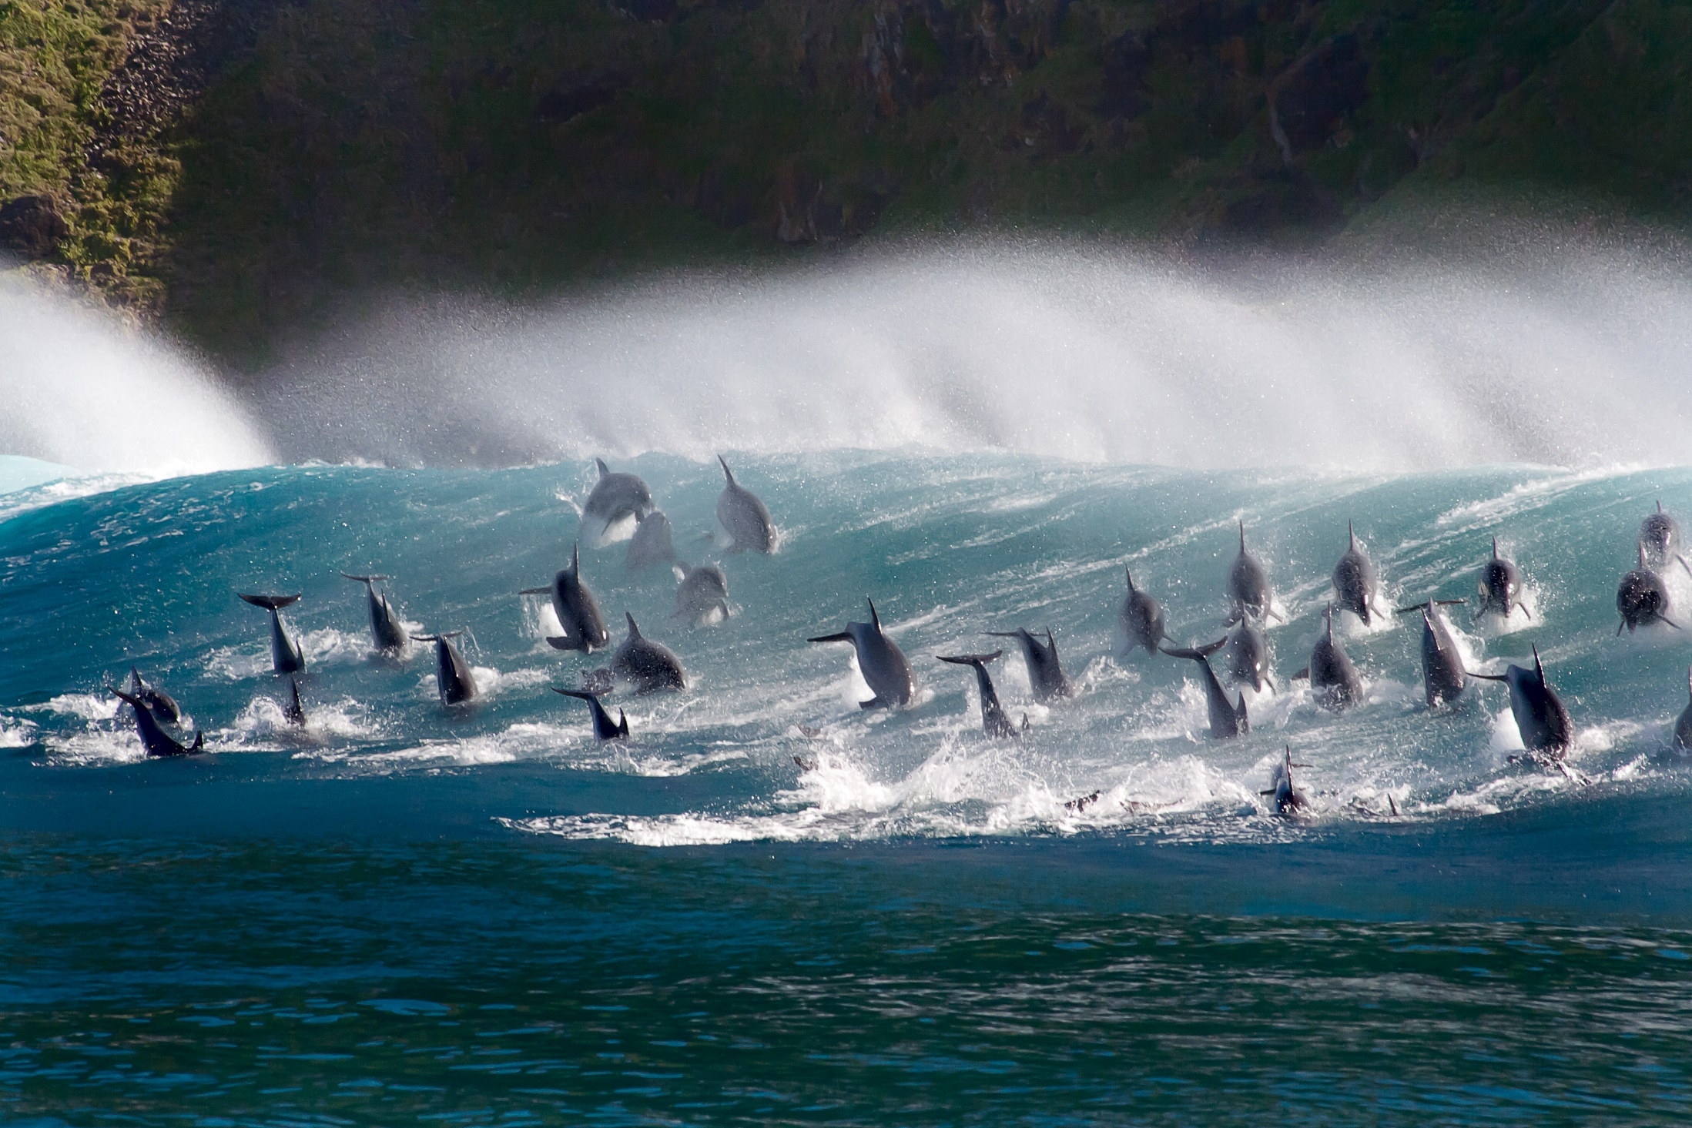

Slide 28
6 Hunger for righteousness Satisfied 饥渴慕义 饱足

Slide 29
Philippians 腓立比书 3:8-9
For him (Jesus) I suffer the loss of everything, and consider them as rubbish in order that I might gain Christ, and be found in him, not having my own righteousness, which is from the Law, but that which is through faith in Christ, the righteousness which is from God by faith.
为了他（耶稣），我把万事都抛弃了，看作废物，为了要得着 基督；并且得以在他里面，不是有自己因律法而得的义，而是有因信从基督、从神而来基于信的义。

Slide 30
7 Merciful Receive mercy 怜恤人 蒙神怜恤

Slide 31
James 雅各书 2:13
For judgment will be merciless on the one who has shown no mercy. Mercy triumphs over judgment.
因为，对不行怜悯的人，审判他们的时候亦没有怜悯；怜悯胜过审判。

Slide 32
8 Pure in heart See God 清心 得见神

Slide 33
Matthew 马太福音 6:22-23
The lamp of the body is the eye. If therefore your eye is single, your whole body will be full of light. But if your eye is bad, your whole body will be full of darkness. If therefore the light that is in you is darkness, how great is that darkness!
眼睛就是身体的灯。如果你的眼睛专一，全身就都明亮。如果你的眼有昏花，全身就都黑暗。如果你里面的光变成黑暗，这是多么的黑暗！

Slide 34
Exodus 出埃及记 33:20
But Yahweh said to Moses, “You cannot see My face, for no man can see Me and live!”
雅伟又对摩西说：你不能看我的脸， 因为没有人看见了我还能活着。

Slide 35
9 Reconcile man to God Be called sons of God 使人与神和好 称为神的儿子

Slide 36
Isaiah以赛亚书 61:3
Giving them garland instead of ashes,
The oil of gladness instead of mourning,
The mantle of praise instead of a spirit of fainting.
So they will be called oaks of righteousness,
The planting of Yahweh,
That He may be glorified.
为锡安悲哀的人穿上装饰，赐给他们华冠代替灰尘，
喜乐油代替悲哀，赞美衣代替沮丧的灵，他们必称为
公义的橡树，是雅伟栽种的，好使他自己得着荣耀。

Slide 37
10 Persecuted Enter God’s kingdom 为义受迫害 得进天国

Slide 38
Matthew 马太福音 5:11-12
Blessed are you when men cast insults at you, and persecute you, and say all kinds of evil against you falsely on account of me. Rejoice, and be glad, for your reward in heaven in great, for so they persecuted the prophets who were before you.
若是你们为我的缘故，受人辱骂迫害、捏造各种坏话毁谤，你们就有福了。你们应该欢喜快乐，因为你们在天的赏赐是大的；在你们以前的先知，他们也曾这样迫害。

Slide 39
13-16 Responsibility & Warning 责任 警告

Slide 40
Matthew 马太福音 5:13-15
You are the salt of the earth; but if the salt loses its flavor, how shall it be used? It no longer is useful and will be thrown out and trampled by people. You are the light of the world. A city that is set on a hill cannot be hidden. One does not light a lamp and place it under a basket, but on a lampstand, and it gives light to all who are in the house.
你们是地上的盐；如果盐失了味，怎能使它再咸呢？结果毫无用处，唯有丢在外面任人践踏。
你们是世上的光。建在山上的城是无法隐藏的。人点了灯，不会放在量器底下，而是放在灯台上，就照亮一家人。

Slide 41
17-20 Warning 警告

Slide 42
Matthew马太福音 5:19
¹⁹ Whoever then annuls (loosens) one of the least of these commandments, and so teaches others, shall be called least in the kingdom of heaven; but whoever keeps and teaches them, he shall be called great in the kingdom of heaven.
¹⁹ 因此，无论谁废除（放宽）诫命中最小的一条，又这样教导人，他在天国中必称为最小的；但若有人遵行这些诫命，并且教导人遵行，他在天国中必称为最大。

Slide 43
Matthew马太福音 5:20
²⁰ For I say to you, unless your righteousness exceeds that of the scribes and Pharisees, you will by no means enter the kingdom of heaven!
²⁰ 我告诉你们，你们的义若不超过文士和法利赛人的义，就必不能进天国!

Slide 45
The End 完

