Slide 1
The Gospel of Matthew Series 马太福音系列

Slide 2
马太福音 Matthew 5:13-14
你们是世上的盐。盐若失了味，怎能叫他再咸呢？以后无用，不过丢在外面，被人践踏了。¹⁴ 你们是世上的光，城造在山上是不能隐藏的。
You are the salt of the earth, but if salt has lost its taste, how shall its saltiness be restored? It is no longer good for anything except to be thrown out and trampled under people's feet. ¹⁴ “You are the light of the world. A city set on a hill cannot be hidden.

Slide 3
马太福音 Matthew 5:1-16
³ 心灵贫乏的人有福了！因为天国是他们的。 ⁴ 哀恸的人有福了！因为他们必得安慰。 ⁵ 温柔的人有福了！因为他们必承受地土。 ⁶ 饥渴慕义的人有福了！因为他们必得饱足。 ⁷ 怜恤人的人有福了！因为他们必蒙怜恤。
³"Blessed are the poor in spirit, for theirs is the kingdom of heaven. ⁴ "Blessed are those who mourn, for they shall be comforted. ⁵ "Blessed are the meek, for they shall inherit the earth. ⁶ "Blessed are those who hunger and thirst for righteousness, for they shall be satisfied. ⁷ "Blessed are the merciful, for they shall receive mercy.

Slide 4
马太福音 Matthew 5:1-16
⁸ 清心的人有福了！因为他们必得见神。⁹ 使人和睦的人有福了！因为他们必称为神的儿子。¹⁰ 为义受逼迫的人有福了！因为天国是他们的。
⁸ "Blessed are the pure in heart, for they shall see God. ⁹ "Blessed are the peacemakers, for they shall be called sons of God. ¹⁰ "Blessed are those who are persecuted for righteousness' sake, for theirs is the kingdom of heaven.

Slide 5
马太福音 Matthew 5:1-16
¹¹ 人若因我辱骂你们，逼迫你们，捏造各样坏话毁谤你们，你们就有福了！ ¹² 应当欢喜快乐，因为你们在天上的赏赐是大的。在你们以前的先知，人也是这样逼迫他们。
¹¹ "Blessed are you when others revile you and persecute you and utter all kinds of evil against you falsely on my account. ¹² Rejoice and be glad, for your reward is great in heaven, for so they persecuted the prophets who were before you.

Slide 6
马太福音 Matthew 5:13
你们是世上的盐。盐若失了味，怎能叫他再咸呢？以后无用，不过丢在外面，被人践踏了。
You are the salt of the earth, but if salt has lost its taste, how shall its saltiness be restored? It is no longer good for anything except to be thrown out and trampled under people's feet.

Slide 7
马太福音 Matthew 5:13
你们是世上的盐。盐若失了味，怎能叫他再咸呢？以后无用，不过丢在外面，被人践踏了。
You are the salt of the earth, but if salt has lost its taste, how shall its saltiness be restored? It is no longer good for anything except to be thrown out and trampled under people's feet.

Slide 8
马太福音 Matthew 5:13
你们是世上的盐。盐若失了味，怎能叫他再咸呢？以后无用，不过丢在外面，被人践踏了。
You are the salt of the earth, but if salt has lost its taste, how shall its saltiness be restored? It is no longer good for anything except to be thrown out and trampled under people's feet.

Slide 9
马太福音 Matthew 5:13
你们是世上的盐。盐若失了味，怎能叫他再咸呢？以后无用，不过丢在外面，被人践踏了。
You are the salt of the earth, but if salt has lost its taste, how shall its saltiness be restored? It is no longer good for anything except to be thrown out and trampled under people's feet.

Slide 10
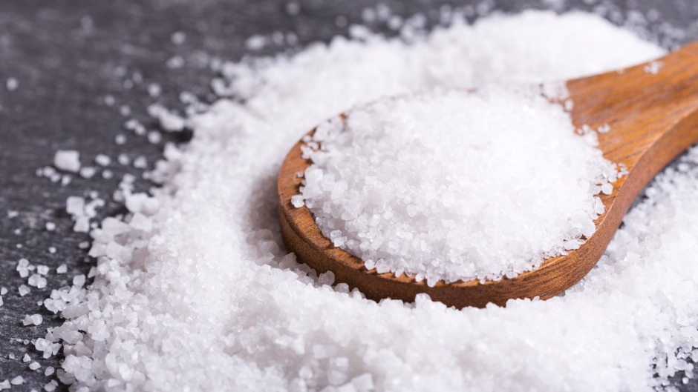

Slide 11
马太福音 Matthew 5:13
你们是世上的盐。盐若失了味，怎能叫他再咸呢？以后无用，不过丢在外面，被人践踏了。
You are the salt of the earth, but if salt has lost its taste, how shall its saltiness be restored? It is no longer good for anything except to be thrown out and trampled under people's feet.

Slide 12
马太福音 Matthew 5:13
你们是世上的盐。盐若失了味，怎能叫他再咸呢？以后无用，不过丢在外面，被人践踏了。
You are the salt of the earth, but if salt has lost its taste, how shall its saltiness be restored? It is no longer good for anything except to be thrown out and trampled under people's feet.

Slide 13
马太福音 Matthew 26:41
应当警醒、祷告，免得陷入试探；你们心灵虽然愿意，肉体却是软弱的。
Watch and pray that you may not enter into temptation. The spirit indeed is willing, but the flesh is weak.”

Slide 14
马太福音 Matthew 5:13
你们是世上的盐。盐若失了味，怎能叫他再咸呢？以后无用，不过丢在外面，被人践踏了。
You are the salt of the earth, but if salt has lost its taste, how shall its saltiness be restored? It is no longer good for anything except to be thrown out and trampled under people's feet.

Slide 15
提摩太后书 2 Timothy 3:1-2,5
¹你该知道，末世必有危险的日子来到。²因为那时人要专顾自己。。。⁵ 有敬虔的外貌，却背了敬虔的实意
¹ But realize this, that in the last days difficult times will come. ² ​For men will be lovers of self… ⁵ having the appearance of godliness, but denying its power

Slide 16
马太福音 Matthew 5:13
你们是世上的盐。盐若失了味，怎能叫他再咸呢？以后无用，不过丢在外面，被人践踏了。
You are the salt of the earth, but if salt has lost its taste, how shall its saltiness be restored? It is no longer good for anything except to be thrown out and trampled under people's feet.

