Slide 1
The Gospel of Matthew Series 马太福音系列

Slide 2
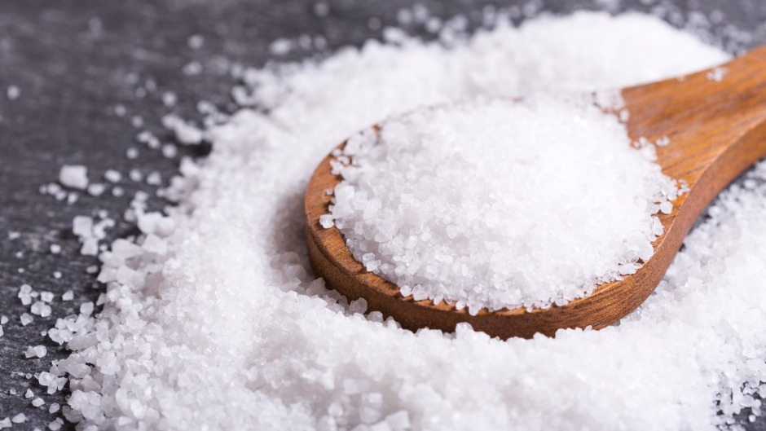

Slide 3
马太福音 Matthew 5:13
你们是世上的盐。盐若失了味，怎能叫他再咸呢？以后无用，不过丢在外面，被人践踏了。
You are the salt of the earth, but if salt has lost its taste, how shall its saltiness be restored? It is no longer good for anything except to be thrown out and trampled under people's feet.

Slide 4
马太福音 Matthew 5:13
你们是世上的盐。盐若失了味，怎能叫他再咸呢？以后无用，不过丢在外面，被人践踏了。
You are the salt of the earth, but if salt has lost its taste, how shall its saltiness be restored? It is no longer good for anything except to be thrown out and trampled under people's feet.

Slide 5
马太福音 Matthew 5:13
你们是世上的盐。盐若成了愚拙，怎能叫他再咸呢？以后无用，不过丢在外面，被人践踏了。
You are the salt of the earth, but if salt has become foolish, how shall its saltiness be restored? It is no longer good for anything except to be thrown out and trampled under people's feet.

Slide 6
约伯记 Job 6:6
淡而无盐的食物有什么好吃呢？蛋白有什么味道呢？
Can something tasteless be eaten without salt, Or is there any taste in the white of an egg ?

Slide 7
马太福音 Matthew 5:13
你们是世上的盐。盐若成了愚拙，怎能叫他再咸呢？以后无用，不过丢在外面，被人践踏了。
You are the salt of the earth, but if salt has become foolish, how shall its saltiness be restored? It is no longer good for anything except to be thrown out and trampled under people's feet.

Slide 8
哥林多前书 1 Cor 1:22-24
犹太人是要神蹟，希腊人是求智慧， ²³ 我们却是传钉十字架的基督，在犹太人为绊脚石，在外邦人为愚拙； ²⁴ 但在那蒙召的，无论是犹太人, 希腊人, 基督总为神的能力, 神的智慧。
For Jews demand signs and Greeks seek wisdom, ²³ but we preach Christ crucified, a stumbling block to Jews and folly to Gentiles, ²⁴ but to those who are called, both Jews and Greeks, Christ the power of God and the wisdom of God.

Slide 9
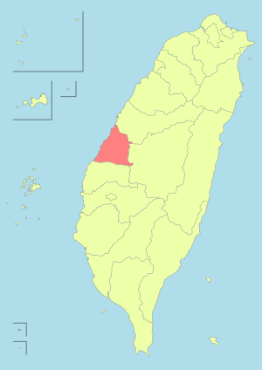

Slide 10
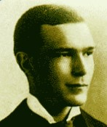
兰大卫医生，生于 1870.8.2
Dr. David Landsborough, born on 1870.8.2

Slide 11
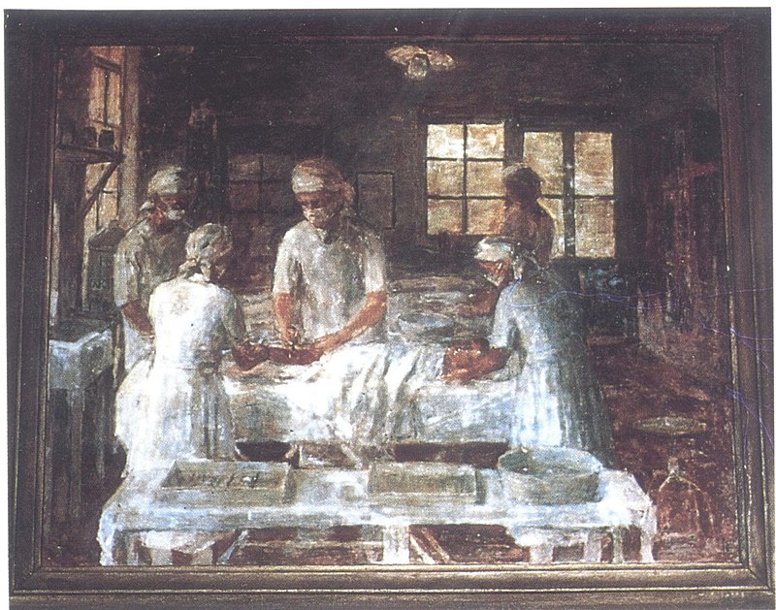

Slide 12
路加福音 Luke 12:16-21
16 就对他们讲了一个比喻，说：“有一个富翁的田地丰收。 17 他自己心里说：‘怎么办呢？因为我没有足够的地方收藏出产了！’ 18 又说：‘我要这样办：我要拆掉这些仓房，建造更大的，好在那里收藏我的一切粮食和货物。
¹⁶ And he told them a parable, saying, “The land of a rich man produced plentifully, ¹⁷ and he thought to himself, ‘What shall I do, for I have nowhere to store my crops?’ ¹⁸ And he said, ‘I will do this: I will tear down my barns and build larger ones, and there I will store all my grain and my goods

Slide 13
路加福音 Luke 12:15-21
19 然后，我要对我的灵魂说：灵魂啊，你拥有许多好东西，足够多年享用，只管安安逸逸地吃喝快乐吧！’ 20 神却对他说：‘无知的人哪，今天晚上，你拥有的就要取去你的灵魂，你所预备的要归给谁呢？’ 21 凡为自己积财，在神面前却不富足的，也是这样。”
¹⁹ And I will say to my soul, “Soul, you have ample goods laid up for many years; relax, eat, drink, be merry.”’ ²⁰ But God said to him, ‘Fool! This night your soul is required of you, and the things you have prepared, whose will they be?’ ²¹ So is the one who lays up treasure for himself and is not rich toward God.”

Slide 14
马太福音 Matthew 5:13
你们是世上的盐。盐若成了愚拙，怎能叫他再咸呢？以后无用，不过丢在外面，被人践踏了。
You are the salt of the earth, but if salt has become foolish, how shall its saltiness be restored? It is no longer good for anything except to be thrown out and trampled under people's feet.

