Slide 1
The Gospel of Matthew Series 马太福音系列

Slide 2
马太福音 Matthew 5:13
You are the salt of the earth, but if salt has lost its taste, how shall its saltiness be restored? It is no longer good for anything except to be thrown out and trampled under people's feet.
你们是世上的盐。盐若失了味，怎能叫他再咸呢？以后无用，不过丢在外面，被人践踏了。

Slide 3
马太福音 Matthew 5:14
You are the light of the world.
A city set on a hill cannot be hidden.
你们是世上的光，城造在山上是不能隐藏的。

Slide 4
创世记 Genesis 1:1-3
In the beginning, God created the heavens and the earth. The earth was without form and void, and darkness was over the face of the deep….
And God said, “Let there be light,” and there was light. 4 And God saw that the light was good. And God separated the light from the darkness.
起初，神创造天地。地是空虚混沌，渊面黑暗…. 神说：要有光，就有了光。 ⁴ 神看光是好的，就把光暗分开了。

Slide 5
约翰一书 1 John 1:5-6
This is the message we have heard from him and proclaim to you, that God is light, and in Him is no darkness at all. If we say we have fellowship with him while we walk in darkness, we lie and do not practice the truth.
神就是光，在他毫无黑暗。这是我们从主所听见、又报给你们的信息。 我们若说是与神相交，却仍在黑暗里行，就是说谎话，不行真理了。

Slide 6
约翰福音 John 8:12
Again Jesus spoke to them, saying, “I am the light of the world. Whoever follows me will not walk in darkness, but will have the light of life.”
耶稣又对众人说：我是世界的光。跟从我的，就不在黑暗里走，必要得着生命的光。

Slide 7
林后 2 Cor 4:6
God, who said, “Let light shine out of darkness,” is the One who has shone in our hearts to give the light of the knowledge of the glory of God in the face of Christ.
那吩咐光从黑暗里照出来的神，已经照在我们心里，叫我们得知神荣耀的光显在耶稣基督的面上。

Slide 8
帖前 1 Thessalonians 5:5
You are all children of the light and children of the day. We do not belong to the night or to the darkness.”
你们都是光明之子，都是白昼之子。我们不是属黑夜的，也不是属幽暗的。

Slide 9
以弗所书 Eph 5:8
for you were formerly darkness, but now you are light in the Lord; walk as children of light.
从前你们是暗昧的，但如今在主里面是光明的，行事为人就当象光明的子女。

Slide 10
马太福音 Matthew 5:14
You are the light of the world.
A city set on a hill cannot be hidden.
你们是世上的光，城造在山上是不能隐藏的。

Slide 11
创世记 Genesis 1:1-3
In the beginning, God created the heavens and the earth. The earth was without form and void, and darkness was over the face of the deep….
And God said, “Let there be light,” and there was light. 4 And God saw that the light was good. And God separated the light from the darkness.
起初，神创造天地。地是空虚混沌，渊面黑暗…. 神说：要有光，就有了光。 ⁴ 神看光是好的，就把光暗分开了。

Slide 12
马太福音 Matthew 5:14
You are the light of the world.
你们是世上的光，城造在山上是不能隐藏的
约翰福音 John 8:12
Again Jesus spoke to them, saying, “I am the light of the world. Whoever follows me will not walk in darkness, but will have the light of life.”
耶稣又对众人说：我是世界的光。跟从我的，就不在黑暗里走，必要得着生命的光。

Slide 13
马太福音 Matthew 5:14-16
You are the light of the world.
A city set on a hill cannot be hidden.
Nor do people light a lamp and put it under a basket, but on a stand, and it gives light to all in the house.
In the same way, let your light shine before others, so that they may see your good works and give glory to your Father who is in heaven.

Slide 14
马太福音 Matthew 5:14-16
你们是世上的光，城造在山上是不能隐藏的。
人点灯，不放在斗底下，是放在灯臺上，就照亮一家的人。 你们的光也当这样照在人前，叫他们看见你们的好行为，便将荣耀归给你们在天上的父。

Slide 15
林前 1 Cor 9:27
….lest after preaching to others, [we ourselves] should be disqualified.
…. 恐怕我传福音给别人，自己反被弃绝了。

Slide 16
马太福音 Matthew 5:14-16
You are the light of the world.
A city set on a hill cannot be hidden.
Nor do people light a lamp and put it under a basket, but on a stand, and it gives light to all in the house.
In the same way, let your light shine before others, so that they may see your good works and give glory to your Father who is in heaven.

Slide 17
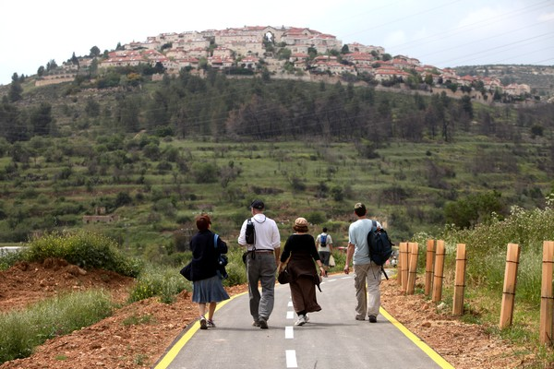
马太福音 Matthew 5:14-16
你们是世上的光，城造在山上是不能隐藏的。
人点灯，不放在斗底下，是放在灯臺上，就照亮一家的人。 你们的光也当这样照在人前，叫他们看见你们的好行为，便将荣耀归给你们在天上的父。

Slide 18
箴言 Prov 6:20, 23
²⁰ My son, keep your father's commandment, and forsake not your mother's teaching.
²³ For the commandment is a lamp and the teaching a light, and the reproofs of discipline are the way of life,
²⁰ 我儿，要谨守你父亲的诫命；不可离弃你母亲的法则（或译：指教）
²³ 因为诫命是灯，法则（或译：指教）是光，训诲的责备是生命的道，

