Slide 1
2018.02.11

Slide 2
The Gospel of Matthew Series 马太福音系列

Slide 3
Exceeds the Righteousness of the Scribes and Pharisees 胜过文士和法利赛人的义 （马太福音 Matthew 5:17-20）

Slide 4
马太福音 Mat 5:17-20
"Think not that I have come to abolish the law and the prophets; I have come not to abolish them but to fulfil them. ¹⁸ For truly, I say to you, till heaven and earth pass away, not an iota, not a dot, will pass from the law until all is accomplished.
"你们不要以为我来是要废除律法和先知；我来不是要废除，而是要完成。我实在告诉你们，就算天地过去，律法的一点一画也不会废去，全部都要成就。

Slide 5
马太福音 Mat 5:17-20
¹⁹ Whoever then breaks one of the least of these commandments and teaches men so, shall be called least in the kingdom of heaven; but he who does them and teaches them shall be called great in the kingdom of heaven. ²⁰ For I tell you, unless your righteousness exceeds that of the scribes and Pharisees, you will never enter the kingdom of heaven.
因此，无论谁废除诫命中最小的一条，又这样教导人，他在天国中必称为最小的；但若有人遵行这些诫命，并且教导人遵行，他在天国中必称为大。我告诉你们，你们的义若不胜过经学家和法利赛人的义，就必不能进天国。

Slide 6
马太福音 Mat 5:17-20
"Think not that I have come to abolish the law and the prophets; I have come not to abolish them but to fulfil them. ¹⁸ For truly, I say to you, till heaven and earth pass away, not an iota, not a dot, will pass from the law until all is accomplished.
"你们不要以为我来是要废除律法和先知；我来不是要废除，而是要完成。我实在告诉你们，就算天地过去，律法的一点一画也不会废去，全部都要成就。

Slide 7
马太福音 Mat 5:17-20
"Think not that I have come to abolish the law and the prophets; I have come not to abolish them but to fulfil them. ¹⁸ For truly, I say to you, till heaven and earth pass away, not an iota, not a dot, will pass from the law until all is accomplished.
"你们不要以为我来是要废除律法和先知；我来不是要废除，而是要完成。我实在告诉你们，就算天地过去，律法的一点一画也不会废去，全部都要成就。

Slide 8
α β γ δ ε ζ η θ
ι κ λ μ ν ξ ο π
ρ σ τ υ φ χ ψ ω

Slide 9
α β γ δ ε ζ η θ
ι κ λ μ ν ξ ο π
ρ σ τ υ φ χ ψ ω

Slide 10
马太福音 Mat 5:17-20
¹⁹ Whoever then breaks one of the least of these commandments and teaches men so, shall be called least in the kingdom of heaven; but he who does them and teaches them shall be called great in the kingdom of heaven. ²⁰ For I tell you, unless your righteousness exceeds that of the scribes and Pharisees, you will never enter the kingdom of heaven.
因此，无论谁废除诫命中最小的一条，又这样教导人，他在天国中必称为最小的；但若有人遵行这些诫命，并且教导人遵行，他在天国中必称为大。我告诉你们，你们的义若不胜过经学家和法利赛人的义，就必不能进天国。

Slide 11
马太福音 Mat 5:17-20
¹⁹ Whoever then breaks one of the least of these commandments and teaches men so, shall be called least in the kingdom of heaven; but he who does them and teaches them shall be called great in the kingdom of heaven. ²⁰ For I tell you, unless your righteousness exceeds that of the scribes and Pharisees, you will never enter the kingdom of heaven.
因此，无论谁废除诫命中最小的一条，又这样教导人，他在天国中必称为最小的；但若有人遵行这些诫命，并且教导人遵行，他在天国中必称为大。我告诉你们，你们的义若不胜过经学家和法利赛人的义，就必不能进天国。

Slide 12
"You have heard that it was said …
But I say to you …
你们听过有这样吩咐古人的话：
可是我告诉你们 …

Slide 13
马太福音 Mat 5:21-22
"You have heard that it was said to the men of old, `You shall not kill; and whoever kills shall be liable to judgment.'
²² But I say to you that every one who is angry with his brother shall be liable to judgment; …
你们听过有这样吩咐古人的话：'不可杀人，杀人的必被判罪。'
可是我告诉你们，凡是向弟兄发怒的，必被判罪 …

Slide 14
马太福音 Mat 5:27-28
"You have heard that it was said, `You shall not commit adultery.'
But I say to you that every one who looks at a woman lustfully has already committed adultery with her in his heart.
"你们听过有这样的吩咐：'不可奸淫。'
可是我告诉你们，凡是看见妇女就动淫念的，心里已经犯了奸淫。

Slide 15
马太福音 Mat 5:31-32
"It was also said, `Whoever divorces his wife, let him give her a certificate of divorce.'
But I say to you that every one who divorces his wife, except on the ground of unchastity, makes her an adulteress …
"又有这样的吩咐：'人若休妻，就应当给她休书。'
可是我告诉你们，凡休妻的，如果不是因她不贞，就是促使她犯奸淫 …

Slide 16
马太福音 Mat 5:33-37
"Again you have heard that it was said to the men of old, `You shall not swear falsely, but shall perform to the Lord what you have sworn.'
But I say to you, Do not swear at all …
Let what you say be simply `Yes' or `No’ …
"你们又听过有这样吩咐古人的话：'不可背约，向主许的愿都要偿还。
可是我告诉你们，总不可发誓 …
你们的话，是就说 ‘是’，不是就说 '不是’ …

Slide 17
马太福音 Mat 5:38-39
"You have heard that it was said, `An eye for an eye and a tooth for a tooth.'
But I say to you, Do not resist one who is evil. But if any one strikes you on the right cheek, turn to him the other also …
"你们听过有这样的吩咐：'以眼还眼，以牙还牙。'
可是我告诉你们，不要与恶人对抗，有人打你的右脸，把另一边也转过来让他打 …

Slide 18
马太福音 Mat 5:43-44
"You have heard that it was said, `You shall love your neighbour and hate your enemy.'
But I say to you, Love your enemies and pray for those who persecute you …
"你们听过有这样的吩咐：'当爱你的邻舍，恨你的仇敌。'
可是我告诉你们，当爱你们的仇敌，为迫害你们的祈祷 …

Slide 19
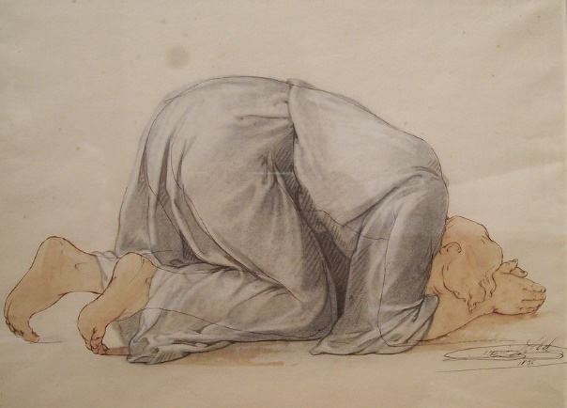
马太福音 Mat 5:3
Poor in spirit 心灵贫乏
Have mercy, O God!
神啊！
可怜我！

Slide 20
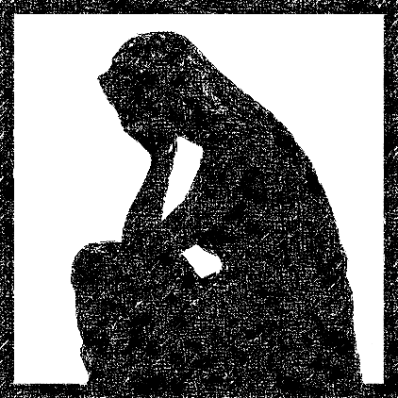
马太福音 Mat 5:4
Mourn 哀恸
为罪哀伤
grief for sin

Slide 21
马太福音 Mat 5:5
Meek 温柔
谦卑等候神来主持公道
Humbly wait upon God
to carry out justice

Slide 22
马太福音 Mat 5:6
Hunger and thirst for righteousness 飢渴慕義
行公义 不妥协
Do righteousness
No compromise

Slide 23
马太福音 Mat 5:7
Merciful 怜恤人
宽恕
Forgive

Slide 24
马太福音 Mat 5:8
Pure in heart 清心
专一
Single-minded

Slide 25
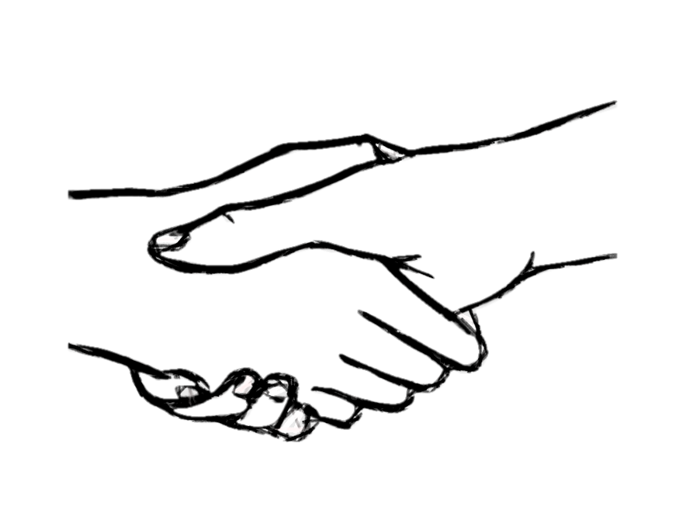
马太福音 Mat 5:9
Peacemakers 使人和睦
与神和好
Reconcile man to God

Slide 26
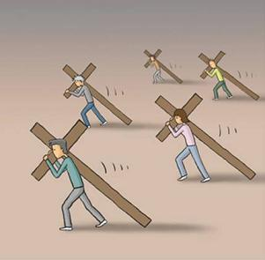
马太福音 Mat 5:10
Being persecuted for righteousness' sake
為義受逼迫
因遵行神的教导而受逼迫
Being persecuted for doing the word of God

Slide 27
马太福音 Mat 5:11
耶稣 - 弥赛亚
Jesus - the Messiah
Blessed are you when men revile you and persecute you and utter all kinds of evil against you falsely on my account.
人若因我辱罵你們、逼迫你們、捏造各樣壞話毀謗你們、你們就有福了。

Slide 28
The End 完

