Slide 1
2018.05.20

Slide 2
The Gospel of Matthew Series 马太福音系列

Slide 3
Turn the Other Cheek 把左颊也转过来 （马太福音 Matthew 5:38-42）

Slide 4
"You have heard that it was said …
But I say to you …
你们听过有这样的吩咐：
可是我告诉你们 …

Slide 5
马太福音 Mat 5:38-39
"You have heard that it was said, `An eye for an eye and a tooth for a tooth.‘
But I say to you, Do not resist one who is evil.
"你们听过有这样的吩咐：'以眼还眼，以牙还牙。'
可是我告诉你们，不要与恶人对抗，

Slide 6
马太福音 Mat 5:39-42
But if any one strikes you on the right cheek, turn to him the other also; ⁴⁰ and if any one would sue you and take your coat, let him have your cloak as well; ⁴¹ and if any one forces you to go one mile, go with him two miles. ⁴² Give to him who begs from you, and do not refuse him who would borrow from you.
有人打你的右脸，把另一边也转过来让他打；
⁴⁰有人要告你，想拿你的衬衫，就连外套也让他拿去。⁴¹有人要强迫你走一里路，就陪他走两里。⁴² 有求你的，就给他；想借贷的，也不可拒绝。

Slide 7
约翰福音 John 6:55-56
For my flesh is food indeed, and my blood is drink indeed. He who eats my flesh and drinks my blood abides in me, and I in him.
因为我的肉是真正的食物，我的血是真正的饮料。⁵⁶ 吃我肉、喝我血的人，就住在我里面，我也住在他里面。

Slide 8
约翰福音 John 6:63
It is the spirit that gives life, the flesh is of no avail; the words that I have spoken to you are spirit and life.
使人活的是灵，肉体是无济于事的。我对你们所说的话是灵、是生命。

Slide 9
歌林多后书 2Co 3:6
God has made us competent to be ministers of a new covenant, not in a written code but in the Spirit; for the written code kills, but the Spirit gives life.
神叫我们能承当这新约的执事。不是凭着字句，乃是凭着精意。因为那字句是叫人死，精意是叫人活。（精意或作圣灵）。

Slide 10
马太福音 Mat 5:39-42
But if any one strikes you on the right cheek, turn to him the other also; ⁴⁰ and if any one would sue you and take your coat, let him have your cloak as well; ⁴¹ and if any one forces you to go one mile, go with him two miles. ⁴² Give to him who begs from you, and do not refuse him who would borrow from you.
有人打你的右脸，把另一边也转过来让他打；
⁴⁰有人要告你，想拿你的衬衫，就连外套也让他拿去。⁴¹有人要强迫你走一里路，就陪他走两里。⁴² 有求你的，就给他；想借贷的，也不可拒绝。

Slide 11
马太福音 (Mat 5:4-9)
"Blessed are those who mourn, for they will be comforted.
"Blessed are the meek, for they will inherit the earth.
"Blessed are the merciful, for they will receive mercy.
"Blessed are the peacemakers, for they will be called children of God
哀恸的人有福了， 因为他们必得安慰。
温柔的人有福了， 因为他们必承受地土
怜悯人的人有福了， 因为他们必蒙怜悯。
使人和睦的人有福了， 因为他们必称为神的儿子。

Slide 12
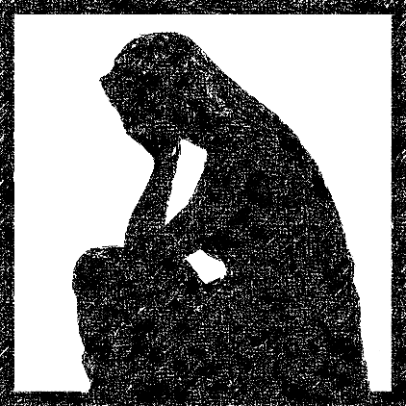
马太福音 Mat 5:4
Mourn 哀恸
为罪哀伤
grief for sin

Slide 13
马太福音 Mat 5:5
Meek 温柔
谦卑等候神来主持公道
Humbly wait upon God
to carry out justice

Slide 14
马太福音 Mat 5:7
Merciful 怜悯人
宽恕
Forgive

Slide 15
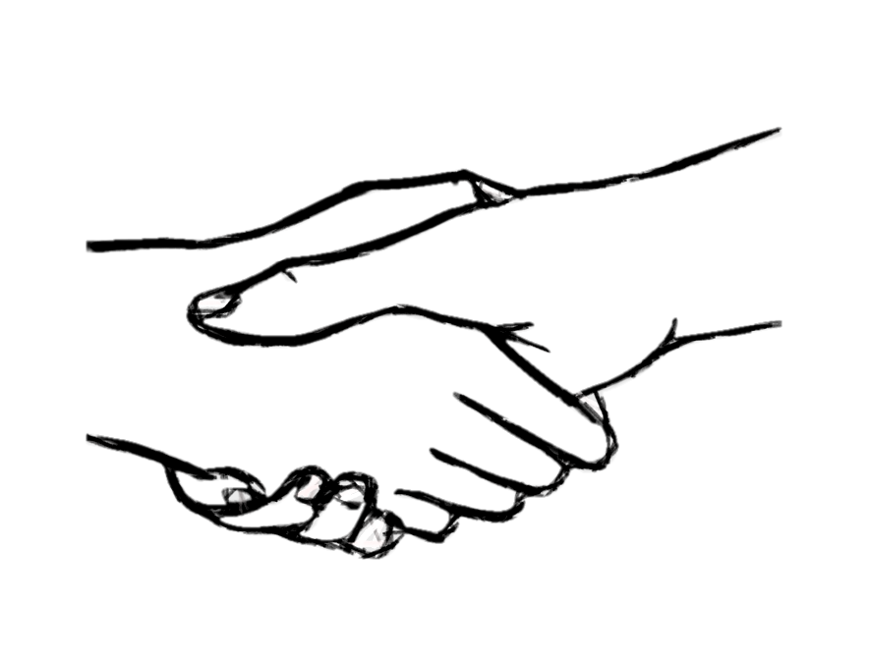
马太福音 Mat 5:9
Peacemakers 使人和睦
与神和好
Reconcile man to God

Slide 16
罗马书 Romans 12:21
Do not be overcome by evil,
but overcome evil with good.
不可被恶所胜，反要以善胜恶。

Slide 17
Compassion
With an intention to save
怜悯之心
为了救他

Slide 18
End

