Slide 1
The Secret Place of God 在隐密处的神
2019.12.08

Slide 2
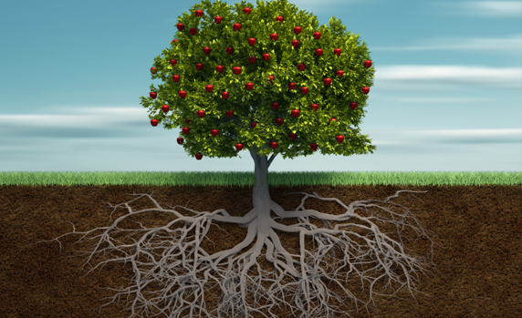
往下扎根 往上结果
Take root downward Bear fruit upward

Slide 3
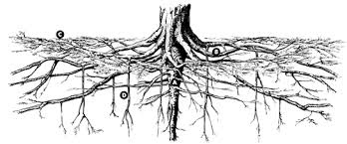
Secret place
隐密处
Do the will of God
遵行神旨意

Slide 4
马太福音 Mat 6:3-4
But when you give alms, do not let your left hand know what your right hand is doing,
⁴ so that your alms may be done in secret; and your Father who sees in secret will reward you.
你施舍的时候，不要让左手知道右手所作的，
⁴ 好使你的施舍是在隐密中行的。你父在隐密中察看，必定报答你。

Slide 5
马太福音 Mat 6:5-6
"And whenever you pray, do not be like the hypocrites; for they love to stand and pray in the synagogues and at the street corners, so that they may be seen by others. Truly I tell you, they have received their reward.
"你们祈祷的时候，不可像伪君子；他们喜欢在会堂和路口站着祈祷，好让人看见。我实在告诉你们，他们已经得了他们的赏赐。

Slide 6
马太福音 Mat 6:5-6
⁶ But whenever you pray, go into your room and shut the door and pray to your Father who is in secret; and your Father who sees in secret will reward you.
但你祈祷的时候，要进到密室里去，关上门，向在隐密中的父祈祷。你父在隐密中察看，必定报答你。

Slide 7
马太福音 Mat 6:17-18
But when you fast, put oil on your head and wash your face, ¹⁸ so that your fasting may be seen not by others but by your Father who is in secret; and your Father who sees in secret will reward you.
可是你禁食的时候，要梳头洗脸，¹⁸ 不要叫人看出你在禁食，只让在隐密中的父看见。你父在隐密中察看，必定报答你。

Slide 8
畏 慰 awesome fear ？ Comfort ？

Slide 9
出埃及记 Exodus 19:16
On the morning of the third day there were thunders and lightnings, and a thick cloud upon the mountain, and a very loud trumpet blast, so that all the people who were in the camp trembled.
到了第三天早晨的时候，山上有雷声、闪电和密云，并且角声非常强大，以致所有在营中的人民都颤抖。

Slide 10
出埃及记 Exodus 19:18
And Mount Sinai was wrapped in smoke, because Yahweh descended upon it in fire; and the smoke of it went up like the smoke of a kiln, and the whole mountain quaked greatly.
西奈全山冒烟，因为雅伟在火中降临到山上；山的烟向上升，好像火窑的烟一样。全山猛烈震动。

Slide 11
出埃及记 Exodus 19:19
And as the sound of the trumpet grew louder and louder, Moses spoke, and God answered him in thunder.
角声越来越大，大到极点的时候，摩西就说话，神用雷声回答摩西。

Slide 12
出埃及记 Exodus 19:12
And you shall set bounds for the people round about, saying, `Take heed that you do not go up into the mountain or touch the border of it; whoever touches the mountain shall be put to death;
你要在山的周围给人民定界限，说：'你们要谨慎，不可上山来，也不可触摸山脚；凡是触摸着那山的，必要把他处死。

Slide 13
马太福音 Mat 6:6
your Father who sees in secret will reward you.
你父在隐密中察看，必定报答你。

Slide 14
马太福音 Mat 6:8
for your Father knows what you need before you ask him.
在你们祈求以先，你们的父已经知道你们的需要了。

Slide 15
The End 完

