Slide 1
2018.08.26

Slide 2
The Gospel of Matthew Series 马太福音系列

Slide 3
The Lord’s Prayer (3) 主祷文 (3) Matthew 马太福音 6.11

Slide 4
Matthew 马太福音 6:11
⁹ So you should pray like this: Our Father in heaven, may your name be held holy, ¹⁰ your kingdom come, your will be done, on earth as in heaven. ¹¹ Give us today our daily bread. ¹² And forgive us our debts, as we have forgiven those who are in debt to us. ¹³ And do not put us to the test, but save us from the evil one. (NJB)
⁹ 所以你们要这样祈祷：我们在天上的父， 愿你的名被尊为圣， ¹⁰ 愿你的国降临， 愿你的旨意成就在地上， 如同在天上一样。 ¹¹ 我们每天所需的食物， 求你今天赐给我们； ¹² 赦免我们的罪， 好像我们饶恕了得罪我们的人； ¹³ 求你让我们不陷诱惑， 救我们脱离那恶者。 《新译本》

Slide 5
Matthew 马太福音 6:11
⁹ So you should pray like this: Our Father in heaven, may your name be held holy, ¹⁰ your kingdom come, your will be done, on earth as in heaven. ¹¹ Give us today our daily bread. ¹² And forgive us our debts, as we have forgiven those who are in debt to us. ¹³ And do not put us to the test, but save us from the evil one. (NJB)
⁹ 所以你们要这样祈祷：我们在天上的父， 愿你的名被尊为圣， ¹⁰ 愿你的国降临， 愿你的旨意成就在地上， 如同在天上一样。 ¹¹ 我们每天所需的食物， 求你今天赐给我们； ¹² 赦免我们的罪， 好像我们饶恕了得罪我们的人； ¹³ 求你让我们不陷诱惑， 救我们脱离那恶者。 《新译本》

Slide 6
Matthew 马太福音 6:11
⁹ So you should pray like this: Our Father in heaven, may your name be held holy, ¹⁰ your kingdom come, your will be done, on earth as in heaven. ¹¹ Give us today our daily bread. ¹² And forgive us our debts, as we have forgiven those who are in debt to us. ¹³ And do not put us to the test, but save us from the evil one. (NJB)
⁹ 所以你们要这样祈祷：我们在天上的父， 愿你的名被尊为圣， ¹⁰ 愿你的国降临， 愿你的旨意成就在地上， 如同在天上一样。 ¹¹ 我们每天所需的食物， 求你今天赐给我们； ¹² 赦免我们的罪， 好像我们饶恕了得罪我们的人； ¹³ 求你让我们不陷诱惑， 救我们脱离那恶者。 《新译本》

Slide 7
Matthew 马太福音 6:11
⁹ So you should pray like this: Our Father in heaven, may your name be held holy, ¹⁰ your kingdom come, your will be done, on earth as in heaven. ¹¹ Give us today our daily bread. ¹² And forgive us our debts, as we have forgiven those who are in debt to us. ¹³ And do not put us to the test, but save us from the evil one. (NJB)
⁹ 所以你们要这样祈祷：我们在天上的父， 愿你的名被尊为圣， ¹⁰ 愿你的国降临， 愿你的旨意成就在地上， 如同在天上一样。 ¹¹ 我们日用的饮食， 今天赐给我们； ¹² 赦免我们的罪， 好像我们饶恕了得罪我们的人； ¹³ 求你让我们不陷诱惑， 救我们脱离那恶者。 《和合本》

Slide 8
Matthew 马太福音 6:11
⁹ So you should pray like this: Our Father in heaven, may your name be held holy, ¹⁰ your kingdom come, your will be done, on earth as in heaven. ¹¹ Give us today our daily bread. ¹² And forgive us our debts, as we have forgiven those who are in debt to us. ¹³ And do not put us to the test, but save us from the evil one. (NJB)
⁹ 所以你们要这样祈祷：我们在天上的父， 愿你的名被尊为圣， ¹⁰ 愿你的国降临， 愿你的旨意成就在地上， 如同在天上一样。 ¹¹ 我们每天所需的食物， 求你今天赐给我们； ¹² 赦免我们的罪， 好像我们饶恕了得罪我们的人； ¹³ 求你让我们不陷诱惑， 救我们脱离那恶者。 《新译本》

Slide 9
Matthew 马太福音 6:11
⁹ So you should pray like this: Our Father in heaven, may your name be held holy, ¹⁰ your kingdom come, your will be done, on earth as in heaven. ¹¹ Give us today our bread for tomorrow. ¹² And forgive us our debts, as we have forgiven those who are in debt to us. ¹³ And do not put us to the test, but save us from the evil one.
⁹ 所以你们要这样祈祷：我们在天上的父， 愿你的名被尊为圣， ¹⁰ 愿你的国降临， 愿你的旨意成就在地上， 如同在天上一样。 ¹¹ 我们明日所需的食物，今日赐给我们； ¹² 赦免我们的罪， 好像我们饶恕了得罪我们的人； ¹³ 求你让我们不陷诱惑， 救我们脱离那恶者。

Slide 10
Luke 路加福音 11:3
² When you pray, this is what to say: Father, may your name be held holy, your kingdom come; ³ give us each day (kath’ imera) our daily bread (ton epiusion), ⁴ and forgive us our sins, for we ourselves forgive each one who is in debt to us. And do not put us to the test. (NJB)
² 你们祈祷的时候，要说：父阿， 愿你的名被尊为圣， 愿你的国降临；³ 我们每天所需(ton epiusion)的粮食， 天天(kath’ imera)赐给我们；⁴ 赦免我们的罪， 因为我们也饶恕所有亏负我们的人； 不要让我们陷入诱惑。

Slide 11
ἐπιούσιον (epi u si on) 1. a sense of immediacy 立即、随即、马上 2. “the following day” 明日

Slide 12
ἐπιούσιον (epi u si on)
“…this difficult word (Mat 6.11, Lk 11.3) was in all probability a new coinage by the author of the Greek Q to render his Aramaic original…
It is much more probable that τὸν ἐπιούσιον should be connected with ἡ ἐπιούσα [ἡμερα] “the immediately following day”, in accordance with the sense of ἐπιεναι “to come close after”.
…The desire to emphasize immediacy made the translator dissatisfied with τὸν τής αὔριον (tomorrow) or the like as a rendering of the Aramaic before him. He followed a right instinct in coining a new adjective from the common term for “the coming day.”
Lightfoot supports this derivation; also Schemiedel, Deissmann and Robertson…… Moulton gives his vote for the immediately following day as being on the whole the most probable etymology.”
(Vocabulary of the Greek Testament---Illustrated from the Papyri and Other Non-Literary Sources, by J.H. Moulton & G. Milligan, page 242)

Slide 13
Give us today the bread for the immediately following day. (literal translation) 立即就到来的明日所需的粮食，求你今日赐给我们。（直译）

Slide 14
The sabbath is arriving soon. Give us double portion of manna today. (paraphrase) 安息日马上就到了，求你今日赐我们双倍的粮食。 （意译）

Slide 15
God’s kingdom is coming to earth soon. The day of salvation is drawing near. Give us the strength we need to survive in these final evil days. 天国马上就降临了。进天国的日子近了。在这邪恶末后的日子，求你天天赐给我们所需的力量，叫我们能忍耐到底而得救。

Slide 16
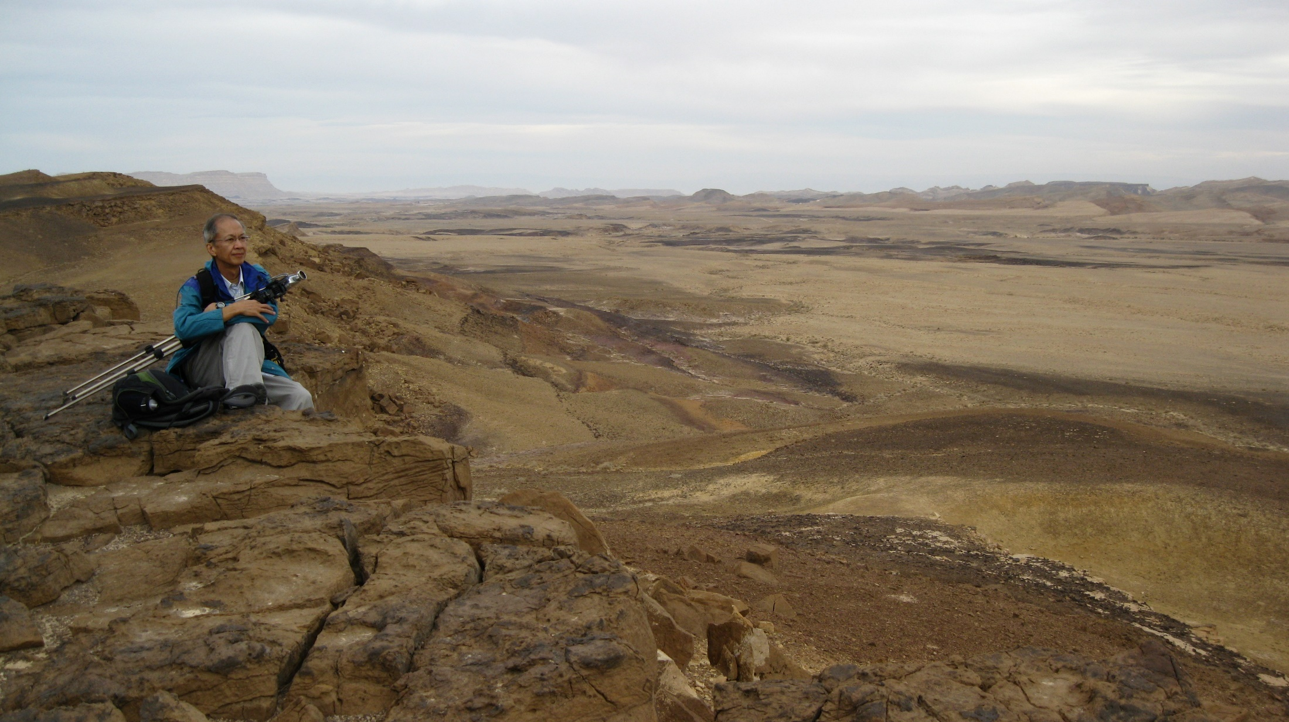

Slide 17
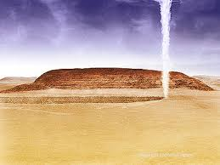

Slide 18
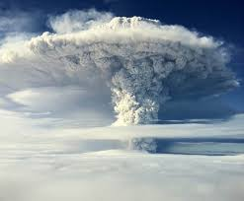

Slide 19
Exodus 出埃及记 13:21-22
²¹ Yahweh went ahead of them in a column of cloud during the daytime to lead them on their way, and at night in a column of fire to give them light; thus they could travel both by day and by night. ²² Neither the column of cloud by day nor the column of fire at night went away from in front of the people. (CJB)
²¹ 雅伟在他们前面行，日间用云柱领他们的路，夜间用火柱光照他们，使他们日夜都可以行走。²² 日间云柱，夜间火柱，都不离开众民的面前。

Slide 20
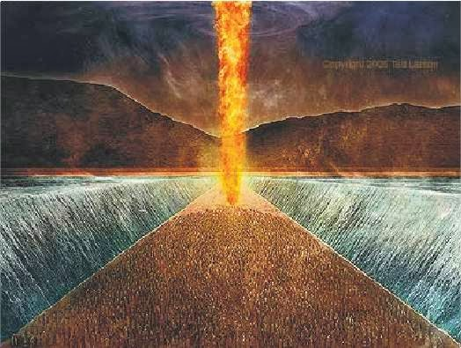

Slide 21
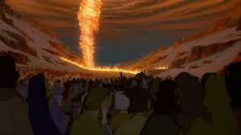

Slide 22
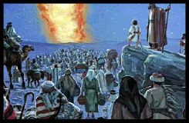

Slide 23
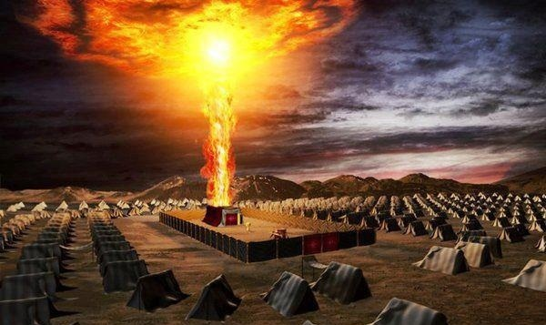

Slide 24
Exodus 出埃及记 16:4-5
⁴ Then Yahweh said to Moses, “Behold, I will rain bread from heaven for you. And the people shall go out and gather a certain quota every day, that I may test them, whether they will walk in My law or not. ⁵ On the sixth day, when they apportion what they have brought in, it will turn out to be twice as much as they gather on the other days.
⁴ 雅伟对摩西说：看哪，我要把粮食从天上降给你们；人民可以出去，每天收取当天的分量，我好试验他们是否遵循我的教导。 ⁵ 到第六天，他们把粮食收进来的时候，会发现比每天收取的多一倍。

Slide 25
Exodus 出埃及记 16:31
³¹ The house of Israel named it manna; it was like coriander seed, white, and it tasted like wafers in honey.
³¹ 以色列家把这饼称作“吗哪”。它有点像芫荽籽，白白的，味道犹如搁了蜜的脆饼。

Slide 26
Exodus 出埃及记 16:26, 30
²⁶ Six days you shall gather it, but on the seventh day, which is the Sabbath, there will be none.
³⁰ So the people rested on the seventh day.
²⁶ 六天你们可以收取，但第七天是安息日，在那一天什么都没有了…… ³⁰ 所以，第七天子民一律休息。

Slide 27
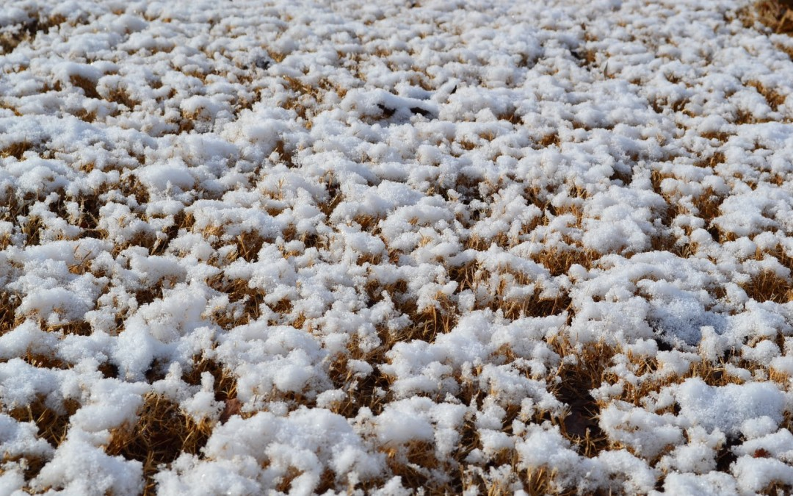

Slide 28
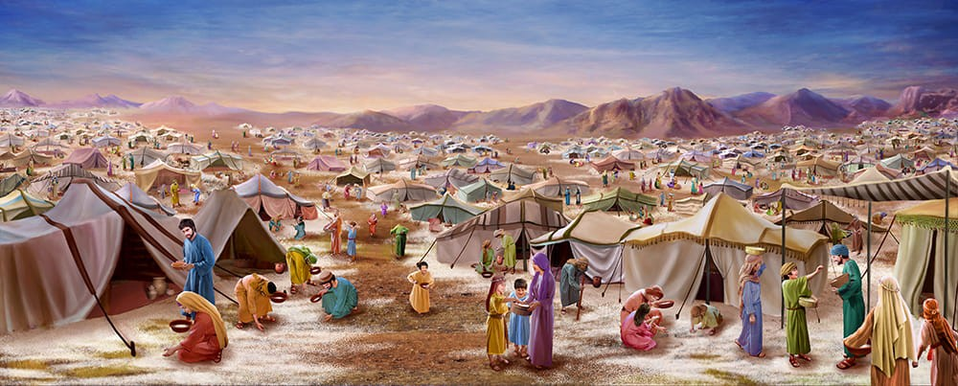

Slide 29
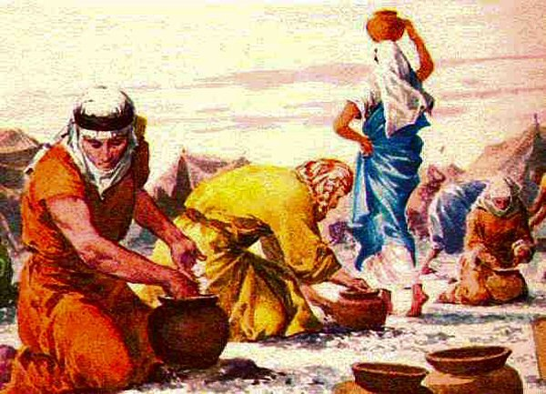

Slide 30
Matthew 马太福音 6:11
¹¹ Give us today our bread for tomorrow.
¹¹ 我们明日所需的食物，今日赐给我们。

Slide 31
The sabbath is arriving soon. Give us double portion of manna today. (paraphrase) 安息日马上就到了，求你今日赐我们双倍的粮食。 （意译）

Slide 32
God’s kingdom is coming to earth soon. The day of salvation is drawing near. Give us the strength we need to survive in these final evil days. 天国马上就降临了。进天国的日子近了。在这邪恶末后的日子，求你天天赐给我们所需的力量，叫我们能忍耐到底而得救。

Slide 33
Luke 路加福音 11:3
² When you pray, this is what to say: Father, may your name be held holy, your kingdom come; ³ give us each day our bread for tomorrow, ⁴ and forgive us our sins, for we ourselves forgive each one who is in debt to us. And do not put us to the test. (NJB)
² 你们祈祷的时候，要说：父阿， 愿你的名被尊为圣， 愿你的国降临；³ 我们明日所需的粮食， 天天赐给我们； ⁴ 赦免我们的罪， 因为我们也饶恕所有亏负我们的人； 不要让我们陷入诱惑。

Slide 34
Luke 路加福音 11:5-6
⁵ He also said to them, “Suppose one of you has a friend; and you go to him in the middle of the night and say to him, ‘Friend, lend me three loaves of bread, ⁶ because a friend of mine who has been travelling has just arrived at my house, and I have nothing for him to eat.’ (CJB)
⁵ 耶稣又对他们说：你们当中，谁有朋友半夜去找他，说：“请你借给我三个饼， ⁶ 因为我有一个朋友旅行来到我这里，我没有什么可以招待他。”

Slide 35
Luke 路加福音 11:7-8
⁷ Now the one inside may answer, ‘Don't bother me! The door is already shut, my children are with me in bed. I can't get up to give you anything!’ ⁸ But I tell you, even if he won't get up because the man is his friend, yet because of the man’s persistence he will get up and give him as much as he needs. (CJB)
⁷ 而他却在里面回答：“不要麻烦我，门已经关好了，孩子也跟我在床上了，我不能起来拿给你。” ⁸ 我告诉你们，即使那人不顾友情不肯起来拿饼，也终于会因为他厚颜地直求而起床，拿出他所需要的一切给他。

Slide 36
Luke 路加福音 11:9-10
⁹ Moreover, I myself say to you: keep asking, and it will be given to you; keep seeking, and you will find; keep knocking, and the door will be opened to you. ¹⁰ For everyone who goes on asking receives; and he who goes on seeking finds; and to him who continues knocking, the door will be opened. (CJB)
⁹ 我又告诉你们，你们继续祈求，就给你们；继续寻找，就寻见；继续叩门，就给你们开门。 ¹⁰ 因为所有继续祈求的就得着，继续寻找的就寻见，继续叩门的就给他开门。

Slide 37
Luke 路加福音 11:11-13
¹¹ Is there any father here who, if his son asked him for a fish, would instead of a fish give him a snake? ¹² or if he asked for an egg would give him a scorpion? ¹³ So if you, even though you are bad, know how to give your children gifts that are good, how much more will the Father keep giving the Holy Spirit from heaven to those who keep asking him! (CJB)
¹¹ 你们中间作父亲的，哪有儿子求鱼，反拿蛇当作鱼给他呢？ ¹² 或求鸡蛋，反给他蝎子呢？ ¹³ 你们虽然不好，尚且知道把好东西给自己的儿女，何况天父，岂不更把圣灵赐给求他的人吗？

Slide 38
Isaiah 以赛亚书 40:28-29
²⁸ The everlasting God, Yahweh,
the Creator of the ends of the earth,
Neither faints nor is weary.
His understanding is unsearchable.
²⁹ He gives power to the weak,
To those who have no might He increases strength.
²⁸ 永在的神、雅伟、地极的创造主
既不疲乏，也不困倦； 他的知识无法测度。
²⁹ 疲乏的，他赐力气，
无力的，他加力量。

Slide 39
Isaiah 以赛亚书 40:30-31
³⁰ Even the youths shall faint and be weary,
And the young men shall utterly fall,
³¹ But those who wait on Yahweh
Shall renew their strength;
They shall mount up with wings like eagles,
They shall run and not be weary,
They shall walk and not faint.
³⁰ 就是年轻人也会疲乏困倦，强壮的人也会跌倒。
³¹ 但那些等候 雅伟的人，必重新得力；
他们必像鹰一样展翅上腾；
他们奔跑，也不困倦，
他们行走，也不疲乏。

Slide 40
Luke 路加福音 11:9-10
⁹ Moreover, I myself say to you: keep asking, and it will be given to you; keep seeking, and you will find; keep knocking, and the door will be opened to you. ¹⁰ For everyone who goes on asking receives; and he who goes on seeking finds; and to him who continues knocking, the door will be opened. (CJB)
⁹ 我又告诉你们，你们继续祈求，就给你们；继续寻找，就寻见；继续叩门，就给你们开门。 ¹⁰ 因为所有继续祈求的就得着，继续寻找的就寻见，继续叩门的就给他开门。

Slide 41
The End 完

Slide 42
www.liverpool.christiandc.org

