Slide 1
2018.09.16

Slide 2
The Gospel of Matthew Series 马太福音系列

Slide 3
Matthew 马太福音 6.16-18 Fasting and Health 禁食与健康

Slide 4
Matthew 马太福音 6:16-18
Moreover, when you fast, do not be like the hypocrites, with a sad countenance. For they disfigure their faces that they may appear to men to be fasting. Assuredly, I say to you, they have their reward. ¹⁷ But you, when you fast, anoint your head and wash your face, ¹⁸ so that you do not appear to men to be fasting, but to your Father who is in the secret place; and your Father who sees in secret will reward you. (NKJ)
你们禁食的时候，不可像伪君子那样愁眉苦脸，他们装成难看的样子，叫人看出他们在禁食。我实在告诉你们，他们已经得了他们的赏赐。 ¹⁷ 可是你禁食的时候，要梳头洗脸， ¹⁸ 不要叫人看出你在禁食，只让在隐密中的父看见。你父在隐密中察看，必定报答你。

Slide 5
Mark 马可福音 2:18
The disciples of John and of the Pharisees practiced fasting. They came and said to Jesus, “Why do John's disciples and the Pharisees' disciples fast, but your disciples do not?” (MIT)
约翰的门徒和法利赛人正在禁食，有人来问耶稣说：为什么约翰的门徒和法利赛人的门徒常常禁食，你的门徒却不禁食呢？

Slide 6
Matthew 马太福音 4:1-2
Then Jesus was led up by the Spirit into the wilderness to be tempted by the devil. ² And when he had fasted forty days and forty nights, afterward he was hungry. (NKJ)
随后，耶稣被圣灵带到旷野，受魔鬼的试探。 ² 耶稣禁食了四十昼夜，就饿了。

Slide 7
Therapeutic fast vs the Biblical fast 治疗禁食 与 圣经禁食观

Slide 8
The Fast Sanatorium 禁食疗养院

Slide 9
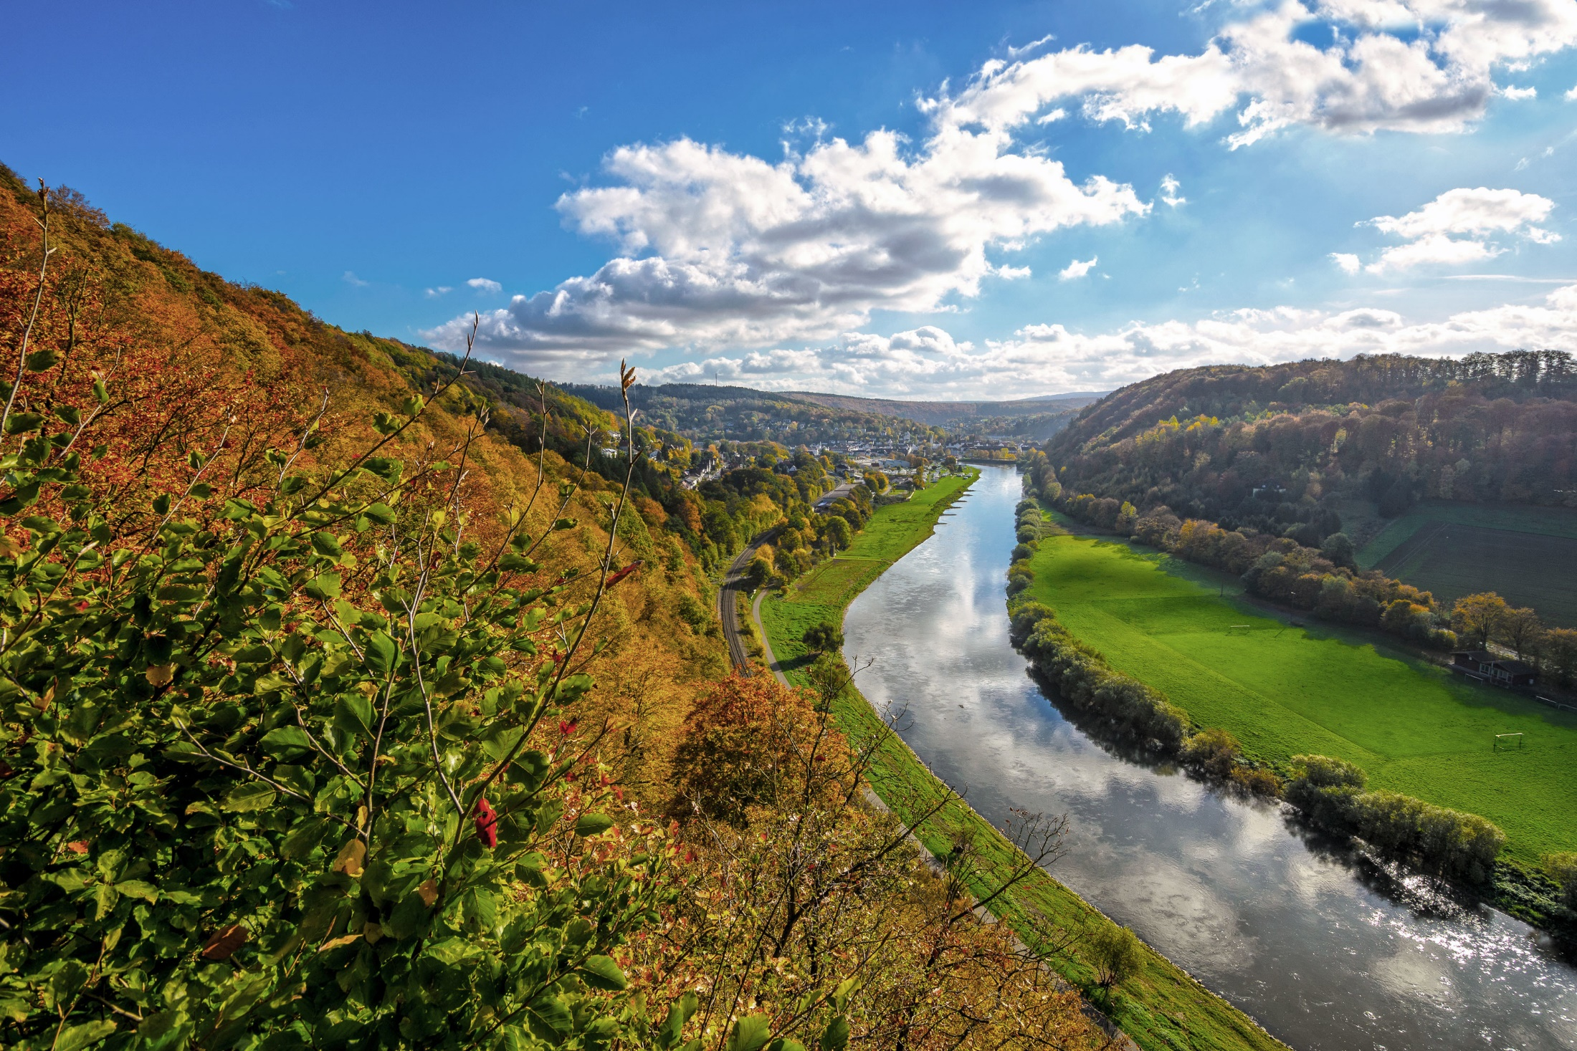

Slide 10
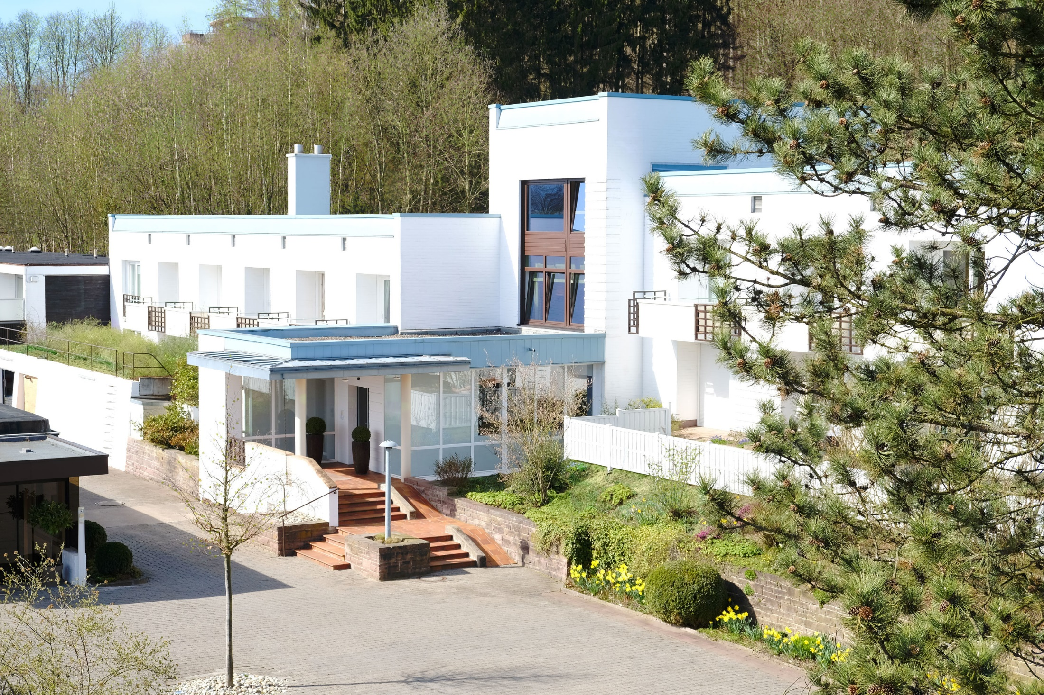

Slide 12
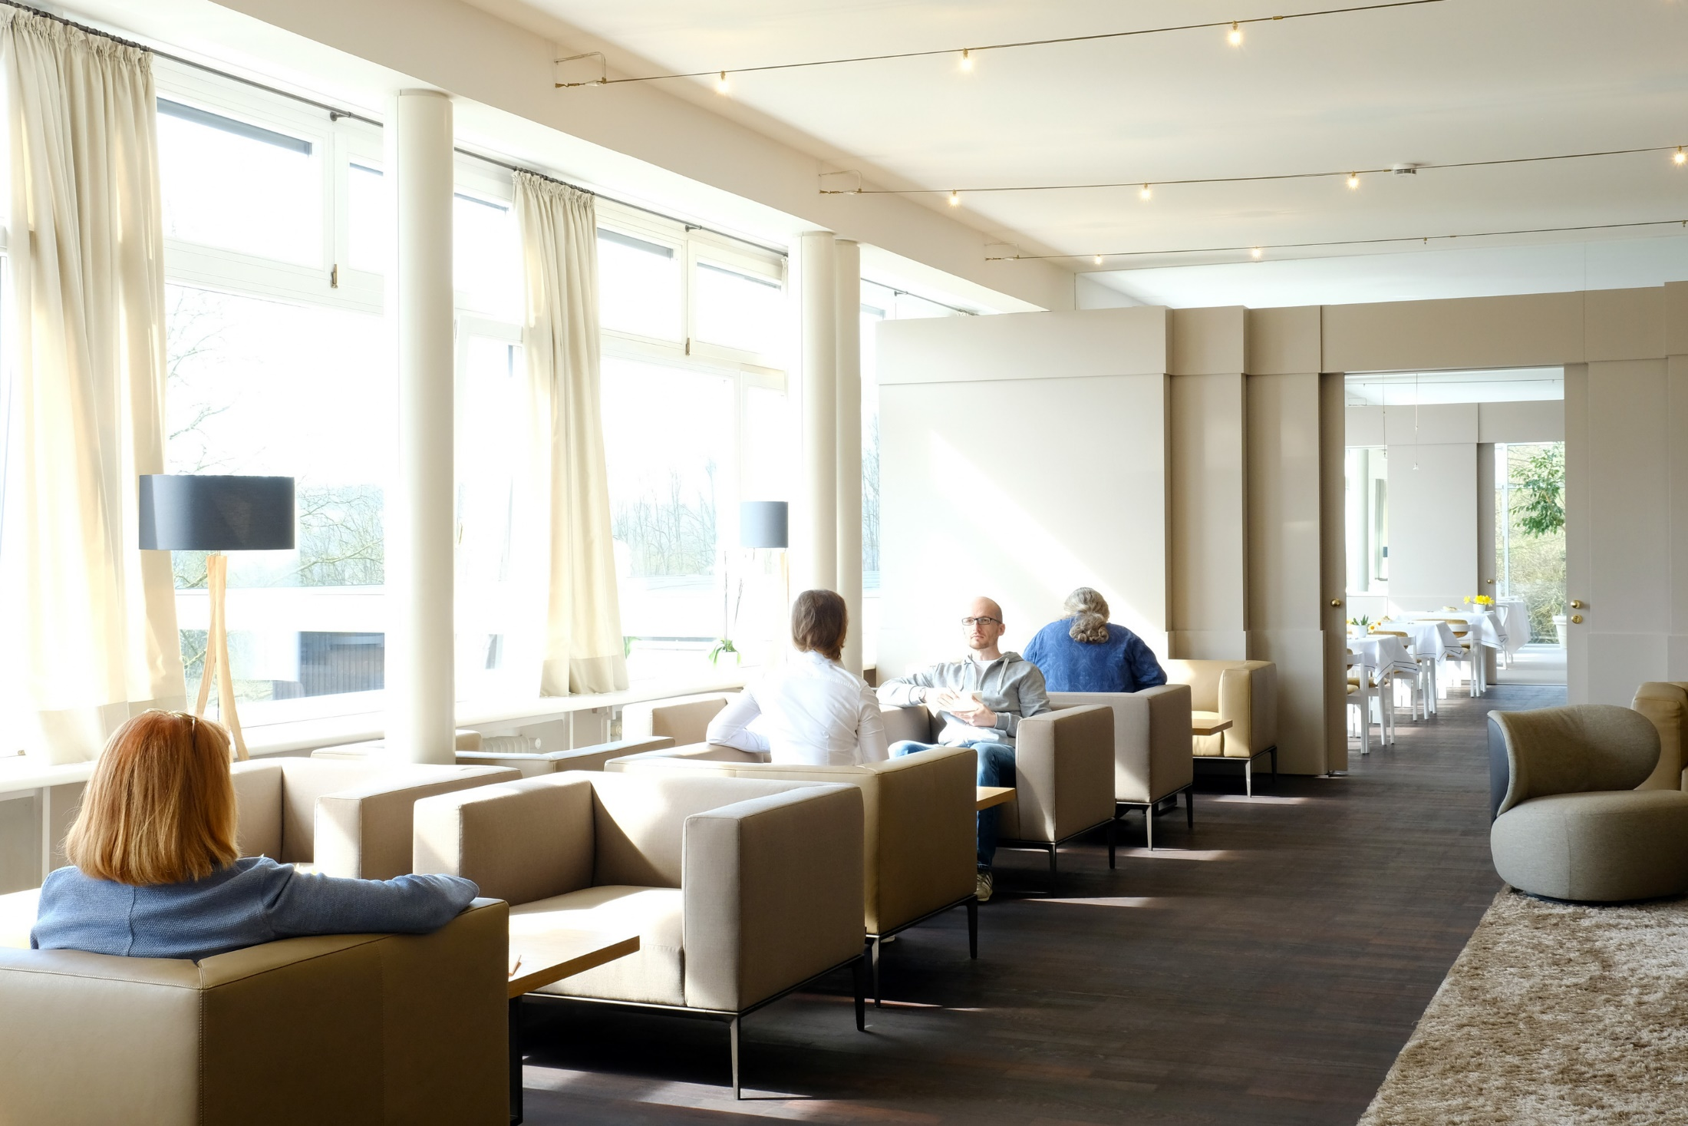

Slide 14
House Rules 疗养院规矩

Slide 15
Treatment Overview 治疗概况

Slide 16
1. Consultation, examination, treatment plan 2. Last meal before fast: fruits only 3. Colon cleansing 4. Fast begins (21 days) 5. Breaking the fast 6. Building up the body gradually: 5 days light meals 7. Looking ahead & departure 1. 问诊、体检、治疗方案 2. 禁食前夕水果餐 3. 清洗结肠 4. 开始禁食21天 5. 21天后停止禁食 6. 禁食后5天清茶淡饭，让身体慢慢地强壮起来 7. 展望未来

Slide 17
1. Consultation, examination, treatment plan 2. Last meal before fast: fruits only 3. Colon cleansing 4. Fast begins (21 days) 5. Breaking the fast 6. Building up the body gradually: 5 days light meals 7. Looking ahead & departure 1. 问诊、体检、治疗方案 2. 禁食前夕水果餐 3. 清洗结肠 4. 开始禁食21天 5. 21天后停止禁食 6. 禁食后5天清茶淡饭，让身体慢慢地强壮起来 7. 展望未来

Slide 18
1. Consultation, examination, treatment plan 2. Last meal before fast: fruits only 3. Colon cleansing 4. Fast begins (21 days) 5. Breaking the fast 6. Building up the body gradually: 5 days light meals 7. Looking ahead & departure 1. 问诊、体检、治疗方案 2. 禁食前夕水果餐 3. 清洗结肠 4. 开始禁食21天 5. 21天后停止禁食 6. 禁食后5天清茶淡饭，让身体慢慢地强壮起来 7. 展望未来

Slide 19
1. Consultation, examination, treatment plan 2. Last meal before fast: fruits only 3. Colon cleansing 4. Fast begins (21 days) 5. Breaking the fast 6. Building up the body gradually: 5 days light meals 7. Looking ahead & departure 1. 问诊、体检、治疗方案 2. 禁食前夕水果餐 3. 清洗结肠 4. 开始禁食21天 5. 21天后停止禁食 6. 禁食后5天清茶淡饭，让身体慢慢地强壮起来 7. 展望未来

Slide 20
1. Consultation, examination, treatment plan 2. Last meal before fast: fruits only 3. Colon cleansing 4. Fast begins (21 days) 5. Breaking the fast 6. Building up the body gradually: 5 days light meals 7. Looking ahead & departure 1. 问诊、体检、治疗方案 2. 禁食前夕水果餐 3. 清洗结肠 4. 开始禁食21天 5. 21天后停止禁食 6. 禁食后5天清茶淡饭，让身体慢慢地强壮起来 7. 展望未来

Slide 21
1. Consultation, examination, treatment plan 2. Last meal before fast: fruits only 3. Colon cleansing 4. Fast begins (21 days) 5. Breaking the fast 6. Building up the body gradually: 5 days light meals 7. Looking ahead & departure 1. 问诊、体检、治疗方案 2. 禁食前夕水果餐 3. 清洗结肠 4. 开始禁食21天 5. 21天后停止禁食 6. 禁食后5天清茶淡饭，让身体慢慢地强壮起来 7. 展望未来

Slide 22
1. Consultation, examination, treatment plan 2. Last meal before fast: fruits only 3. Colon cleansing 4. Fast begins (21 days) 5. Breaking the fast 6. Building up the body gradually: 5 days light meals 7. Looking ahead & departure 1. 问诊、体检、治疗方案 2. 禁食前夕水果餐 3. 清洗结肠 4. 开始禁食21天 5. 21天后停止禁食 6. 禁食后5天清茶淡饭，让身体慢慢地强壮起来 7. 展望未来

Slide 23
Daily routine 每天例行公事

Slide 24
Morning Morning walk, consultation 11am 1 cup of freshly pressed fruit / vegetable juice If thirsty during the day, drink water 12-2:30pm Rest in bed Afternoon Afternoon walk Evening Health education lectures 早晨 散步，或会诊 11点 鲜榨蔬果汁一杯 白天感到可渴了，就喝净化矿泉水 12-2:20 午休 下午 散步 晚上 健康讲座

Slide 25
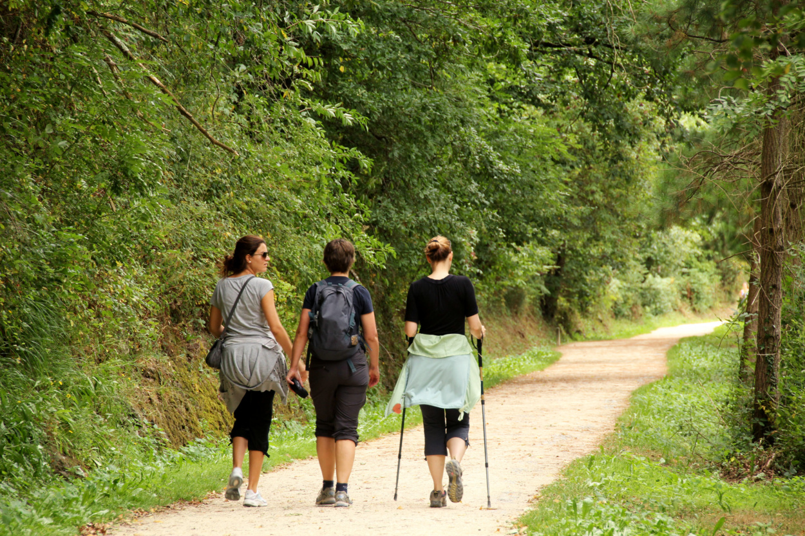

Slide 26
Morning Morning walk, consultation 11am 1 cup of freshly pressed fruit / vegetable juice If thirsty during the day, drink water 12-2:30pm Rest in bed Afternoon Afternoon walk Evening Health education lectures 早晨 散步，或会诊 11点 鲜榨蔬果汁一杯 白天感到可渴了，就喝净化矿泉水 12-2:20 午休 下午 散步 晚上 健康讲座

Slide 27
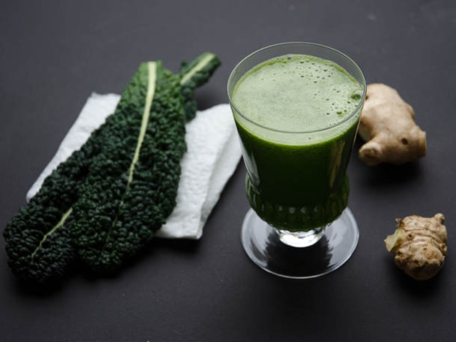

Slide 28
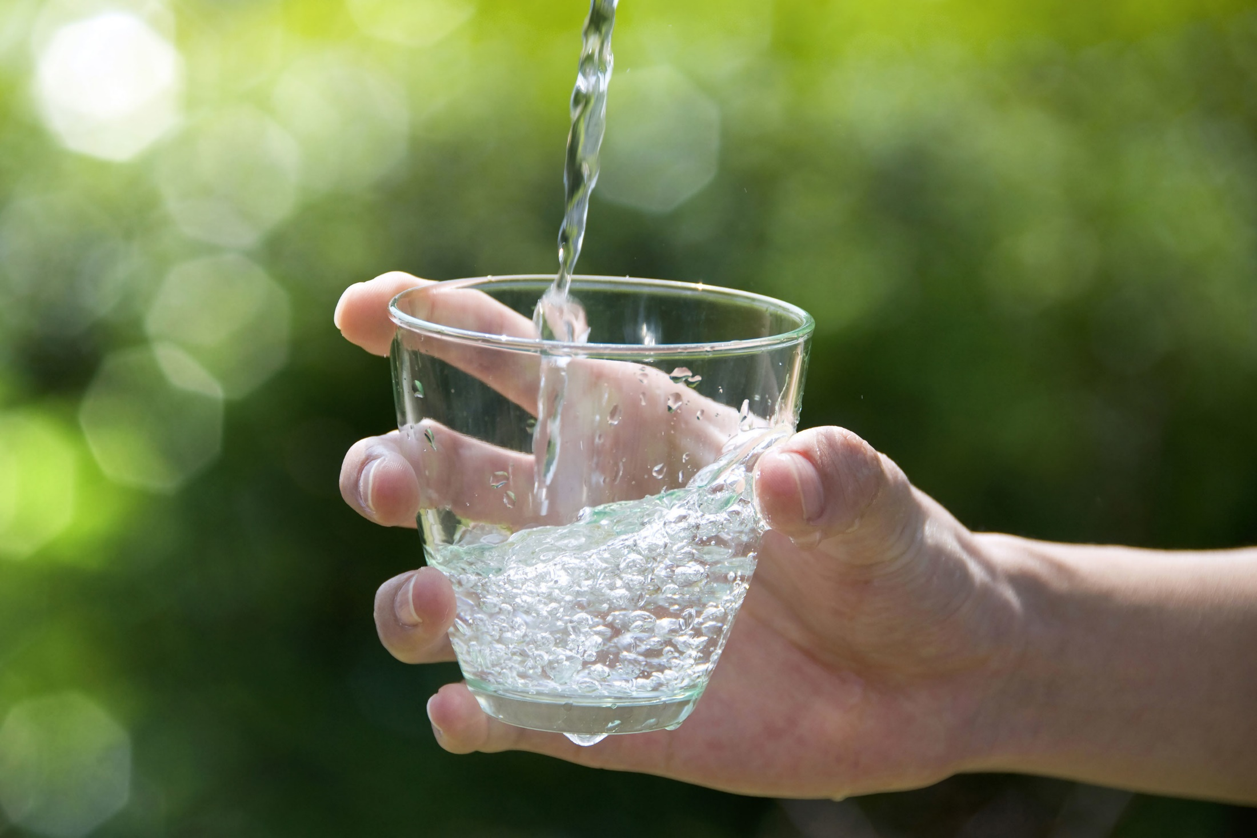

Slide 29
Morning Morning walk, consultation 11am 1 cup of freshly pressed fruit / vegetable juice If thirsty during the day, drink water 12-2:30pm Rest in bed Afternoon Afternoon walk Evening Health education lectures 早晨 散步，或会诊 11点 鲜榨蔬果汁一杯 白天感到可渴了，就喝净化矿泉水 12-2:20 午休 下午 散步 晚上 健康讲座

Slide 30
Morning Morning walk, consultation 11am 1 cup of freshly pressed fruit / vegetable juice If thirsty during the day, drink water 12-2:30pm Rest in bed Afternoon Afternoon walk Evening Health education lectures 早晨 散步，或会诊 11点 鲜榨蔬果汁一杯 白天感到可渴了，就喝净化矿泉水 12-2:20 午休 下午 散步 晚上 健康讲座

Slide 31
Celebrate the breaking of the fast 庆祝禁食成功

Slide 32
The 5 building-up days 禁食后5天清茶淡饭

Slide 33
Training of the will, the whole person 意志力的锻炼、全人的锻炼

Slide 34
Flushing 冲洗

Slide 35
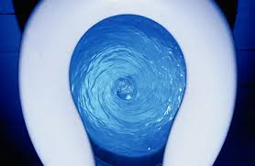

Slide 36
Flushing Burning 洗、烧

Slide 37
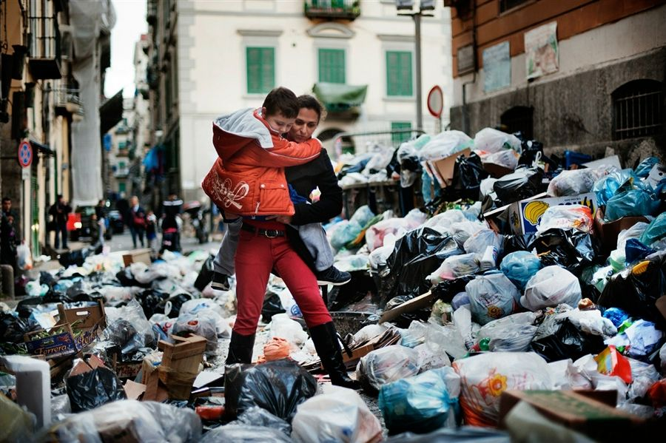

Slide 38
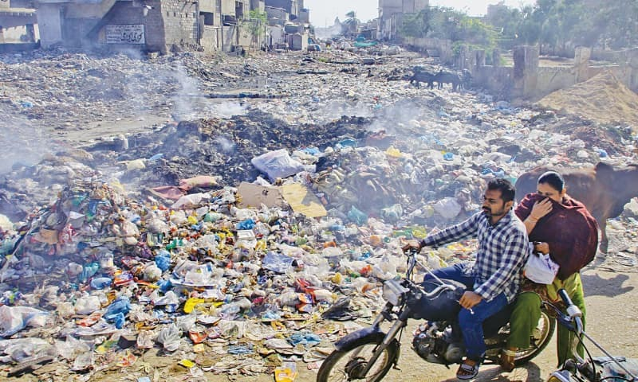

Slide 39
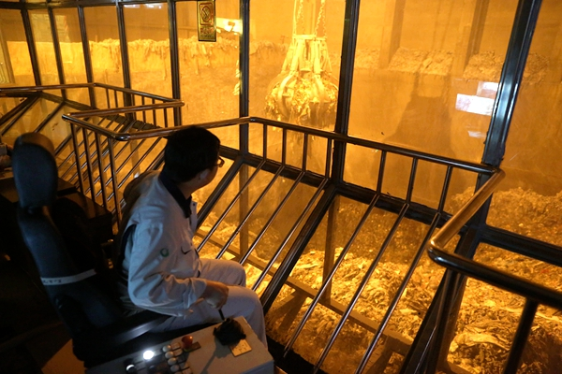

Slide 40
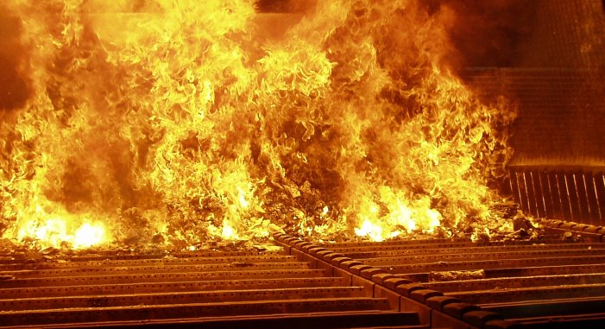

Slide 41
Flushing Burning Healing 洗、烧、恢复健康

Slide 43
Therapeutic Fast 1. Heal diseases by eliminating poisons in the body & building up the immune system 2. Strengthen the will & the spirit of man, to rise above the mundane and desires 治疗禁食 1. 通过排毒和加强免疫能力，达到治病的目的。 2. 通过对欲念加以克制，加强意志和心灵的 力 量，使内心能不受世俗欲念的影响。

Slide 44
The Biblical Fast 1. Purpose: love of God and man’s sanctification. By checking desire for food, strengthen the will & the spirit of man to rise above the mundane. 2. Due to elimination of poisons & strengthening of the immune system, health improves. 圣经禁食观 1. 目的：爱上帝，成聖——通过对欲念加以克 制，加强意志和心灵的力量，内心不受世俗 欲念的影响。 2. 因着排毒和免疫能力加强，健康得以改善。

Slide 45
Matthew 马太福音 4:1-2
Then Jesus was led up by the Spirit into the wilderness to be tempted by the devil. ² And when he had fasted forty days and forty nights, afterward he was hungry. (NKJ)
随后，耶稣被圣灵带到旷野，受魔鬼的诱惑。 ² 耶稣禁食了四十昼夜，就饿了。

Slide 46
Deuteronomy 申命记 8:3
So He humbled you, allowed you to hunger, and fed you with manna which you did not know nor did your fathers know, that He might make you know that man shall not live by bread alone; but man lives by every word that proceeds from the mouth of Yahweh.
他使你受苦，任你饥饿，把你和你的列祖不认识的吗哪赐给你吃，使你知道人活着，不是单靠食物，更要靠雅伟口里所出的一切话。

Slide 47
Romans 罗马书 8:13-14
For if you live according to the flesh you will die; but if by the Spirit you put to death the deeds of the body, you will live. ¹⁴ For as many as are led by the Spirit of God, these are sons of God.
如果随着肉体而活，你们必定死；如果靠着圣灵治死身体的恶行，你们就必活着。 ¹⁴ 因为蒙 神的灵引导的，都是 神的儿子。

Slide 48
Jesus, Thine All-victorious Love by Charles Wesley (1707-88) 耶稣全胜大爱

Slide 49
Jesus, thine all-victorious love shed in my heart abroad. Then shall my heart no longer rove, rooted and fixed in God
Oh, that in me the sacred fire might now begin to glow. Burn up the dross of base desire and make the mountains flow
Refining fire, go through my heart, illuminate my soul. Scatter thy life through every part and sanctify the whole
My steadfast soul from falling free shall then no longer move. While Christ is all the world to me and my heart is love
1 耶稣你的全胜大爱 丰富浇灌我心，我脚不复盘旋在外，神内生根稳定。
2 神圣灵火燎我心灵，从今发出光辉，烧尽贪欲、污秽浮渣，刚硬的心融化。
4 思想意念灵火燔审，照亮我的灵魂，神的生命充满我身，全人洁净成聖。
5 心志忠实不复动摇，流浪在外不再。基督如今是我至宝，我心充满了爱。

Slide 50
The End 完

Slide 51
www.liverpool.christiandc.org

