Slide 1
2019.06.30

Slide 2
The Gospel of Matthew Series 马太福音系列

Slide 3
If your eye is sound, your whole body will be full of light 眼睛若健全 全身就明亮 （马太福音 Matthew 6:22-23）

Slide 4
Matthew 6:22
The eye is the lamp of the body. So, if your eye is sound, your whole body will be full of light;
眼睛就是身体的灯。如果你的眼睛健全，全身就都明亮；

Slide 5
Matthew 6:23
but if your eye is not sound, your whole body will be full of darkness. If then the light in you is darkness, how great is the darkness!
如果你的眼睛有毛病，全身就都黑暗。如果你里面的光变成黑暗，这是多么的黑暗！

Slide 6
ἁπλοῦς
Single
专一

Slide 7
Multi-task 一心多用

Slide 11
Focus 专注

Slide 13
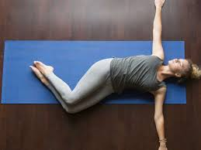

Slide 16
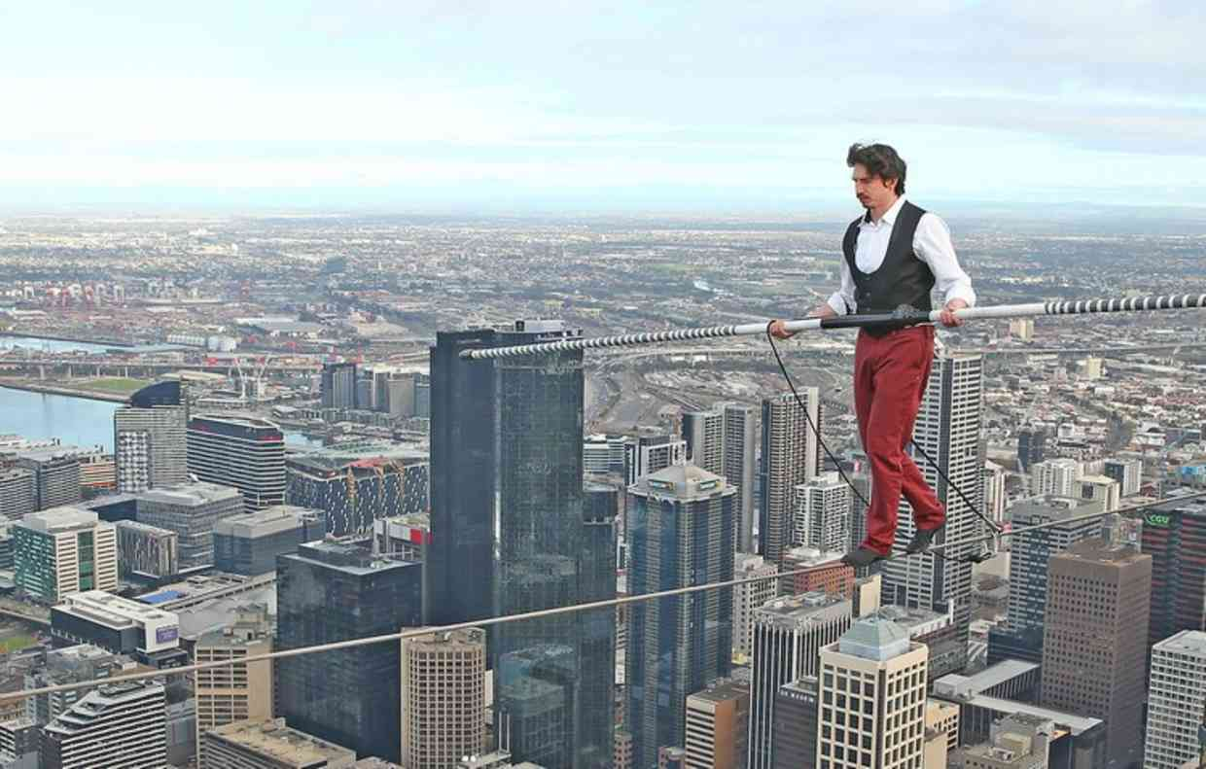

Slide 17
James 1:7-8
For that person must not suppose that a double-minded man, ⁸ unstable in all his ways, will receive anything from the Lord.
那样的人，不要想从主得到什么，因为三心两意的人，在他的一切道路上，都摇摆不定。

Slide 18
Matthew 5:8
Blessed are the pure in heart, for they shall see God.
清心的人有福了，因为他们必得见神。

