Slide 1
2018.10.14

Slide 2
The Gospel of Matthew Series 马太福音系列

Slide 3
Your heavenly Father knows your need 天父知道你们所需的一切 （马太福音 Matthew 6:25-34）

Slide 4
马太福音 Mat 6:19-21
"Do not store up for yourselves treasures on earth, where moth and rust destroy, and where thieves break in and steal. ²⁰ "But store up for yourselves treasures in heaven, where neither moth nor rust destroys, and where thieves do not break in or steal; ²¹ for where your treasure is, there your heart will be also.
"不可为自己在地上积聚财宝，因为地上有虫蛀，有锈侵蚀，也有贼挖洞来偷。 ²⁰ 要为自己积聚财宝在天上，那里没有虫蛀锈蚀，也没有贼挖洞来偷。 ²¹ 因为你的财宝在哪里，你的心也在哪里。

Slide 5
马太福音 Mat 6:22-23
"The eye is the lamp of the body. So, if your eye is sound, your whole body will be full of light; ²³ but if your eye is not sound, your whole body will be full of darkness. If then the light in you is darkness, how great is the darkness!
"眼睛就是身体的灯。如果你的眼睛健全，全身就都明亮； ²³ 如果你的眼睛有毛病，全身就都黑暗。如果你里面的光变成黑暗，这是多么的黑暗！

Slide 6
马太福音 Mat 6:24
"No one can serve two masters; for either he will hate the one and love the other, or he will be devoted to the one and despise the other. You cannot serve God and mammon (money).
"一个人不能服事两个主人；他若不是恨这个爱那个，就是忠于这个轻视那个。你们不能服事神，又服事金钱。

Slide 7
马太福音 Mat 6:25
"Therefore I tell you, do not be anxious about your life, what you shall eat or what you shall drink, nor about your body, what you shall put on. Is not life more than food, and the body more than clothing?
所以我告诉你们，不要为生命忧虑吃什么喝什么，也不要为身体忧虑穿什么。难道生命不比食物重要吗？身体不比衣服重要吗？

Slide 8
马太福音 Mat 6:25
Is not life more than food,
and the body more than clothing?
难道生命不比食物重要吗？
身体不比衣服重要吗？

Slide 9
马太福音 Mat 6:33
Seek first his kingdom and his righteousness,
and all these things shall be yours as well.
你们要先求他的国和他的义，
这一切都必加给你们。

Slide 10
马太福音 Mat 6:32
Your heavenly Father knows
that you need them all.
你们的天父原知道
你们需要这一切

Slide 11
马太福音 Mat 6:26
Look at the birds of the air: they neither sow nor reap nor gather into barns, and yet your heavenly Father feeds them. Are you not of more value than they?
你们看天空的飞鸟：它们不撒种，不收割，也不收进仓里，你们的天父尚且养活它们；难道你们不比它们更宝贵吗？

Slide 12
马太福音 Mat 6:28-29
And why are you anxious about clothing? Consider the lilies of the field, how they grow; they neither toil nor spin; yet I tell you, even Solomon in all his glory was not arrayed like one of these.
何必为衣服忧虑呢？试想田野的百合花怎样生长，它们不劳苦，也不纺织。但我告诉你们，就是所罗门最威荣的时候所穿的，也比不上这花中的一朵。

Slide 14
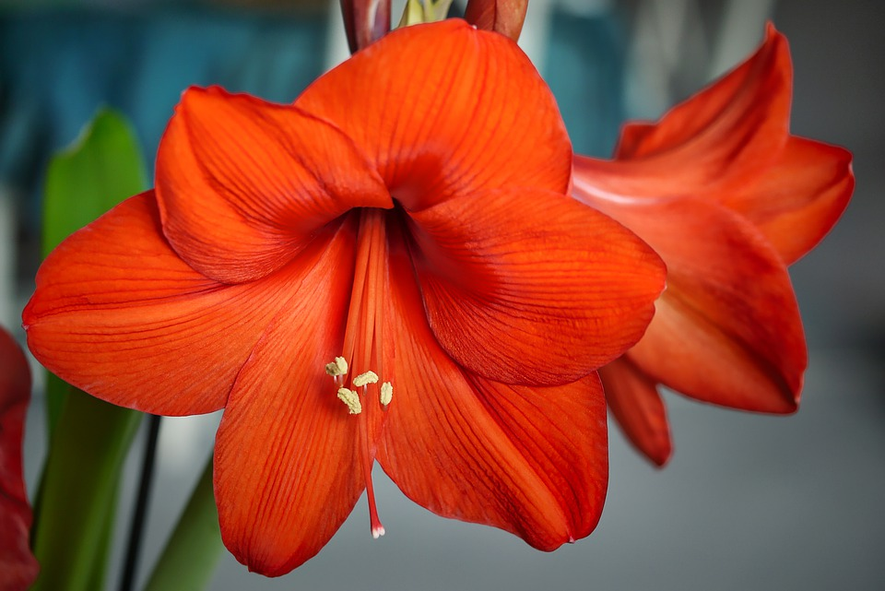

Slide 16
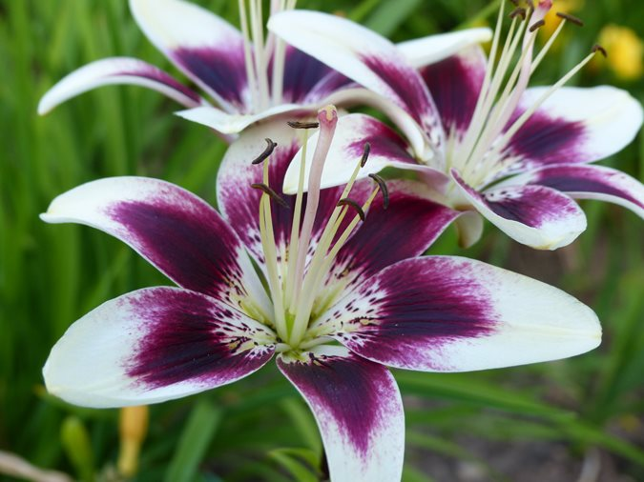

Slide 17
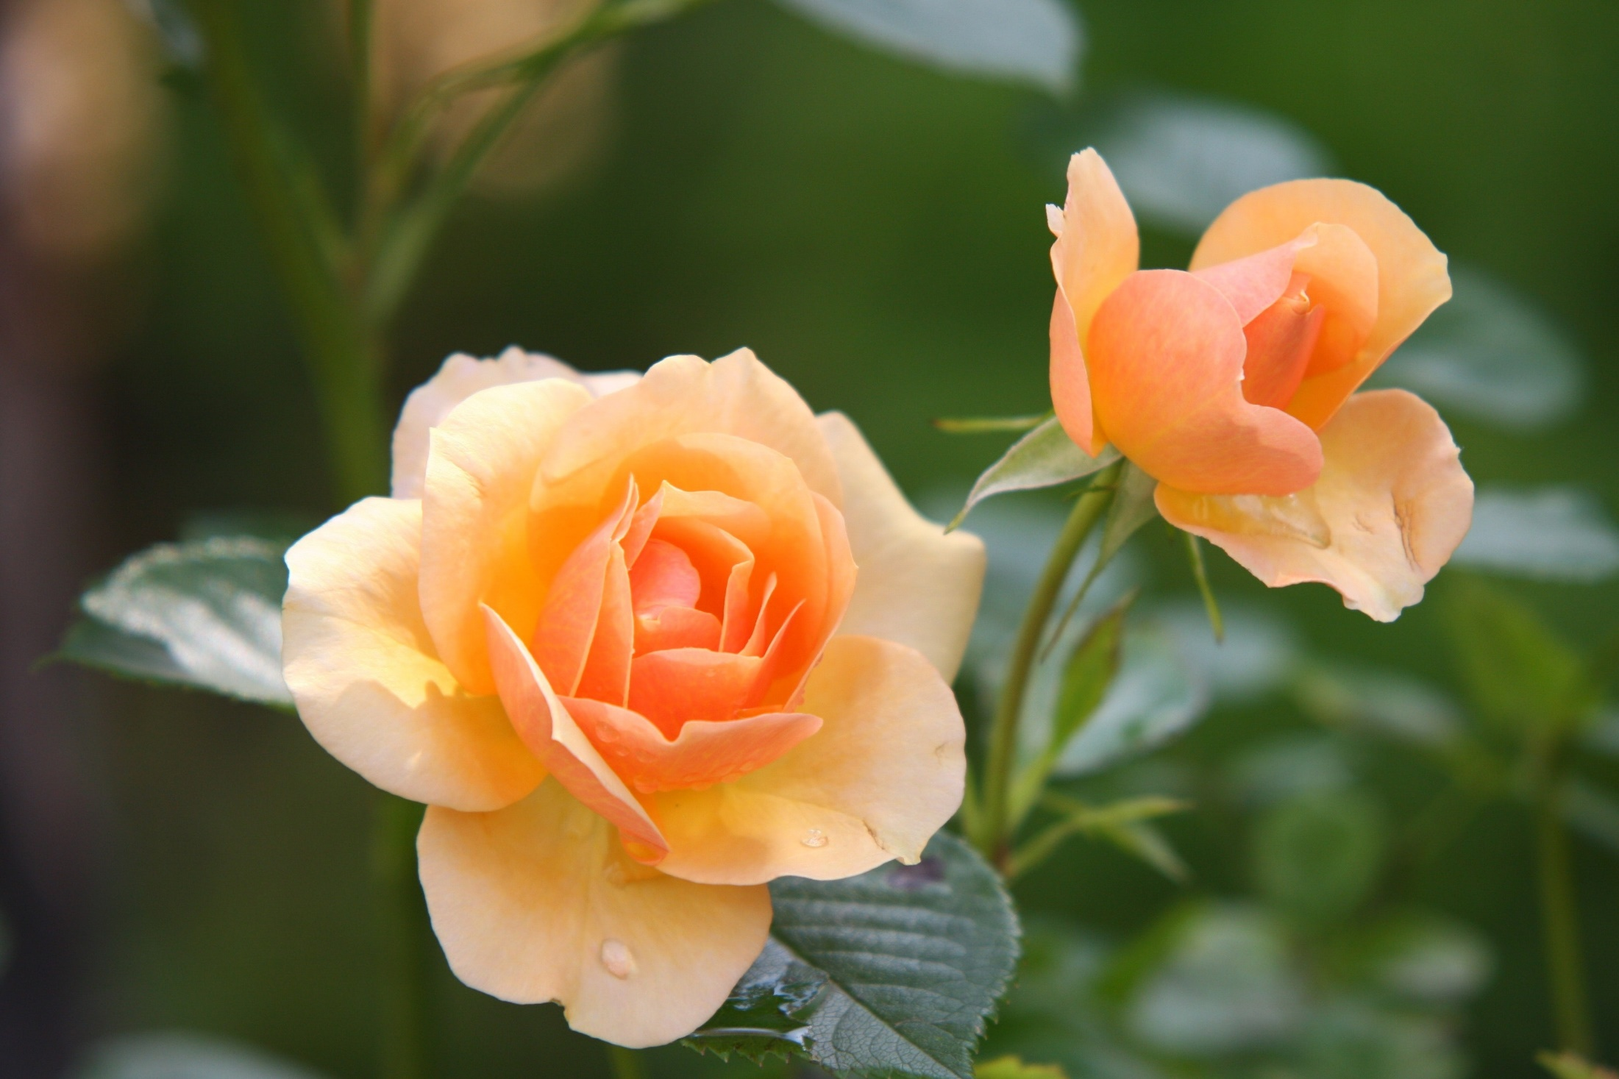

Slide 20
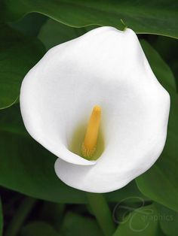

Slide 21
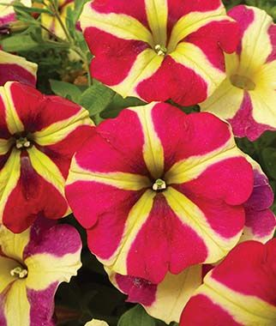

Slide 22
马太福音 Mat 6:30
But if God so clothes the grass of the field, which today is alive and tomorrow is thrown into the oven, will he not much more clothe you, O men of little faith?
田野的草，今天还在，明天就投进炉里， 神尚且这样妆扮它们；小信的人哪，何况你们呢？

Slide 23
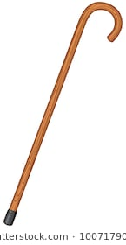
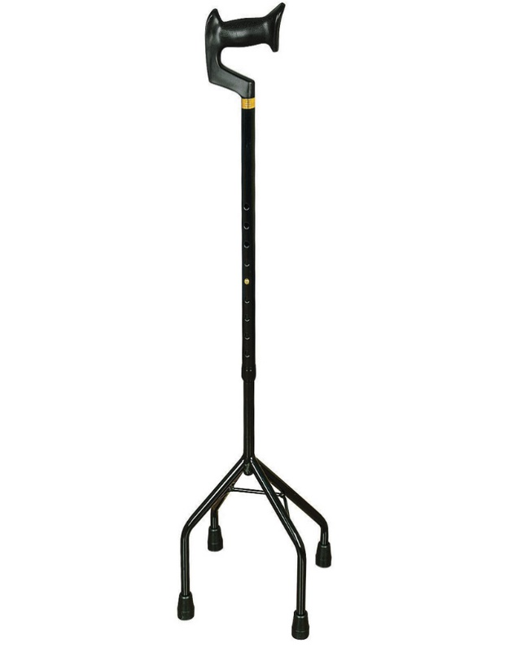
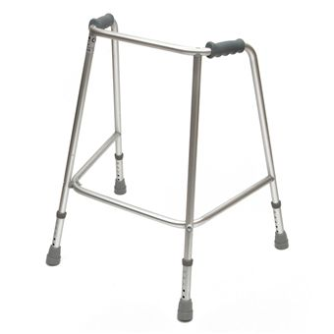

Slide 24
以赛亚书 Isaiah 30:15
For thus said the Lord Yahweh, the Holy One of Israel, "In returning and rest you shall be saved; in quietness and in trust shall be your strength." And you would not,
因为主雅伟以色列的圣者这样说："你们得救在于悔改和安息，你们得力在于平静和信靠。" 但你们竟不愿意。

Slide 25
马太福音 Mat 6:27
And which of you by being anxious can add one cubit to his span of life?
你们中间谁能用忧虑使自己的寿命延长一刻呢？

Slide 26
彼得前书 1Pe 5:6-7
Therefore humble yourselves under the mighty hand of God, that He may exalt you at the proper time, ⁷ casting all your anxiety on Him, because He cares for you.
所以你们要谦卑，服在神大能的手下，到了时候，他必叫你们升高。⁷ 你们要把一切忧虑卸给神，因为他顾念你们。

Slide 27
马太福音 Mat 6:31-32
Therefore do not be anxious, saying, `What shall we eat?' or `What shall we drink?' or `What shall we wear?’ For the Gentiles seek all these things; and your heavenly Father knows that you need them all.
所以不要忧虑，说：'我们该吃什么？喝什么？穿什么？’ 这些都是教外人所寻求的，你们的天父原知道你们需要这一切。

Slide 28
马太福音 Mat 6:33-34
But seek first his kingdom and his righteousness, and all these things shall be yours as well. "Therefore do not be anxious about tomorrow, for tomorrow will be anxious for itself. Let the day's own trouble be sufficient for the day.
你们要先求他的国和他的义，这一切都必加给你们。所以不要为明天忧虑，因为明天自有明天的忧虑，一天的难处一天当就够了。"

Slide 29
End

