Slide 1
The Gospel of Matthew Series 马太福音系列

Slide 2
马太福音 Mat 7 Final remarks 结语

Slide 3
马太福音 Mat 7:21
“不是每一个对我说：‘主啊，主啊！’的人，都能进入天国，唯有遵行我天父旨意的人，才能进去。
"Not every one who says to me, `Lord, Lord,' shall enter the kingdom of heaven, but he who does the will of my Father who is in heaven.

Slide 4
马太福音 Matthew 7:24-27
²⁴ 所以，凡听见我这话就去行的，好比一个聪明人，把房子盖在磐石上； ²⁵ 雨淋，水沖，风吹，撞着那房子，房子总不倒塌，因为根基立在磐石上。
²⁴ Everyone then who hears these words of mine and does them will be like a wise man who built his house on the rock. ²⁵ And the rain fell, and the floods came, and the winds blew and beat on that house, but it did not fall, because it had been founded on the rock.

Slide 5
马太福音 Matthew 7:24-27
²⁶ 凡听见我这话不去行的，好比一个无知的人，把房子盖在沙土上； ²⁷ 雨淋，水沖，风吹，撞着那房子，房子就倒塌了，并且倒塌得很大。
²⁶ And everyone who hears these words of mine and does not do them will be like a foolish man who built his house on the sand. ²⁷ And the rain fell, and the floods came, and the winds blew and beat against that house, and it fell, and great was the fall of it.”

Slide 6
马太福音 Matthew 7:24-27
²⁴ 所以，凡听见我这话就去行的，好比一个聪明人，把房子盖在磐石上； ²⁵ 雨淋，水沖，风吹，撞着那房子，房子总不倒塌，因为根基立在磐石上。
²⁴ Everyone then who hears these words of mine and does them will be like a wise man who built his house on the rock. ²⁵ And the rain fell, and the floods came, and the winds blew and beat on that house, but it did not fall, because it had been founded on the rock.

Slide 7
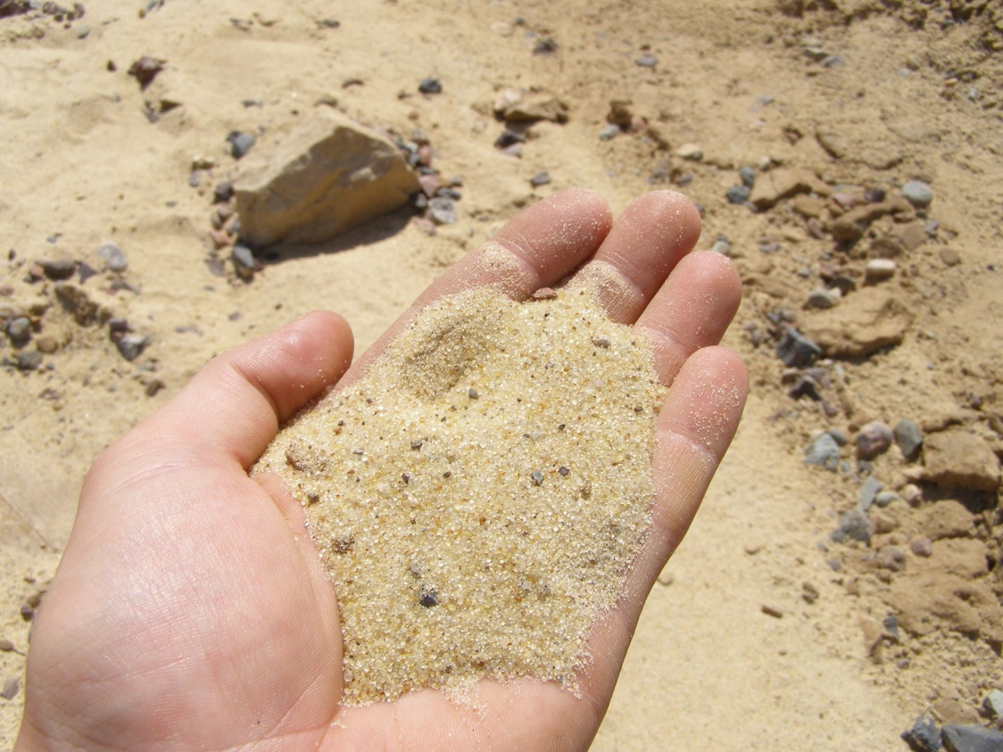
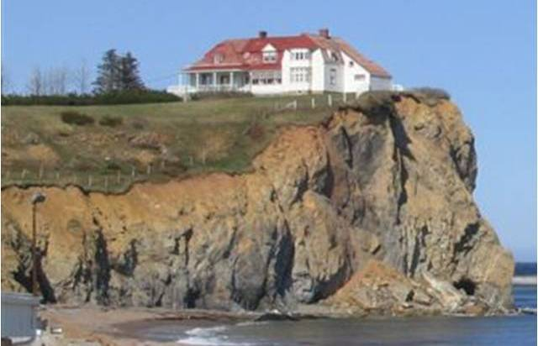
vs

Slide 8
林前 1 Cor 3:10
我照神所给我的恩，好象一个聪明的工头，立好了根基，有别人在上面建造；只是各人要谨慎怎样在上面建造。 ¹¹ 因为那已经立好的根基就是耶稣基督，此外没有人能立别的根基。
According to the grace of God given to me, like a skilled master builder I laid a foundation, and someone else is building upon it. Let each one take care how he builds upon it. ¹¹ For no one can lay a foundation other than that which is laid, which is Jesus Christ.

Slide 9
歌罗西书 Col2:6-7
你们既然接受了主基督耶稣，就当遵他而行， ⁷ 在他里面生根建造，信心坚固，正如你们所领的教训，感谢的心也更增长了。
Therefore, as you received Christ Jesus the Lord, so walk in him, ⁷ rooted and built up in him and established in the faith, just as you were taught, abounding in thanksgiving.

