Slide 1
2019.05.19

Slide 2
The Gospel of Matthew Series 马太福音系列

Slide 3
马太福音 Matthew 7:24-27

Slide 4
Respond to God in Faith 以信心回应神

Slide 5
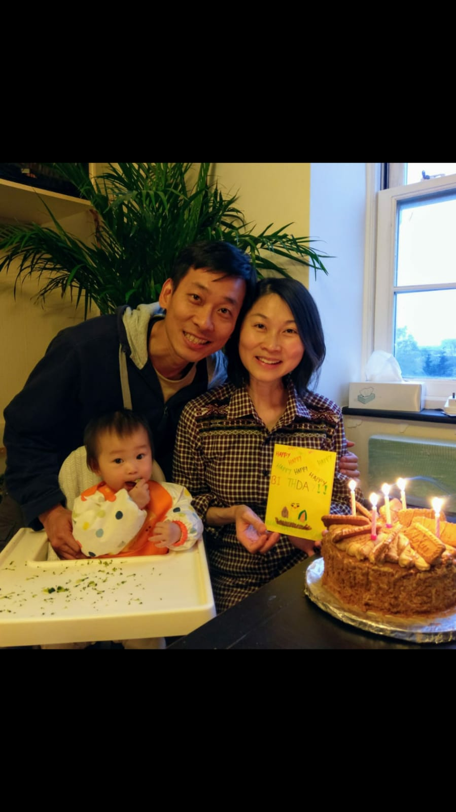

Slide 6
马太福音 Matthew 7:24-27
²⁴ 所以，凡听见我这话就去行的，好比一个聪明人，把房子盖在磐石上； ²⁵ 雨淋，水沖，风吹，撞着那房子，房子总不倒塌，因为根基立在磐石上。
²⁴ Everyone then who hears these words of mine and does them will be like a wise man who built his house on the rock. ²⁵ And the rain fell, and the floods came, and the winds blew and beat on that house, but it did not fall, because it had been founded on the rock.

Slide 7
马太福音 Matthew 7:24-27
²⁶ 凡听见我这话不去行的，好比一个无知的人，把房子盖在沙土上； ²⁷ 雨淋，水沖，风吹，撞着那房子，房子就倒塌了，并且倒塌得很大。
²⁶ And everyone who hears these words of mine and does not do them will be like a foolish man who built his house on the sand. ²⁷ And the rain fell, and the floods came, and the winds blew and beat against that house, and it fell, and great was the fall of it.”

Slide 8
马太福音 Matthew 7:24-27
²⁴ 所以，凡听见我这话就去行的，好比一个聪明人，把房子盖在磐石上； ²⁵ 雨淋，水沖，风吹，撞着那房子，房子总不倒塌，因为根基立在磐石上。
²⁴ Everyone then who hears these words of mine and does them will be like a wise man who built his house on the rock. ²⁵ And the rain fell, and the floods came, and the winds blew and beat on that house, but it did not fall, because it had been founded on the rock.

Slide 9
马太福音 Mathew 7:21
“不是每一个对我说：‘主啊，主啊！’的人，都能进入天国，唯有遵行我天父旨意的人，才能进去。
"Not every one who says to me, `Lord, Lord,' shall enter the kingdom of heaven, but he who does the will of my Father who is in heaven.

Slide 10
马太福音 Mathew 7:22-23
到那日，必有许多人对我说：‘主啊，主啊！难道我们没有奉你的名讲道，奉你的名赶鬼，奉你的名行过许多神迹吗？ ²³ 但我必向他们声明：‘我从来不认识你们；你们这些作恶的人，离开我去吧！’
On that day many will say to me, ‘Lord, Lord, did we not prophesy in your name, and cast out demons in your name, and do many mighty works in your name?’ ²³ And then will I declare to them, ‘I never knew you; depart from me, you workers of lawlessness.

Slide 11
雅各书 James 2:23
“亚伯拉罕信神，这就算为他的义。” 他也被称为神的朋友。
“Abraham believed God, and it was counted to him as righteousness”—and he was called a friend of God.

Slide 12
创世纪 Genesis 12:1-4
雅伟对亚伯兰说：“你要离开本地、本族、父家，到我指示你的地方去。² 我必使你成为大国，赐福给你，使你的名为大，你也必使别人得福。。。⁴ 亚伯兰就照着雅伟吩咐他的去了
Now Yahweh said to Abram, “Go from your country and your kindred and your father‘s house to the land that I will show you. 2 And I will make of you a great nation, and I will bless you and make your name great, so that you will be a blessing… 4 So Abram went, as Yahweh had told him,

Slide 13
马太福音 Matthew 7:24-27
²⁴ 所以，凡听见我这话就去行的，好比一个聪明人，把房子盖在磐石上； ²⁵ 雨淋，水沖，风吹，撞着那房子，房子总不倒塌，因为根基立在磐石上。
²⁴ Everyone then who hears these words of mine and does them will be like a wise man who built his house on the rock. ²⁵ And the rain fell, and the floods came, and the winds blew and beat on that house, but it did not fall, because it had been founded on the rock.

Slide 14
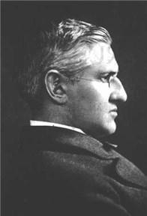
史巴福先生, 诗歌“我心得安宁”的作者
Mr Horatio G. Spafford.
Author of the hymn “It is well with my soul”

Slide 15
It Is Well with My Soul 我心灵得安宁
When peace, like a river, attendeth my way
When sorrows like sea billows roll
Whatever my lot, Thou hast taught me to say
It is well, it is well with my soul
有时享平安，如江河又平稳
有时忧伤来似浪滚
不论何环境，主已教导我说
我心灵得安宁，得安宁。

Slide 16
It Is Well with My Soul 我心灵得安宁
Though Satan should buffet, though trials should come
Let this blest assurance control
That Christ hath regarded my helpless estate
And hath shed His own blood for my soul.
撒但虽来侵 众试炼虽来临
但有福确据在我心
基督已顾念，我乏助之困境
甘流血救赎我，赐安宁

Slide 17
It Is Well with My Soul 我心灵得安宁
Chorus:
It is well (it is well)
with my soul (with my soul)
It is well, it is well with my soul
副歌
我心灵 (我心灵)得安宁 (得安宁)
我心灵，得安宁，得安宁

Slide 18
It Is Well with My Soul 我心灵得安宁
My sin, oh, the bliss of this glorious thought My sin, not in part but the whole is nailed to the cross, and I bear it no more
praise the Lord, praise the Lord, O my soul
回看我众罪 全钉在十架上
每念此衷心极欢畅
主担我重担 何奇妙大恩情
赞美主！我心灵 得安宁。

Slide 19
It Is Well with My Soul 我心灵得安宁
And, Lord, haste the day when my faith shall be sight
the clouds be rolled back as a scroll
the trump shall resound, and the Lord shall descend
even so, it is well with my soul
求主快再来 使我亲眼看见
云彩将卷起在主前
号筒声吹响 主再临掌权柄
愿主来！我心灵 必安宁。

Slide 20
It Is Well with My Soul 我心灵得安宁
Chorus:
It is well (it is well)
with my soul (with my soul)
It is well, it is well with my soul
副歌
我心灵 (我心灵)得安宁 (得安宁)
我心灵，得安宁，得安宁

